Slide 1
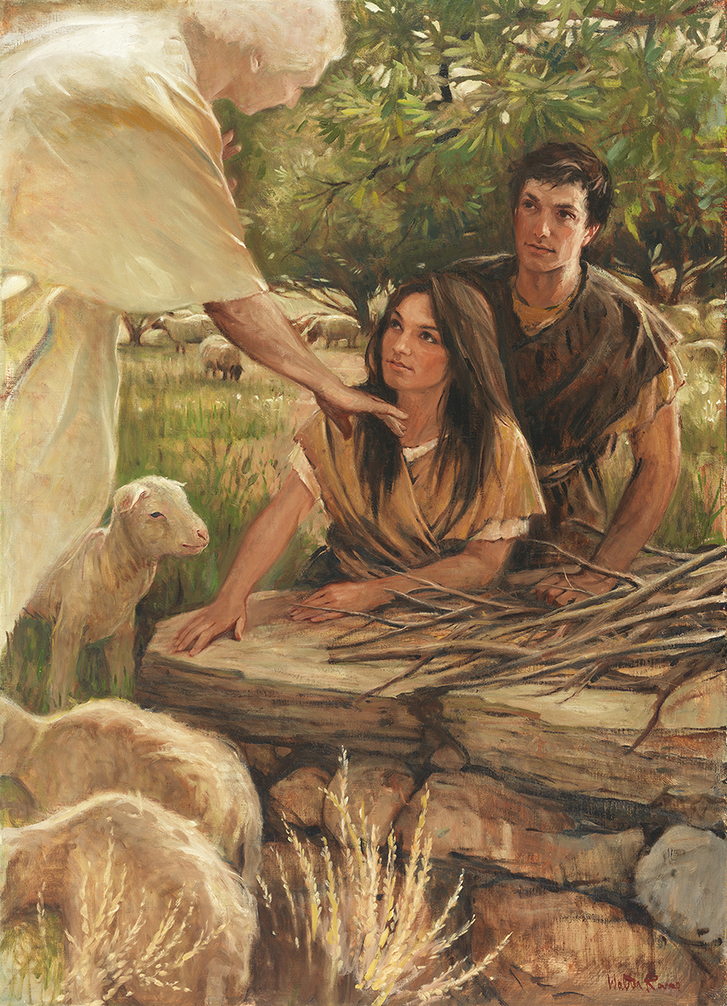
SEMINARY
Old Testament

Slide 2
LESSON 72
Deuteronomy 14–26

Slide 3
LESSON 72
Deuteronomy 14–15
“The Lord commands His people to be holy, to care for the poor, and to remember His blessings”

Slide 4
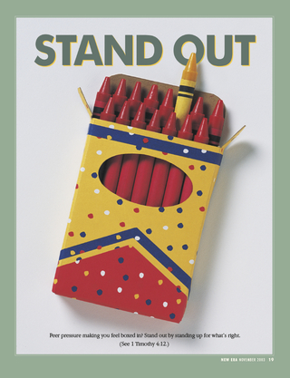
LESSON 72
Why do you think it might be a good thing to stand out because of your beliefs?
Deuteronomy 14:1-2
1 Ye are the children of the Lord your God: ye shall not cut yourselves, nor make any baldness between your eyes for the dead.
2 For thou art an holy people unto the Lord thy God, and the Lord hath chosen thee to be a peculiar people unto himself, above all the nations that are upon the earth.
What words or phrases describe the Lord’s people?
What words or phrases describe the Lord’s people?
What kind of attitude would the Israelites need to develop in order to live this commandment?

Slide 5
What can we learn from verse 9 about refusing to help the poor?
What can we learn from verse 9 about refusing to help the poor?
LESSON 72
Deuteronomy 15:7-9
7 ¶ If there be among you a poor man of one of thy brethren within any of thy gates in thy land which the Lord thy God giveth thee, thou shalt not harden thine heart, nor shut thine hand from thy poor brother:
8 But thou shalt open thine hand wide unto him, and shalt surely lend him sufficient for his need, in that which he wanteth.
9 Beware that there be not a thought in thy wicked heart, saying, The seventh year, the year of release, is at hand; and thine eye be evil against thy poor brother, and thou givest him nought; and he cry unto the Lord against thee, and it be sin unto thee.
What was Moses’s warning in this situation?
We sin by refusing to help others in need when we are able to give.
Why is it a sin to refuse to help those in need?
What can a person do if he or she does not have the resources or ability to help those in need?

Slide 6
LESSON 72
Deuteronomy 15:10–11
10 Thou shalt surely give him, and thine heart shall not be grieved when thou givest unto him: because that for this thing the Lord thy God shall bless thee in all thy works, and in all that thou puttest thine hand unto.
11 For the poor shall never cease out of the land: therefore I command thee, saying, Thou shalt open thine hand wide unto thy brother, to thy poor, and to thy needy, in thy land.
What will we experience if we willingly help those in need?
If we willingly help those in need, then we will be blessed in all our works.
What other needs might a person have besides the need for financial assistance?
What kinds of opportunities has the Lord given us to help provide for those in need?

Slide 7
LESSON 72
Deuteronomy 16–19
“The Lord instructs His people regarding His commandments and explains the consequences for disobedience”

Slide 8
LESSON 72
Deuteronomy 20
“The Lord declares punishments
on the wicked”

Slide 9
LESSON 72
What are some ways in which infectious diseases can be spread?
What are some ways to keep infectious diseases from spreading?
How can sin be compared to disease?
Deuteronomy 20:16-18
16 But of the cities of these people, which the Lord thy God doth give thee for an inheritance, thou shalt save alive nothing that breatheth:
17 But thou shalt utterly destroy them; namely, the Hittites, and the Amorites, the Canaanites, and the Perizzites, the Hivites, and the Jebusites; as the Lord thy God hath commanded thee:
18 That they teach you not to do after all their abominations, which they have done unto their gods; so should ye sin against the Lord your God.
What were the armies to do with those nations who inhabited the heart of the promised land?
What word in verse 18 describes behavior that could be seen as a spiritual disease that could have spread among the Israelites?
What do we learn from verse 18 about why the wicked are sometimes destroyed?
God may destroy the wicked to prevent their sins from spreading to others.

Slide 10
LESSON 72
1 Nephi 17:33–35
33 And now, do ye suppose that the children of this land, who were in the land of promise, who were driven out by our fathers, do ye suppose that they were righteous? Behold, I say unto you, Nay.
34 Do ye suppose that our fathers would have been more choice than they if they had been righteous? I say unto you, Nay.
35 Behold, the Lord esteemeth all flesh in one; he that is righteous is favored of God. But behold, this people had rejected every word of God, and they were ripe in iniquity; and the fulness of the wrath of God was upon them; and the Lord did curse the land against them, and bless it unto our fathers; yea, he did curse it against them unto their destruction, and he did bless it unto our fathers unto their obtaining power over it.
What phrases describe the condition of the people who lived in the promised land?
What do you think it means that they were “ripe in iniquity” (verse 35)?
What does the phrase “this people had rejected every word of God” (verse 35) suggest?
How did the Lord’s instructions to the Israelites to utterly destroy the wicked nations inhabiting the heart of the promised land show His love and concern for the Israelites?

Slide 11
LESSON 72
Deuteronomy 21–26
“Moses again declares the Lord’s
laws to Israel”

Slide 12
LESSON 72
Deuteronomy 26:16–19.
16 ¶ This day the Lord thy God hath commanded thee to do these statutes and judgments: thou shalt therefore keep and do them with all thine heart, and with all thy soul.
17 Thou hast avouched the Lord this day to be thy God, and to walk in his ways, and to keep his statutes, and his commandments, and his judgments, and to hearken unto his voice:
18 And the Lord hath avouched thee this day to be his peculiar people, as he hath promised thee, and that thou shouldest keep all his commandments;
19 And to make thee high above all nations which he hath made, in praise, and in name, and in honour; and that thou mayest be an holy people unto the Lord thy God, as he hath spoken.
What phrases in Deuteronomy 26:16 describe how Israel was to keep God’s commandments?
What blessings did the Lord declare Israel would receive if they obeyed in this way?
What can we learn about obedience from this passage?

Slide 13
LESSON 72
We can be the Lord’s peculiar and holy people if we obey His commandments with all our heart and soul.
What does it mean to obey the Lord’s commandments with all your heart and soul?
Which commandment could you say you have tried to keep with all your heart and soul? How has the Lord blessed you for your efforts?

Slide 14

LESSON 72

