Slide 1
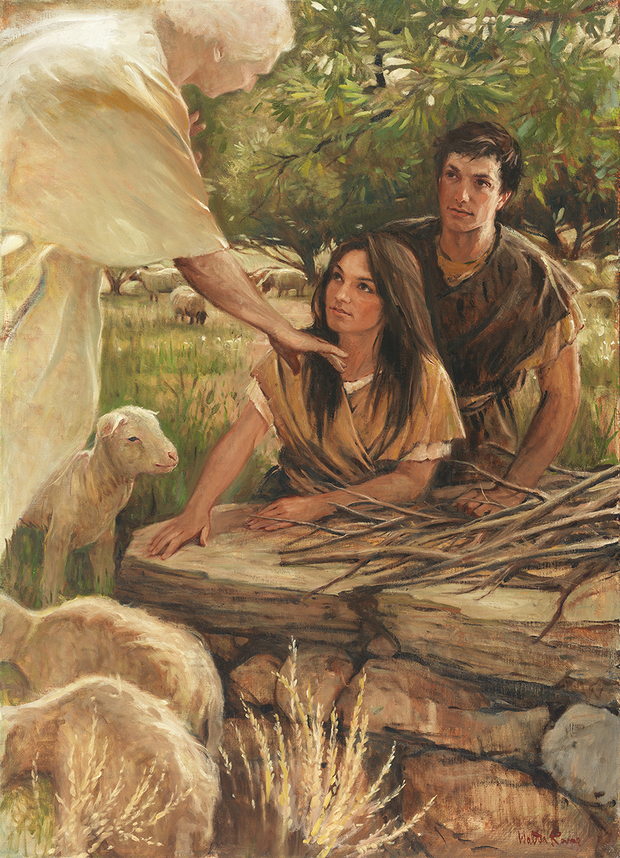
SEMINARY
Old Testament

Slide 2
LESSON 71
Deuteronomy 1–13

Slide 3
LESSON 71
Deuteronomy 1–6
“Moses teaches Israel about the importance of remembering and obeying the Lord”

Slide 4
LESSON 71
The Lord miraculously delivers the Israelites from Egypt (see Deuteronomy 4:34; 6:21–23; 7:17–19).
Israel hears the Lord declare the Ten Commandments from Mount Horeb (Sinai) (see Deuteronomy 4:10–13, 33; 5:4–22).
Israel is fed manna in the wilderness (see Deuteronomy 8:3, 16).
Israel rebels against the Lord by making and worshipping a golden calf (Deuteronomy 9:11–12, 16, 21).

Slide 5
LESSON 71
Deuteronomy 6:12-15
12 Then beware lest thou forget the Lord, which brought thee forth out of the land of Egypt, from the house of bondage.
13 Thou shalt fear the Lord thy God, and serve him, and shalt swear by his name.
14 Ye shall not go after other gods, of the gods of the people which are round about you;
15 (For the Lord thy God is a jealous God among you) lest the anger of the Lord thy God be kindled against thee, and destroy thee from off the face of the earth.
Deuteronomy 8:2-3
2 And thou shalt remember all the way which the Lord thy God led thee these forty years in the wilderness, to humble thee, and to prove thee, to know what was in thine heart, whether thou wouldest keep his commandments, or no.
3 And he humbled thee, and suffered thee to hunger, and fed thee with manna, which thou knewest not, neither did thy fathers know; that he might make thee know that man doth not live by bread only, but by every word that proceedeth out of the mouth of the Lord doth man live.

Slide 6
LESSON 71
What reasons did you find for why Moses repeatedly mentioned the Israelites’ experiences in the wilderness?
Deuteronomy 4:9
Only take heed to thyself, and keep thy soul diligently, lest thou forget the things which thine eyes have seen, and lest they depart from thy heart all the days of thy life: but teach them thy sons, and thy sons’ sons;
What do you think it means to “take heed to thyself, and keep thy soul diligently, lest thou forget the things which thine eyes have seen” (Deuteronomy 4:9)?
What principle can we learn from Moses’s instruction to the Israelites?
If we are not diligent, then we may forget times when we have seen the Lord’s influence in our lives.

Slide 7
LESSON 71
When have you seen the Lord’s influence in your life or in the life of someone you know?
How can always remembering this experience help you remain faithful to the Lord?
Deuteronomy 6:3-5
3 ¶ Hear therefore, O Israel, and observe to do it; that it may be well with thee, and that ye may increase mightily, as the Lord God of thy fathers hath promised thee, in the land that floweth with milk and honey.
4 Hear, O Israel: The Lord our God is one Lord:
5 And thou shalt love the Lord thy God with all thine heart, and with all thy soul, and with all thy might.
What commandment did Moses declare to the Israelites?
What would be the result if the Israelites obeyed this commandment?

Slide 8
LESSON 71
Deuteronomy 6:6-9
6 And these words, which I command thee this day, shall be in thine heart:
7 And thou shalt teach them diligently unto thy children, and shalt talk of them when thou sittest in thine house, and when thou walkest by the way, and when thou liest down, and when thou risest up.
8 And thou shalt bind them for a sign upon thine hand, and they shall be as frontlets between thine eyes.
9 And thou shalt write them upon the posts of thy house, and on thy gates.
What did Moses say the Israelites should do with God’s commandments?
What does it mean to have the Lord’s commandments in our hearts?
What can we do to remind ourselves of the Lord’s commandments and to have them in our hearts?

Slide 9
LESSON 71
Deuteronomy 7–13
“Moses instructs Israel to remove the Canaanites and their items of worship from the land and to keep the Lord’s commandments”

Slide 10

LESSON 71
What makes a snare an effective way to catch animals?
In what ways is the bait in a snare like temptations we experience?

Slide 11
LESSON 71
Deuteronomy 7:1-6, 16, 25-26.
1 When the Lord thy God shall bring thee into the land whither thou goest to possess it, and hath cast out many nations before thee, the Hittites, and the Girgashites, and the Amorites, and the Canaanites, and the Perizzites, and the Hivites, and the Jebusites, seven nations greater and mightier than thou;
2 And when the Lord thy God shall deliver them before thee; thou shalt smite them, and utterly destroy them; thou shalt make no covenant with them, nor shew mercy unto them:
3 Neither shalt thou make marriages with them; thy daughter thou shalt not give unto his son, nor his daughter shalt thou take unto thy son.
4 For they will turn away thy son from following me, that they may serve other gods: so will the anger of the Lord be kindled against you, and destroy thee suddenly.
5 But thus shall ye deal with them; ye shall destroy their altars, and break down their images, and cut down their groves, and burn their graven images with fire.
6 For thou art an holy people unto the Lord thy God: the Lord thy God hath chosen thee to be a special people unto himself, above all people that are upon the face of the earth.
16 And thou shalt consume all the people which the Lord thy God shall deliver thee; thine eye shall have no pity upon them: neither shalt thou serve their gods; for that will be a snare unto thee.
25 The graven images of their gods shall ye burn with fire: thou shalt not desire the silver or gold that is on them, nor take it unto thee, lest thou be snared therein: for it is an abomination to the Lord thy God.
26 Neither shalt thou bring an abomination into thine house, lest thou be a cursed thing like it: but thou shalt utterly detest it, and thou shalt utterly abhor it; for it is a cursed thing.

Slide 12
LESSON 71
What did the Lord command the Israelites to do with the people in the land of Canaan and the items associated with their worship of false gods?
What did the Lord say would happen if the Israelites disobeyed this command?
What must we do with influences that could lead us to sin?
To be the Lord’s people, we must remove evil from our lives and avoid influences that can lead us to sin.

Slide 13
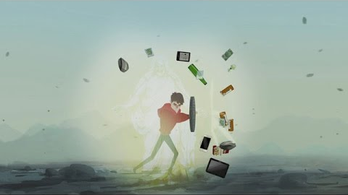
LESSON 71

