Slide 1
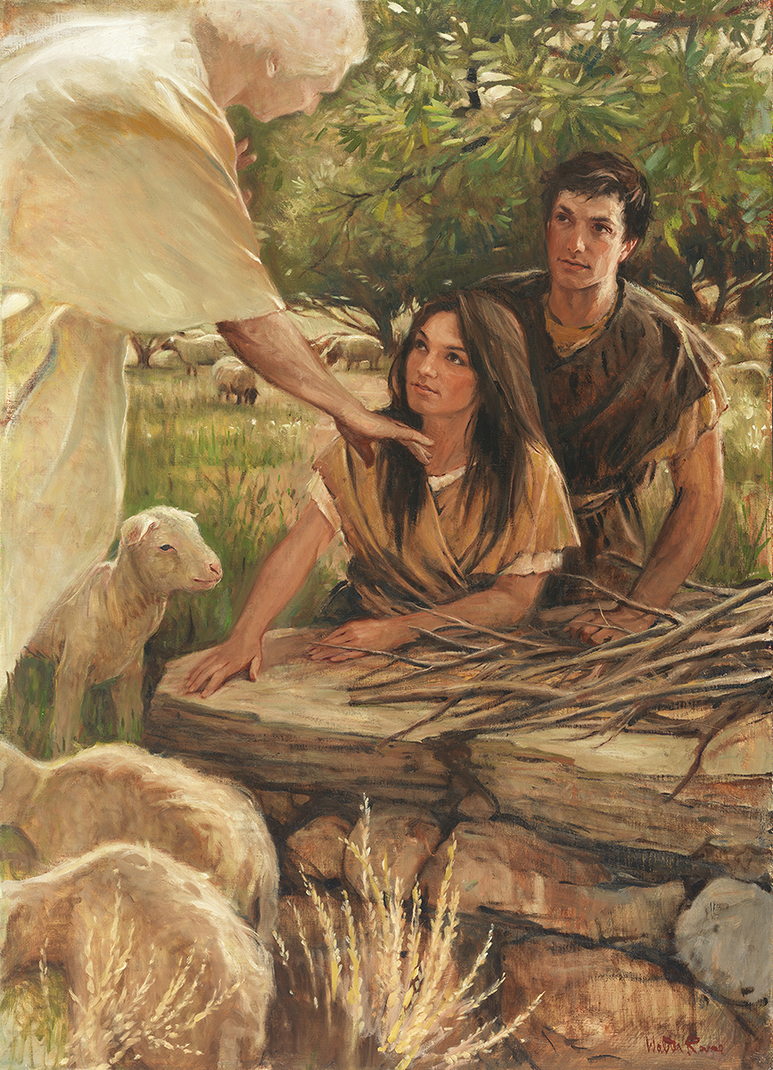
SEMINARY
Old Testament

Slide 2
LESSON 70
The Restoration
(Part 4)

Slide 3
LESSON 70
Practice Exercise (20 minutes)

Slide 4
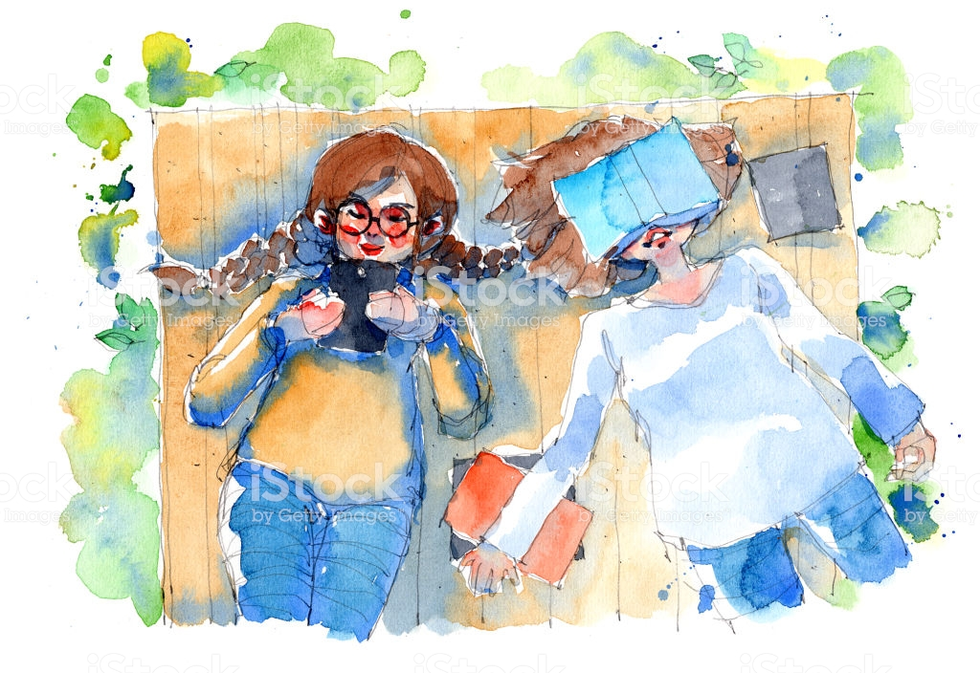
LESSON 70
Megan is a member of The Church of Jesus Christ of Latter-day Saints. Rachel, a Christian of another faith, and Megan have been friends for a long time. They talk about a variety of topics, including religion. One day while they are riding on the bus, Rachel says to Megan, “Help me understand something. Like you, I believe the Bible to be the word of God. Why would we need the Book of Mormon if we already have the Bible?”

Slide 5
LESSON 70
Ezekiel 37:15–17
15 ¶ The word of the Lord came again unto me, saying,
16 Moreover, thou son of man, take thee one stick, and write upon it, For Judah, and for the children of Israel his companions: then take another stick, and write upon it, For Joseph, the stick of Ephraim, and for all the house of Israel his companions:
17 And join them one to another into one stick; and they shall become one in thine hand.
Act in Faith:
How could having a testimony of the Book of Mormon help Megan to act in faith as she responds to Rachel’s concern?
What views or assumptions might have led Rachel to ask this question?
What gospel teachings might Megan use that could relate to Rachel’s question?
What doctrinal mastery passage in the Bible could Megan use to help answer Rachel’s question?
How does Ezekiel 37:15-17 help answer this question?
What are some other divinely appointed sources Megan could use to help answer Rachel’s question?

Slide 6

LESSON 70
Why Is the Book of Mormon Essential?
“Why is the Book of Mormon so essential if we already have the Bible to teach us about Jesus Christ? Have you ever wondered why there are so many Christian churches in the world today when they obtain their doctrines from essentially the same Bible? It is because they interpret the Bible differently. If they interpreted it the same, they would be the same church. This is not a condition the Lord desires, for the Apostle Paul declared that there is ‘one Lord, one faith, one baptism’ (Ephesians 4:5). To help bring this oneness about, the Lord established a divine law of witnesses. Paul taught, ‘In the mouth of two or three witnesses shall every word be established’ (2 Corinthians 13:1).
Elder Tad R. Callister
of the Presidency of
the Seventy
“The Bible is one witness of Jesus Christ; the Book of Mormon is another. Why is this second witness so crucial? The following illustration may help: How many straight lines can you draw through a single point on a piece of paper?” (Tad R. Callister, “The Book of Mormon—A Book from God,” Ensign or Liahona, Nov. 2011, 75).

Slide 7
LESSON 70
“How many straight lines can you draw through a single point on a piece of paper? The answer is infinite. For a moment, suppose that single point represents the Bible and that hundreds of those straight lines drawn through that point represent different interpretations of the Bible and that each of those interpretations represents a different church.
The Bible

Slide 8
LESSON 70
“What happens, however, if on that piece of paper there is a second point representing the Book of Mormon? How many straight lines could you draw between these two reference points: the Bible and the Book of Mormon?” (Tad R. Callister, “The Book of Mormon—A Book from God,” 75).
The Book of Mormon
The Bible
“How many straight lines could you draw between these two reference points: the Bible and the Book of Mormon? Only one. Only one interpretation of Christ’s doctrines survives the testimony of these two witnesses.
“Again and again the Book of Mormon acts as a confirming, clarifying, unifying witness of the doctrines taught in the Bible so that there is only ‘one Lord, one faith, one baptism’ [Ephesians 4:5]” (Tad R. Callister, “The Book of Mormon—A Book from God,” 75).

Slide 9
LESSON 70
Doctrinal Mastery Cumulative Review
(20 minutes)

Slide 10
LESSON 70
Proverbs 3:5–6
Isaiah 5:20
Isaiah 1:18;
Isaiah 53:3–5
Moses 7:18
Abraham 3:22–23
Joshua 24:15
Isaiah 29:13–14
Genesis 1:26-27
Moses 1:39
Daniel 2:44
Ezekiel 37:15–17

Slide 11
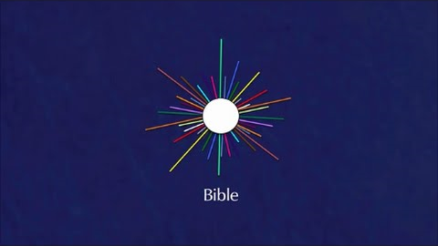
LESSON 70

