Slide 1
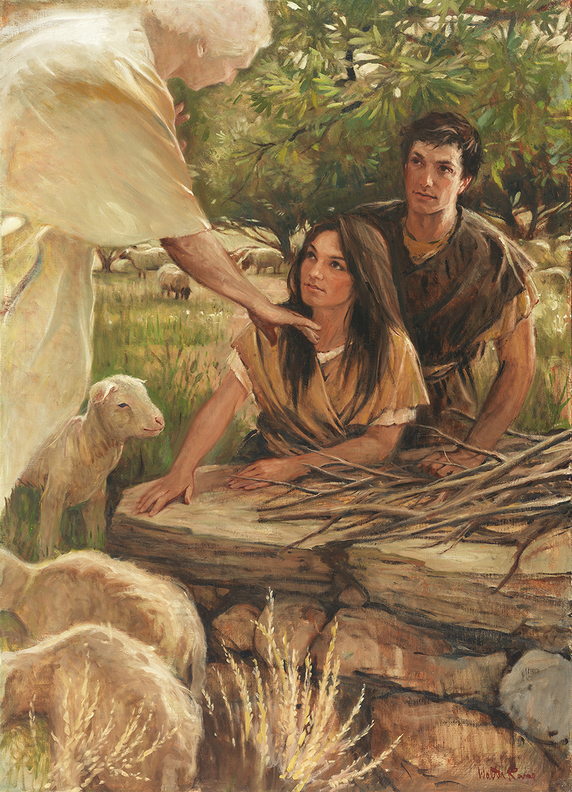
SEMINARY
Old Testament

Slide 2
LESSON 69
Numbers 22–36

Slide 3
LESSON 69
Numbers 22–24
“Balak offers riches and honor to Balaam if he will curse the Israelites, but Balaam blesses Israel”

Slide 4
LESSON 69
What tactics does Satan use to entice us to get off the path that leads back to God?
What are some practices that would help us stay on the path back to God?
Numbers 22:1–6.
1 And the children of Israel set forward, and pitched in the plains of Moab on this side Jordan by Jericho.
2 ¶ And Balak the son of Zippor saw all that Israel had done to the Amorites.
3 And Moab was sore afraid of the people, because they were many: and Moab was distressed because of the children of Israel.
4 And Moab said unto the elders of Midian, Now shall this company lick up all that are round about us, as the ox licketh up the grass of the field. And Balak the son of Zippor was king of the Moabites at that time.
5 He sent messengers therefore unto Balaam the son of Beor to Pethor, which is by the river of the land of the children of his people, to call him, saying, Behold, there is a people come out from Egypt: behold, they cover the face of the earth, and they abide over against me:
6 Come now therefore, I pray thee, curse me this people; for they are too mighty for me: peradventure I shall prevail, that we may smite them, and that I may drive them out of the land: for I wot that he whom thou blessest is blessed, and he whom thou cursest is cursed.

Slide 5
LESSON 69
How did Balak feel about the Israelites? Why did he feel this way?
What did Balak request of Balaam?
Numbers 22:15-17
15 ¶ And Balak sent yet again princes, more, and more honourable than they.
16 And they came to Balaam, and said to him, Thus saith Balak the son of Zippor, Let nothing, I pray thee, hinder thee from coming unto me:
17 For I will promote thee unto very great honour, and I will do whatsoever thou sayest unto me: come therefore, I pray thee, curse me this people.
Whom did King Balak send to deliver his message to Balaam?
What did King Balak offer Balaam?
What can we learn from Balak’s methods about how the adversary entices us to sin?
The adversary sometimes uses promises of riches, popularity, and worldly status to entice us to commit sin.

Slide 6
LESSON 69
Numbers 22:18-21
18 And Balaam answered and said unto the servants of Balak, If Balak would give me his house full of silver and gold, I cannot go beyond the word of the Lord my God, to do less or more.
19 Now therefore, I pray you, tarry ye also here this night, that I may know what the Lord will say unto me more.
20 And God came unto Balaam at night, and said unto him, If the men come to call thee, rise up, and go with them; but yet the word which I shall say unto thee, that shalt thou do.
21 And Balaam rose up in the morning, and saddled his ass, and went with the princes of Moab.
How did Balaam respond?
Why do you think Balaam sought the Lord’s counsel a second time after having already received instruction to not go with Balak’s men?

Slide 7
LESSON 69
Numbers 22:22
¶ And God’s anger was kindled because he went: and the angel of the Lord stood in the way for an adversary against him. Now he was riding upon his ass, and his two servants were with him.
Why do you think God was angry when Balaam went with the princes of Moab?

Slide 8
LESSON 69
Numbers 22:23–34
23 And the ass saw the angel of the Lord standing in the way, and his sword drawn in his hand: and the ass turned aside out of the way, and went into the field: and Balaam smote the ass, to turn her into the way.
24 But the angel of the Lord stood in a path of the vineyards, a wall being on this side, and a wall on that side.
25 And when the ass saw the angel of the Lord, she thrust herself unto the wall, and crushed Balaam’s foot against the wall: and he smote her again.
26 And the angel of the Lord went further, and stood in a narrow place, where was no way to turn either to the right hand or to the left.
27 And when the ass saw the angel of the Lord, she fell down under Balaam: and Balaam’s anger was kindled, and he smote the ass with a staff.
28 And the Lord opened the mouth of the ass, and she said unto Balaam, What have I done unto thee, that thou hast smitten me these three times?
29 And Balaam said unto the ass, Because thou hast mocked me: I would there were a sword in mine hand, for now would I killthee.
30 And the ass said unto Balaam, Am not I thine ass, upon which thou hast ridden ever since I was thine unto this day? was I ever wont to do so unto thee? And he said, Nay.
31 Then the Lord opened the eyes of Balaam, and he saw the angel of the Lord standing in the way, and his sword drawn in his hand: and he bowed down his head, and fell flat on his face.
32 And the angel of the Lord said unto him, Wherefore hast thou smitten thine ass these three times? behold, I went out to withstand thee, because thy way is perverse before me:
33 And the ass saw me, and turned from me these three times: unless she had turned from me, surely now also I had slain thee, and saved her alive.
34 And Balaam said unto the angel of the Lord, I have sinned; for I knew not that thou stoodest in the way against me: now therefore, if it displease thee, I will get me back again.

Slide 9
LESSON 69
What can we learn from Balaam’s experience?
We should not allow the enticements of the world to influence our devotion to the Lord.
What problems could understanding this truth help you avoid?
What blessings have you or someone you know experienced by not allowing the enticements of the world to influence your devotion to God?

Slide 10
LESSON 69
Numbers 25
“Israelites who commit serious
sins are slain”

Slide 11
LESSON 69
Numbers 25:1-3
1 And Israel abode in Shittim, and the people began to commit whoredom with the daughters of Moab.
2 And they called the people unto the sacrifices of their gods: and the people did eat, and bowed down to their gods.
3 And Israel joined himself unto Baal-peor: and the anger of the Lord was kindled against Israel.
What did some of the Israelites do when they came to Moab?
Revelations 2:14
But I have a few things against thee, because thou hast there them that hold the doctrine of Balaam, who taught Balac to cast a stumbling block before the children of Israel, to eat things sacrificed unto idols, and to commit fornication.
What did Balaam teach Balak to do? Is this how you expected this account to end? Why or why not?
Why is the term stumbling block a good description of sin?

Slide 12
LESSON 69
Numbers 26-36
“The children of Israel are numbered again, and Moses sets Joshua apart to lead Israel and gives instructions before they enter the promised land”

