Slide 1
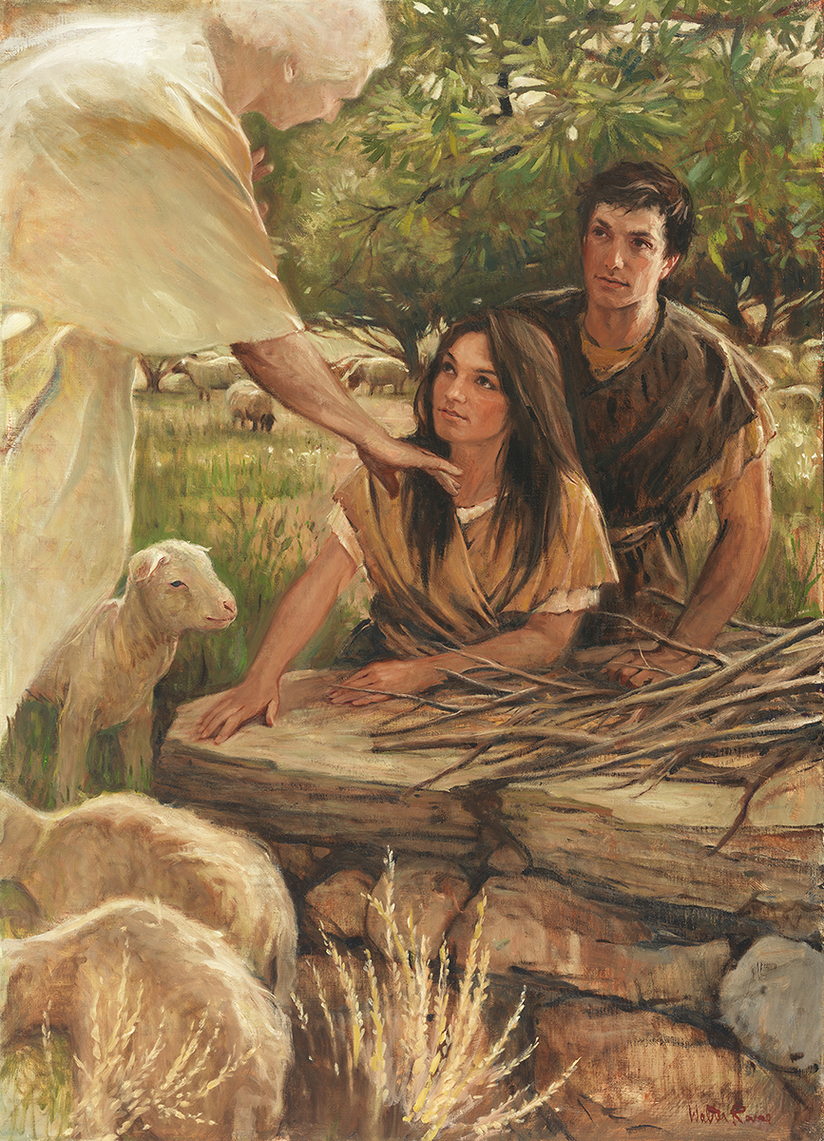
SEMINARY
Old Testament

Slide 2
LESSON 68
Numbers 20–21

Slide 3
LESSON 68
Numbers 20:1–13
“Moses smites a rock and brings forth water to quench Israel’s thirst”

Slide 4
LESSON 68
While preparing a talk for sacrament meeting, you receive impressions about what you should say. After you give the talk, a member of your ward approaches you and says, “Thank you so much for what you said today. You are an amazing speaker, and your words were exactly what I needed to hear. I am so grateful for you.”
A friend who accepted the gospel because of your example says, “You changed my life. Because of you, I am happy and have direction and peace in my life.”
What are some possible ways you could respond to their praise?

Slide 5
LESSON 68
Numbers 20:4-11
4 And why have ye brought up the congregation of the Lord into this wilderness, that we and our cattle should die there?
5 And wherefore have ye made us to come up out of Egypt, to bring us in unto this evil place? it is no place of seed, or of figs, or of vines, or of pomegranates; neither is there any water to drink.
6 And Moses and Aaron went from the presence of the assembly unto the door of the tabernacle of the congregation, and they fell upon their faces: and the glory of the Lord appeared unto them.
7 ¶ And the Lord spake unto Moses, saying,
8 Take the rod, and gather thou the assembly together, thou, and Aaron thy brother, and speak ye unto the rock before their eyes; and it shall give forth his water, and thou shalt bring forth to them water out of the rock: so thou shalt give the congregation and their beasts drink.
9 And Moses took the rod from before the Lord, as he commanded him.
10 And Moses and Aaron gathered the congregation together before the rock, and he said unto them, Hear now, ye rebels; must we fetch you water out of this rock?
11 And Moses lifted up his hand, and with his rod he smote the rock twice: and the water came out abundantly, and the congregation drank, and their beasts also.
In what ways were Moses’s actions different from the Lord’s instructions?
What phrase in verse 10 shows that Moses and Aaron took credit for providing water for the Israelites?

Slide 6
LESSON 68
Numbers 20:12
¶ And the Lord spake unto Moses and Aaron, Because ye believed me not, to sanctify me in the eyes of the children of Israel, therefore ye shall not bring this congregation into the land which I have given them.
What did the Lord say to Moses and Aaron?
What did the Lord say the consequence would be for Moses’s and Aaron’s actions?
Why do you think the Israelites needed to understand that it was God who provided the water?
The Lord desires that we help others see His power and influence in their lives.
Why is it important to direct others’ attention to the Lord’s power instead of to ourselves?

Slide 7
LESSON 68
Numbers 20:14–29
“Israel is not allowed to pass through Edom, and Eleazar is made high priest when Aaron dies”

Slide 8
LESSON 68
Numbers 20:28-29
28 And Moses stripped Aaron of his garments, and put them upon Eleazar his son; and Aaron died there in the top of the mount: and Moses and Eleazar came down from the mount.
29 And when all the congregation saw that Aaron was dead, they mourned for Aaron thirty days, even all the house of Israel.
Who died at this time?
Who became the high priest in Aaron’s place?

Slide 9
LESSON 68
Numbers 21
“Moses raises a brass serpent on a pole to heal those bitten by poisonous serpents”

Slide 10

LESSON 68
What would you do if you were bitten by a poisonous snake?
What are possible cures for poisonous snakebites?

Slide 11
LESSON 68
Numbers 21:4–5
4 ¶ And they journeyed from mount Hor by the way of the Red sea, to compass the land of Edom: and the soul of the people was much discouraged because of the way.
5 And the people spake against God, and against Moses, Wherefore have ye brought us up out of Egypt to die in the wilderness? for there is no bread, neither is there any water; and our soul loatheth this light bread.
How did the children of Israel respond to the difficulty of journeying around the land of Edom?
Numbers 21:6-9
6 And the Lord sent fiery serpents among the people, and they bit the people; and much people of Israel died.
7 ¶ Therefore the people came to Moses, and said, We have sinned, for we have spoken against the Lord, and against thee; pray unto the Lord, that he take away the serpents from us. And Moses prayed for the people.
8 And the Lord said unto Moses, Make thee a fiery serpent, and set it upon a pole: and it shall come to pass, that every one that is bitten, when he looketh upon it, shall live.
9 And Moses made a serpent of brass, and put it upon a pole, and it came to pass, that if a serpent had bitten any man, when he beheld the serpent of brass, he lived.

Slide 12
LESSON 68
Whom did the Israelites first turn to for help?
What did the Lord tell Moses to do to help the people who had been bitten?
What did the people need to do to be healed?
Poisonous serpents = sin and its consequences.
How do you think sin is similar to being bitten by a poisonous snake?
What could the venom of sin do to us if we do not get help?

Slide 13
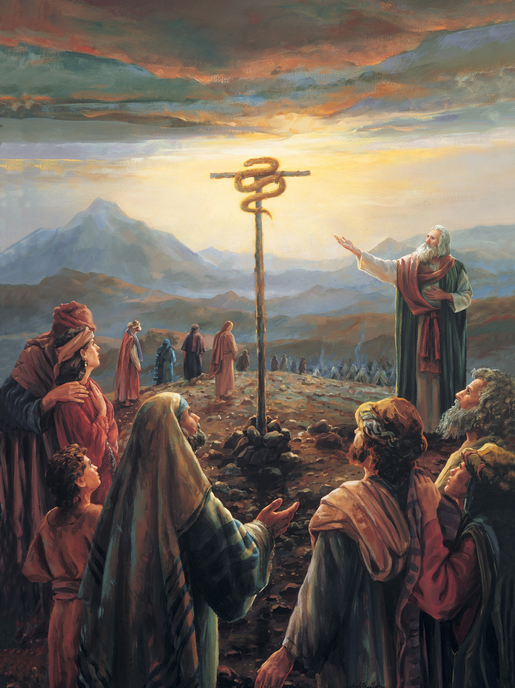
LESSON 68
Whom and what was the serpent on the pole meant to point the people to?
What did the children of Israel need to do to be healed?
What must we do to be healed from the poisonous effects of sin?
If we have faith to look to and believe in Jesus Christ, we can be healed, or forgiven of our sins.

Slide 14
LESSON 68
John 3:14–15
Alma 33:19–22
Helaman 8:14–15.
14 ¶ And as Moses lifted up the serpent in the wilderness, even so must the Son of man be lifted up:
15 That whosoever believeth in him should not perish, but have eternal life.
19 Behold, he was spoken of by Moses; yea, and behold a type was raised up in the wilderness, that whosoever would look upon it might live. And many did look and live.
20 But few understood the meaning of those things, and this because of the hardness of their hearts. But there were many who were so hardened that they would not look, therefore they perished. Now the reason they would not look is because they did not believe that it would heal them.
21 O my brethren, if ye could be healed by merely casting about your eyes that ye might be healed, would ye not behold quickly, or would ye rather harden your hearts in unbelief, and be slothful, that ye would not cast about your eyes, that ye might perish?
22 If so, wo shall come upon you; but if not so, then cast about your eyes and begin to believe in the Son of God, that he will come to redeem his people, and that he shall suffer and die to atone for their sins; and that he shall rise again from the dead, which shall bring to pass the resurrection, that all men shall stand before him, to be judged at the last and judgment day, according to their works.
14 Yea, did he not bear record that the Son of God should come? And as he lifted up the brazen serpent in the wilderness, even so shall he be lifted up who should come.
15 And as many as should look upon that serpent should live, even so as many as should look upon the Son of God with faith, having a contrite spirit, might live, even unto that life which is eternal.

Slide 15
LESSON 68
Why do you think some people refused to look at the brazen serpent? Why do you think others chose to look?
What is required for us to look to the Savior to be healed or forgiven of our sins?
How does the pole with the brazen serpent relate to the principle on the board?
What did Moses do to help the children of Israel to be healed?

Slide 16
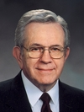
LESSON 68
“Jesus Christ has prescribed a very clear method for us to repent and find healing in our lives. The cure for most mistakes can be found by seeking forgiveness through personal prayer. However, there are certain spiritual illnesses, particularly those dealing with violations of the moral law, which absolutely require the assistance and treatment of a qualified spiritual physician. …
“If you … wish to return to full spiritual health, see your bishop. He holds the keys and can help you along the pathway of repentance” (Boyd K. Packer, “The Key to Spiritual Protection,” Ensign or Liahona, Nov. 2013, 28).
President
Boyd K. Packer
Why is it sometimes necessary to get the help of a bishop or branch president as we look to Christ for healing of our sins?

Slide 17
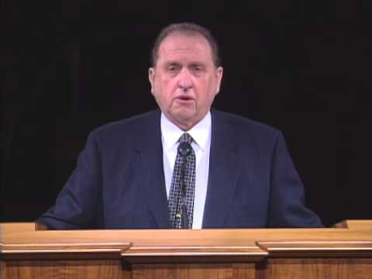
LESSON 68

