Slide 1
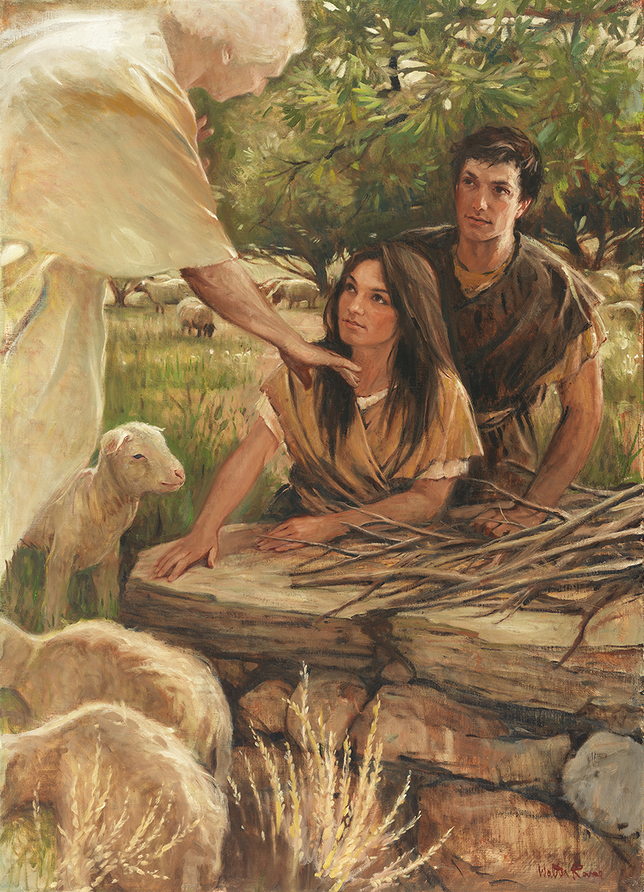
SEMINARY
Old Testament

Slide 2
LESSON 67
Numbers 15–19

Slide 3
LESSON 67
Numbers 15
“The Lord explains the consequences for ignorant sins and willful rebellion”

Slide 4
LESSON 67
A young man who is a recent convert to the Church was raised in a home where profanity was often used. As a result, he uses profanity out of habit without realizing that it is wrong.
Just before a young woman begins her application for missionary service, she decides to spend time with friends who are not making good choices. When they offer her an alcoholic drink, she willfully drinks it, believing she can always repent later so she can still serve a mission.
What do you think are some differences between these two situations?

Slide 5
LESSON 67
Ignorant
Willful
One who defiantly and willfully sins versus one who sins ignorantly or makes a mistake unintentionally and feels guilty about offending God.
Numbers 15:27–29
27 ¶ And if any soul sin through ignorance, then he shall bring a she goat of the first year for a sin offering.
28 And the priest shall make an atonement for the soul that sinneth ignorantly, when he sinneth by ignorance before the Lord, to make an atonement for him; and it shall be forgiven him.
29 Ye shall have one law for him that sinneth through ignorance, both for him that is born among the children of Israel, and for the stranger that sojourneth among them.
How might the priest’s actions be symbolic of what the Savior does for us when we do wrong unintentionally or out of ignorance?
What can we learn about the Atonement of Jesus Christ based on the Lord’s instructions recorded in these verses?
If we repent, we can be forgiven of our sins, including those we commit in ignorance, through the Atonement of Jesus Christ.

Slide 6
LESSON 67
Numbers 15:30-31
30 ¶ But the soul that doeth ought presumptuously, whether he be born in the land, or a stranger, the same reproacheth the Lord; and that soul shall be cut off from among his people.
31 Because he hath despised the word of the Lord, and hath broken his commandment, that soul shall utterly be cut off; his iniquity shall be upon him.
What do you think it means that the person “despised the word of the Lord” (verse 31)?
What did the Lord say would happen to those who willfully broke His commandments?
What may the phrase “his iniquity shall be upon him” in verse 31 mean?
If we willfully break God’s commandments and do not repent, then we must stand accountable before God for those sins.
What do you think it means to be accountable before God?

Slide 7
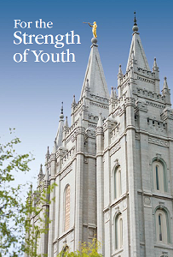
LESSON 67
“Some people knowingly break God’s commandments, planning to repent later, such as before they go to the temple or serve a mission. Such deliberate sin mocks the Savior’s Atonement” (For the Strength of Youth [booklet, 2011], 29).
Why is willfully sinning so serious?

Slide 8
LESSON 67
Numbers 16–17
“The Lord destroys rebellious Israelites and shows Israel whom He has chosen to lead them”

Slide 9
LESSON 67
What are some of the methods Satan uses to entice us to rebel against God?
Numbers 16:1–3
1 Now Korah, the son of Izhar, the son of Kohath, the son of Levi, and Dathan and Abiram, the sons of Eliab, and On, the son of Peleth, sons of Reuben, took men:
2 And they rose up before Moses, with certain of the children of Israel, two hundred and fifty princes of the assembly, famous in the congregation, men of renown:
3 And they gathered themselves together against Moses and against Aaron, and said unto them, Ye take too much upon you, seeing all the congregation are holy, every one of them, and the Lord is among them: wherefore then lift ye up yourselves above the congregation of the Lord?
What does the phrase “famous in the congregation, men of renown” (verse 2) tell you about those who rebelled against Moses?
What did these leaders accuse Moses and Aaron of doing?

Slide 10
LESSON 67
Numbers 16:4-7
4 And when Moses heard it, he fell upon his face:
5 And he spake unto Korah and unto all his company, saying, Even to morrow the Lord will shew who are his, and who is holy; and will cause him to come near unto him: even him whom he hath chosen will he cause to come near unto him.
6 This do; Take you censers, Korah, and all his company;
7 And put fire therein, and put incense in them before the Lord to morrow: and it shall be that the man whom the Lord doth choose, he shall be holy: ye take too much upon you, ye sons of Levi.
What did Moses tell Korah and his followers?

Slide 11
LESSON 67
Numbers 16:8–11
Numbers 16:12–15
8 And Moses said unto Korah, Hear, I pray you, ye sons of Levi:
9 Seemeth it but a small thing unto you, that the God of Israel hath separated you from the congregation of Israel, to bring you near to himself to do the service of the tabernacle of the Lord, and to stand before the congregation to minister unto them?
10 And he hath brought thee near to him, and all thy brethren the sons of Levi with thee: and seek ye the priesthood also?
11 For which cause both thou and all thy company are gathered together against the Lord: and what is Aaron, that ye murmur against him?
12 ¶ And Moses sent to call Dathan and Abiram, the sons of Eliab: which said, We will not come up:
13 Is it a small thing that thou hast brought us up out of a land that floweth with milk and honey, to kill us in the wilderness, except thou make thyself altogether a prince over us?
14 Moreover thou hast not brought us into a land that floweth with milk and honey, or given us inheritance of fields and vineyards: wilt thou put out the eyes of these men? we will not come up.
15 And Moses was very wroth, and said unto the Lord, Respect not thou their offering: I have not taken one ass from them, neither have I hurt one of them.
Numbers 16:20–26
20 And the Lord spake unto Moses and unto Aaron, saying,
21 Separate yourselves from among this congregation, that I may consume them in a moment.
22 And they fell upon their faces, and said, O God, the God of the spirits of all flesh, shall one man sin, and wilt thou be wroth with all the congregation?
23 ¶ And the Lord spake unto Moses, saying,
24 Speak unto the congregation, saying, Get you up from about the tabernacle of Korah, Dathan, and Abiram.
25 And Moses rose up and went unto Dathan and Abiram; and the elders of Israel followed him.
26 And he spake unto the congregation, saying, Depart, I pray you, from the tents of these wicked men, and touch nothing of theirs, lest ye be consumed in all their sins.
Numbers 16:16–19
16 And Moses said unto Korah, Be thou and all thy company before the Lord, thou, and they, and Aaron, to morrow:
17 And take every man his censer, and put incense in them, and bring ye before the Lord every man his censer, two hundred and fifty censers; thou also, and Aaron, each of you his censer.
18 And they took every man his censer, and put fire in them, and laid incense thereon, and stood in the door of the tabernacle of the congregation with Moses and Aaron.
19 And Korah gathered all the congregation against them unto the door of the tabernacle of the congregation: and the glory of the Lord appeared unto all the congregation.

Slide 12
LESSON 67
What did Korah and his people seek?
What does Dathan and Abiram’s response to Moses recorded in verses 12–14 reveal about them?
Why did the Lord tell the people to leave the tents of the wicked and not touch any of their things?

Slide 13
LESSON 67
Numbers 16:27-35
27 So they gat up from the tabernacle of Korah, Dathan, and Abiram, on every side: and Dathan and Abiram came out, and stood in the door of their tents, and their wives, and their sons, and their little children.
28 And Moses said, Hereby ye shall know that the Lord hath sent me to do all these works; for I have not done them of mine own mind.
29 If these men die the common death of all men, or if they be visited after the visitation of all men; then the Lord hath not sent me.
30 But if the Lord make a new thing, and the earth open her mouth, and swallow them up, with all that appertain unto them, and they go down quick into the pit; then ye shall understand that these men have provoked the Lord.
31 ¶ And it came to pass, as he had made an end of speaking all these words, that the ground clave asunder that was under them:
32 And the earth opened her mouth, and swallowed them up, and their houses, and all the men that appertained unto Korah, and all their goods.
33 They, and all that appertained to them, went down alive into the pit, and the earth closed upon them: and they perished from among the congregation.
34 And all Israel that were round about them fled at the cry of them: for they said, Lest the earth swallow us up also.
35 And there came out a fire from the Lord, and consumed the two hundred and fifty men that offered incense.

Slide 14
LESSON 67
What can we learn from this account about separating ourselves from evil influences?
If we separate ourselves from evil influences, then we may avoid the Lord’s judgments that come upon the wicked.
What are some evil influences in our day that we need to separate ourselves from?
How can separating ourselves from evil influences help us to not be enticed to rebel against God?
Numbers 17:5
And it shall come to pass, that the man’s rod, whom I shall choose, shall blossom: and I will make to cease from me the murmurings of the children of Israel, whereby they murmur against you.

Slide 15
LESSON 67
Numbers 18-19
“The Lord establishes the duties of the priests and the Levites and gives directions for sacrifice”

Slide 16
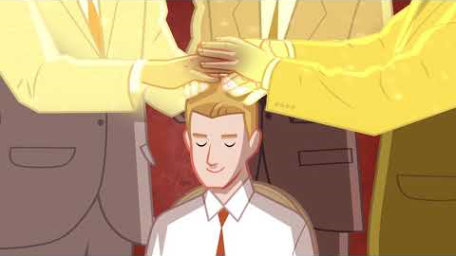
LESSON 67

