Slide 1
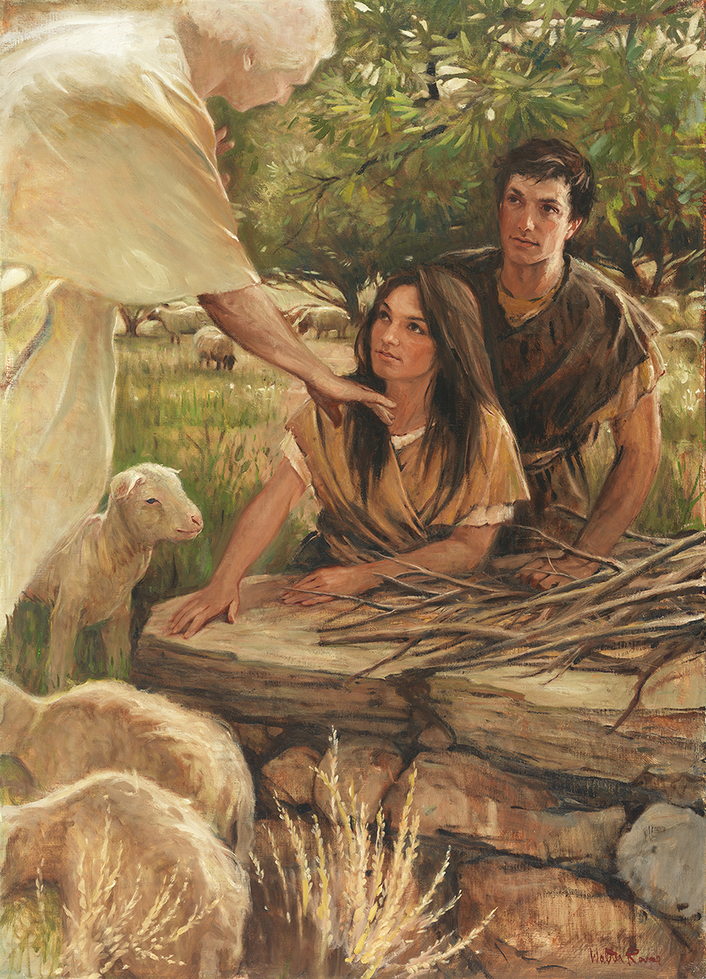
SEMINARY
Old Testament

Slide 2
LESSON 66
Numbers 13-14

Slide 3
LESSON 66
Numbers 13-14
“Moses sends a member of each tribe to investigate the land of Canaan and report their findings”

Slide 4
LESSON 66
Dare to be a Mormon.
Dare to stand alone.
Dare to have a purpose firm.
President Thomas S. Monson (1927–2018). (This rhyme is found in “Dare to Stand Alone,” Ensign or Liahona, Nov. 2011, 61.)
Dare to make it known.

Slide 5
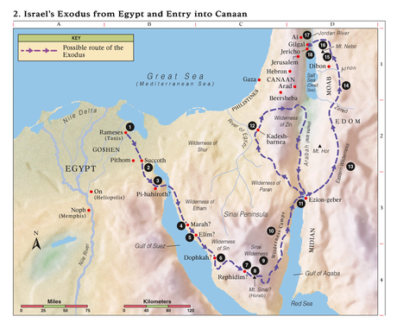
LESSON 66

Slide 6
LESSON 66
Numbers 13:17–20
17 ¶ And Moses sent them to spy out the land of Canaan, and said unto them, Get you up this way southward, and go up into the mountain:
18 And see the land, what it is; and the people that dwelleth therein, whether they be strong or weak, few or many;
19 And what the land is that they dwell in, whether it be good or bad; and what cities they be that they dwell in, whether in tents, or in strong holds;
20 And what the land is, whether it be fat or lean, whether there be wood therein, or not. And be ye of good courage, and bring of the fruit of the land. Now the time was the time of the firstripe grapes.
What did Moses ask the men to find out about the land and the people?

Slide 7
LESSON 66
The 10 spies’ report of the land and the people (Numbers 13:27–29, 31–33)
The Israelites’ response to the 10 spies’ report (Numbers 14:1–4)
Joshua and Caleb’s report of the land and the people (Numbers 13:30; 14:6–9)

Slide 8
LESSON 66
Questions for the 10 spies
How would you describe the land you saw?
How would you describe the people in the land of Canaan?
What feelings did you have when you saw the people? Why?
Questions for the Israelites
What feelings did you have when you listened to the 10 spies’ report? Why?
What did you suggest the people do rather than follow Moses into the promised land? Why?
Questions for Joshua and Caleb
How would you describe the land you saw?
How would you describe the people there?
The other spies are convinced that Israel cannot overcome the people in Canaan. Why are you so sure that Israel can?

Slide 9
LESSON 66
Numbers 14:9
Only rebel not ye against the Lord, neither fear ye the people of the land; for they are bread for us: their defence is departed from them, and the Lord is with us: fear them not.
What phrase did you find?
What principles can we learn from Joshua and Caleb’s words and example?
If we know the Lord is with us, we can overcome fear and more courageously stand for righteousness.

Slide 10
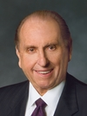
LESSON 66
“We may at times find ourselves surrounded by others and yet standing in the minority or even standing alone concerning what is acceptable and what is not. Do we have the moral courage to stand firm for our beliefs, even if by so doing we must stand alone? …
“… May we ever be courageous and prepared to stand for what we believe, and if we must stand alone in the process, may we do so courageously, strengthened by the knowledge that in reality we are never alone when we stand with our Father in Heaven” (Thomas S. Monson, “Dare to Stand Alone,” Ensign or Liahona, Nov. 2011, 60, 67).
President
Thomas S. Monson
When have you felt that God was with you as you stood for righteousness?
How did it help you to know that God was with you?

Slide 11
LESSON 66
Numbers 14:10
But all the congregation bade stone them with stones. And the glory of the Lord appeared in the tabernacle of the congregation before all the children of Israel.
How did the Israelites respond to Joshua and Caleb?
How would you compare the Israelites’ response to circumstances we might face today when we stand for what is right?

Slide 12
LESSON 66
Numbers 14:21–23, 29–33.
21 But as truly as I live, all the earth shall be filled with the glory of the Lord.
22 Because all those men which have seen my glory, and my miracles, which I did in Egypt and in the wilderness, and have tempted me now these ten times, and have not hearkened to my voice;
23 Surely they shall not see the land which I sware unto their fathers, neither shall any of them that provoked me see it:
29 Your carcases shall fall in this wilderness; and all that were numbered of you, according to your whole number, from twenty years old and upward, which have murmured against me,
30 Doubtless ye shall not come into the land, concerning which I sware to make you dwell therein, save Caleb the son of Jephunneh, and Joshua the son of Nun.
31 But your little ones, which ye said should be a prey, them will I bring in, and they shall know the land which ye have despised.
32 But as for you, your carcases, they shall fall in this wilderness.
33 And your children shall wander in the wilderness forty years, and bear your whoredoms, until your carcases be wasted in the wilderness.
What consequences would the Israelites receive?
Of all the Israelites 20 years or older, who were the only ones who would be blessed to enter the promised land?

Slide 13
LESSON 66
To receive all of the Lord’s blessings, we must
choose to follow Him fully.
Numbers 14:24.
But my servant Caleb, because he had another spirit with him, and hath followed me fully, him will I bring into the land where into he went; and his seed shall possess it.
Why was Caleb able to enter the promised land?
What do you think it means that Caleb “had another spirit with him”?
What do you think it means that Caleb followed the Lord fully?

Slide 14
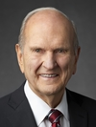
LESSON 66
“[You] will encounter people who pick which commandments they will keep and ignore others that they choose to break. I call this the cafeteria approach to obedience. This practice of picking and choosing will not work. It will lead to misery. To prepare to meet God, one keeps all of His commandments. It takes faith to obey them, and keeping His commandments will strengthen that faith” (Russell M. Nelson, “Face the Future with Faith,” Ensign or Liahona, May 2011, 34).
President
Russell M. Nelson

Slide 15
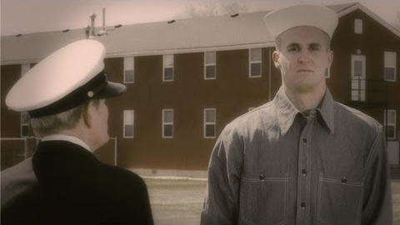
LESSON 66

