Slide 1
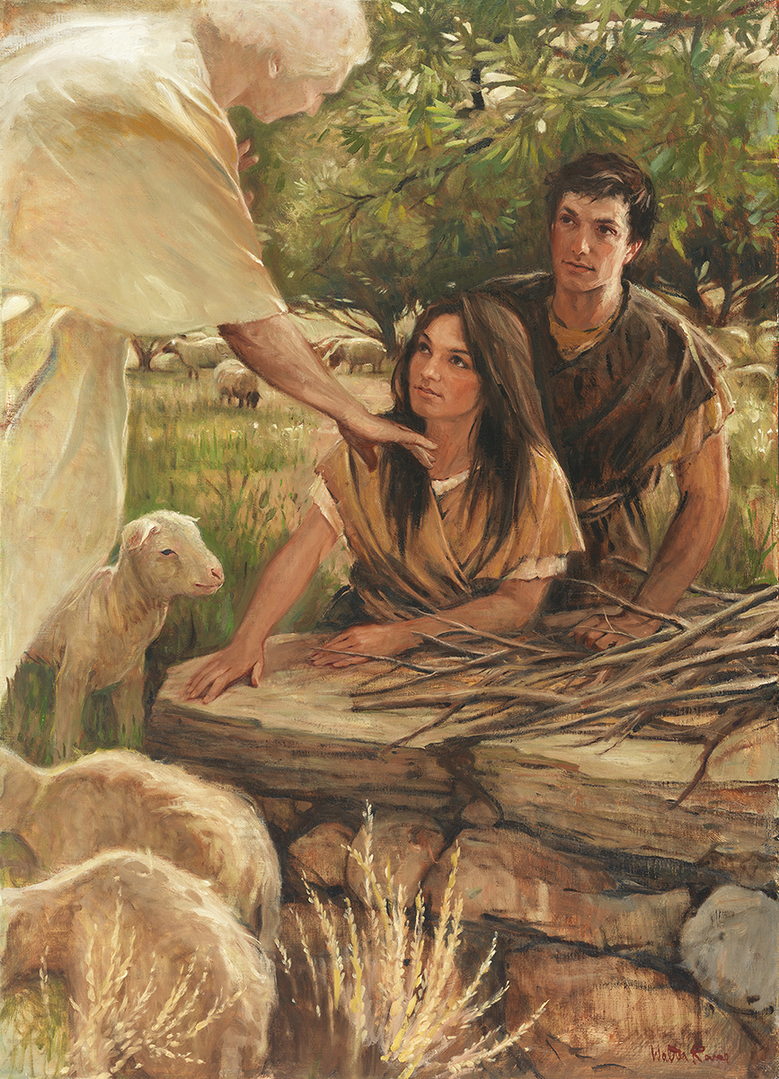
SEMINARY
Old Testament

Slide 2
LESSON 65
Numbers 1–12

Slide 3
LESSON 65
Numbers 1–10
“The Lord organizes the camp of Israel, gives them specific laws, and leads them in the wilderness”

Slide 4
LESSON 65
Camp of Israel
North
Naphtali
Dan
Asher
Manasseh
Zebulun
West
Ephraim
Tabernacle
Judah
East
Benjamin
Issachar
Simeon
Reuben
Gad
South

Slide 5
LESSON 65
What do you notice about the camp of Israel?
Numbers 6:1-8
1 And the Lord spake unto Moses, saying,
2 Speak unto the children of Israel, and say unto them, When either man or woman shall separate themselves to vow a vow of a Nazarite, to separate themselves unto the Lord:
3 He shall separate himself from wine and strong drink, and shall drink no vinegar of wine, or vinegar of strong drink, neither shall he drink any liquor of grapes, nor eat moist grapes, or dried.
4 All the days of his separation shall he eat nothing that is made of the vine tree, from the kernels even to the husk.
5 All the days of the vow of his separation there shall no razor come upon his head: until the days be fulfilled, in the which he separateth himself unto the Lord, he shall be holy, and shall let the locks of the hair of his head grow.
6 All the days that he separateth himself unto the Lord he shall come at no dead body.
7 He shall not make himself unclean for his father, or for his mother, for his brother, or for his sister, when they die: because the consecration of his God is upon his head.
8 All the days of his separation he is holy unto the Lord.
What are some reasons why full-time missionaries are asked to meet these standards and expectations?
What Nazarite living standards did you find?

Slide 6
LESSON 65
What word is used in verse 8 to describe the Israelites who chose to follow the Nazarite vows?
What can we learn about showing dedication to God from the Nazarite vow?
We show our commitment to God when we strictly observe His standards.
What are some specific things we can do to show our commitment to God?
What examples have you seen of others dedicating themselves to God?

Slide 7
LESSON 65
I will separate myself from the world by …
I will dedicate myself to God by …

Slide 8
LESSON 65
Numbers 11:1–20
“The Israelites complain, and Moses asks the Lord for help in governing the people”

Slide 9
LESSON 65
Numbers 11:1
And when the people complained, it displeased the Lord: and the Lord heard it; and his anger was kindled; and the fire of the Lord burnt among them, and consumed them that were in the uttermost parts of the camp.
What did the Lord do after some people complained?
Why do you think the Lord was so displeased with the Israelites for complaining?

Slide 10
LESSON 65
Numbers 11:4-9
4 ¶ And the mixed multitude that was among them fell a lusting: and the children of Israel also wept again, and said, Who shall give us flesh to eat?
5 We remember the fish, which we did eat in Egypt freely; the cucumbers, and the melons, and the leeks, and the onions, and the garlick:
6 But now our soul is dried away: there is nothing at all, beside this manna, before our eyes.
7 And the manna was as coriander seed, and the colour thereof as the colour of bdellium.
8 And the people went about, and gathered it, and ground it in mills, or beat it in a mortar, and baked it in pans, and made cakes of it: and the taste of it was as the taste of fresh oil.
9 And when the dew fell upon the camp in the night, the manna fell upon it.
What words or phrases indicate that some of the children of Israel were ungrateful despite the Lord’s blessings?
What principle can we learn from the Israelites’ poor example?
Failing to recognize our blessings is ingratitude to the Lord.
What can we do to better recognize our blessings? How has doing this in the past helped you?

Slide 11
LESSON 65
Numbers 11:11–12:16
“Moses feels overwhelmed by his challenges and Aaron and Miriam speak against him”

Slide 12
LESSON 65
Numbers 11:11–14
11 And Moses said unto the Lord, Wherefore hast thou afflicted thy servant? and wherefore have I not found favour in thy sight, that thou layest the burden of all this people upon me?
12 Have I conceived all this people? have I begotten them, that thou shouldest say unto me, Carry them in thy bosom, as a nursing father beareth the sucking child, unto the land which thou swarest unto their fathers?
13 Whence should I have flesh to give unto all this people? for they weep unto me, saying, Give us flesh, that we may eat.
14 I am not able to bear all this people alone, because it is too heavy for me.
What challenge did Moses present to the Lord?
Moses felt overwhelmed trying to lead a large number of people who were selfish and ungrateful.

Slide 13
LESSON 65
Numbers 11:16–17
16 ¶ And the Lord said unto Moses, Gather unto me seventy men of the elders of Israel, whom thou knowest to be the elders of the people, and officers over them; and bring them unto the tabernacle of the congregation, that they may stand there with thee.
17 And I will come down and talk with thee there: and I will take of the spirit which is upon thee, and will put it upon them; and they shall bear the burden of the people with thee, that thou bear it not thyself alone.
What solution did the Lord provide to help ease Moses’s burden of leadership?
What did the Lord say he would put upon the 70 elders of Israel that would help them bear the burden of the people?

Slide 14
LESSON 65
Numbers 11:18-20
18 And say thou unto the people, Sanctify yourselves against to morrow, and ye shall eat flesh: for ye have wept in the ears of the Lord, saying, Who shall give us flesh to eat? for it was well with us in Egypt: therefore the Lord will give you flesh, and ye shall eat.
19 Ye shall not eat one day, nor two days, nor five days, neither ten days, nor twenty days;
20 But even a whole month, until it come out at your nostrils, and it be loathsome unto you: because that ye have despised the Lord which is among you, and have wept before him, saying, Why came we forth out of Egypt?

Slide 15
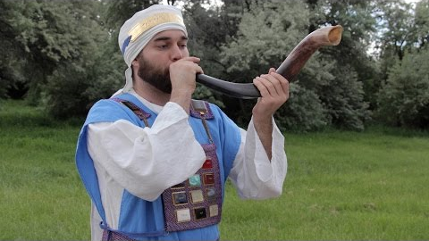
LESSON 65

