Slide 1
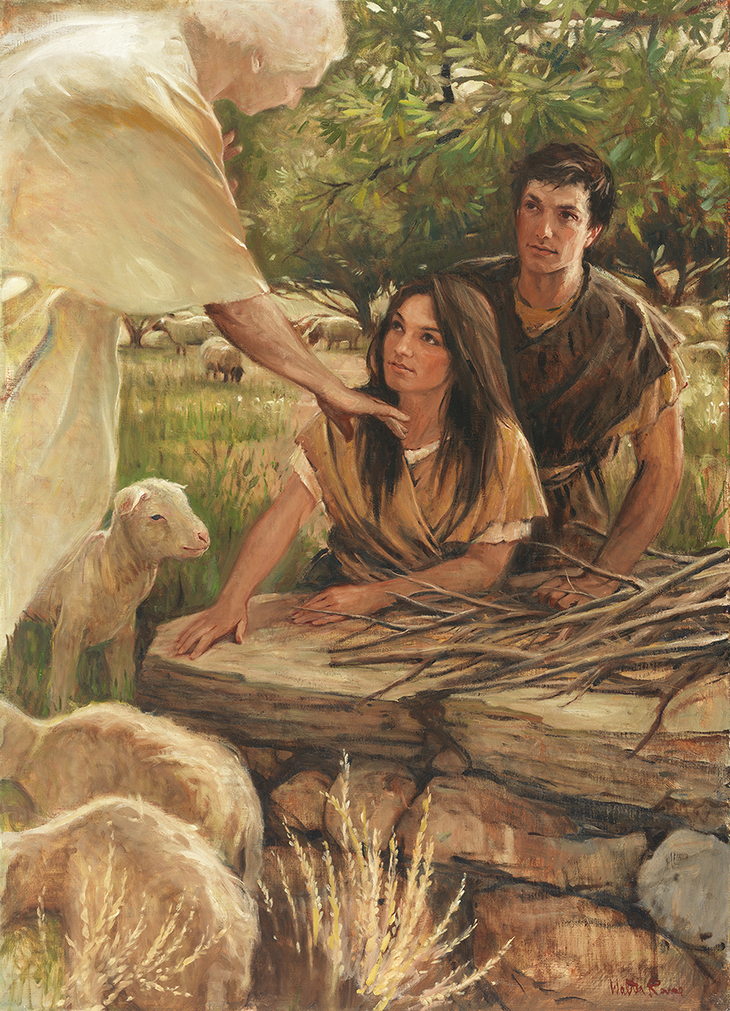
SEMINARY
Old Testament

Slide 2
LESSON 63
Leviticus 8–18

Slide 3
LESSON 63
Leviticus 8-11
“Aaron and his sons are consecrated before the people and then offer sacrifices, and the Lord gives Israel a dietary law”

Slide 4
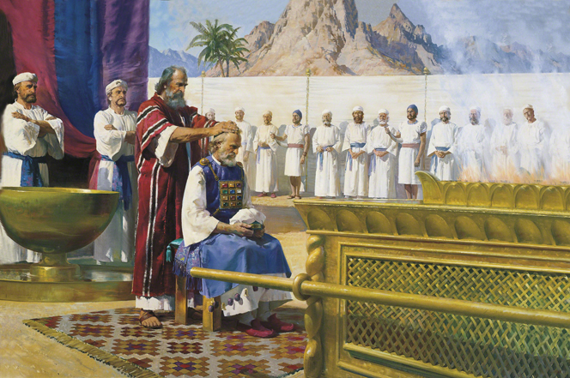
LESSON 63
How might the way Aaronic Priesthood holders prepare, administer, and pass the sacrament affect your experience with this ordinance?

Slide 5
LESSON 63
What is a principle we can learn from verse 23?
As those who hold the priesthood properly fulfill their responsibilities, they help people draw nearer to the Lord.
What responsibilities do Aaronic Priesthood holders have today?
How could Aaronic Priesthood holders fulfill these responsibilities in a way to help others draw nearer to the Lord?

Slide 6
LESSON 63
Leviticus 12–15
“The Lord gives laws and ordinances that pertain to physical cleanliness and sanitation”

Slide 7
LESSON 63
How would you feel if, in that dirty condition, you had to go to a place where people are normally clean, such as a church meeting or a formal social gathering?
Leviticus 13:1-3
1 And the Lord spake unto Moses and Aaron, saying,
2 When a man shall have in the skin of his flesh a rising, a scab, or bright spot, and it be in the skin of his flesh like the plague of leprosy; then he shall be brought unto Aaron the priest, or unto one of his sons the priests:
3 And the priest shall look on the plague in the skin of the flesh: and when the hair in the plague is turned white, and the plague in sight be deeper than the skin of his flesh, it is a plague of leprosy: and the priest shall look on him, and pronounce him unclean.
For a moment, we will liken leprosy to sin.

Slide 8
LESSON 63
Leviticus 14:1-3
1 And the Lord spake unto Moses, saying,
2 This shall be the law of the leper in the day of his cleansing: He shall be brought unto the priest:
3 And the priest shall go forth out of the camp; and the priest shall look, and, behold, if the plague of leprosy be healed in the leper;
Who may the priest represent in our own experiences seeking to be cleansed from our sins?
The priest is like a bishop or branch president.

Slide 9
LESSON 63
Leviticus 14:12-14, 19-20
12 And the priest shall take one he lamb, and offer him for a trespass offering, and the log of oil, and wave them for a wave offering before the Lord:
13 And he shall slay the lamb in the place where he shall kill the sin offering and the burnt offering, in the holy place: for as the sin offering is the priest’s, so is the trespass offering: it is most holy:
14 And the priest shall take some of the blood of the trespass offering, and the priest shall put it upon the tip of the right ear of him that is to be cleansed, and upon the thumb of his right hand, and upon the great toe of his right foot:
19 And the priest shall offer the sin offering, and make an atonement for him that is to be cleansed from his uncleanness; and afterward he shall kill the burnt offering:
20 And the priest shall offer the burnt offering and the meat offering upon the altar: and the priest shall make an atonement for him, and he shall be clean.
What can the ritual with the lambs teach us about the Savior and what He does for those who repent?

Slide 10
LESSON 63
The offerings are like our repentance.
What can we learn from these rituals about what we must do to be cleansed from our sins?
To be forgiven of our sins, we must turn to the Lord and obey the conditions of repentance He has given.
How can a bishop or branch president help an individual to receive the blessing of forgiveness through the Savior’s Atonement?

Slide 11
LESSON 63
Leviticus 16-18
“The Lord instructs Israel concerning the Day of Atonement and commands them to not follow the wicked practices of other nations”

Slide 12
LESSON 63
Leviticus 16:7-10
7 And he shall take the two goats, and present them before the Lord at the door of the tabernacle of the congregation.
8 And Aaron shall cast lots upon the two goats; one lot for the Lord, and the other lot for the scapegoat.
9 And Aaron shall bring the goat upon which the Lord’s lot fell, and offer him for a sin offering.
10 But the goat, on which the lot fell to be the scapegoat, shall be presented alive before the Lord, to make an atonement with him, and to let him go for a scapegoat into the wilderness.

Slide 13

LESSON 63
Leviticus 16:15-16
Leviticus 16:20-21
15 ¶ Then shall he kill the goat of the sin offering, that is for the people, and bring his blood within the veil, and do with that blood as he did with the blood of the bullock, and sprinkle it upon the mercy seat, and before the mercy seat:
16 And he shall make an atonement for the holy place, because of the uncleanness of the children of Israel, and because of their transgressions in all their sins: and so shall he do for the tabernacle of the congregation, that remaineth among them in the midst of their uncleanness.
20 ¶ And when he hath made an end of reconciling the holy place, and the tabernacle of the congregation, and the altar, he shall bring the live goat:
21 And Aaron shall lay both his hands upon the head of the live goat, and confess over him all the iniquities of the children of Israel, and all their transgressions in all their sins, putting them upon the head of the goat, and shall send him away by the hand of a fit man into the wilderness:
What can the ritual described in verses 15–16 teach us about the Atonement of Jesus Christ?
What can the ritual described in verses 21–22 teach us about the Atonement of Jesus Christ?

Slide 14
LESSON 63
What are some lessons that the Israelites might have learned through these rituals performed on the Day of Atonement?
Through His Atonement, Jesus Christ took away the sins of the world by taking them upon Himself. Jesus Christ’s Atonement included His infinite suffering and the shedding of His blood in Gethsemane and on the cross.

Slide 15
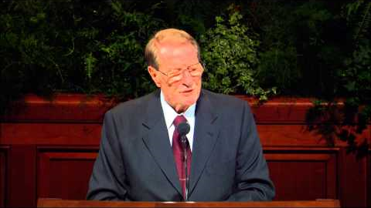
LESSON 63

