Slide 1
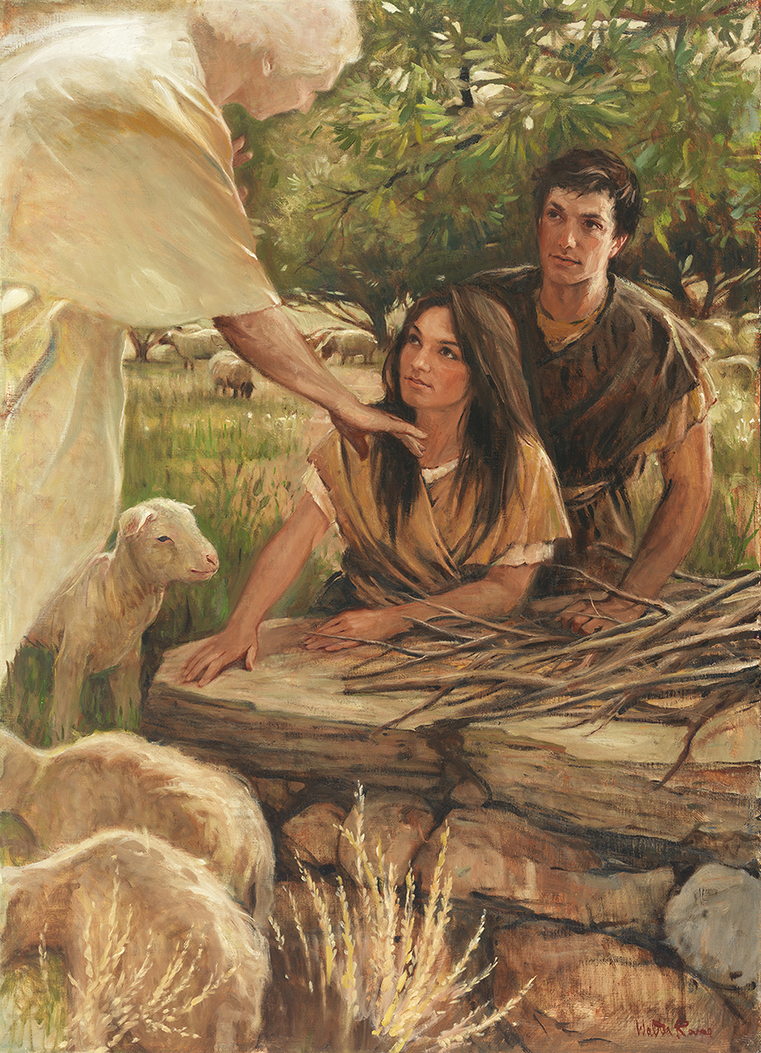
SEMINARY
Old Testament

Slide 2
LESSON 60
Exodus 33–40

Slide 3
LESSON 60
Exodus 33
“Because of the children of Israel’s sins, the Lord declares that they cannot see His face”

Slide 4
LESSON 60
A young man transgresses a commandment. He experiences guilt and shame. He believes that Heavenly Father will never forgive him of his sin.
A different young man transgresses the same commandment. He thinks the sin he has committed is not a big deal. He believes that because he is generally a good person, God will not punish him for his sin.
How would you summarize the differences between the attitudes and beliefs of these two young men?
What error do you notice in the belief of each young man? (The first falsely believes that God is not forgiving. The second falsely believes that God will not hold him accountable for his sins.)
What problems could arise from these false beliefs?

Slide 5
LESSON 60
Exodus 33:1-4
1 And the Lord said unto Moses, Depart, and go up hence, thou and the people which thou hast brought up out of the land of Egypt, unto the land which I sware unto Abraham, to Isaac, and to Jacob, saying, Unto thy seed will I give it:
2 And I will send an angel before thee; and I will drive out the Canaanite, the Amorite, and the Hittite, and the Perizzite, the Hivite, and the Jebusite:
3 Unto a land flowing with milk and honey: for I will not go up in the midst of thee; for thou art a stiffnecked people: lest I consume thee in the way.
4 ¶ And when the people heard these evil tidings, they mourned: and no man did put on him his ornaments.
Why did the Israelites mourn?
What does verse 3 teach us about the effect of sin on our relationship with the Lord?
Sin separates us from the Lord.
Exodus 33:9-11
9 And it came to pass, as Moses entered into the tabernacle, the cloudy pillar descended, and stood at the door of the tabernacle, and the Lord talked with Moses.
10 And all the people saw the cloudy pillar stand at the tabernacle door: and all the people rose up and worshipped, every man in his tent door.
11 And the Lord spake unto Moses face to face, as a man speaketh unto his friend. And he turned again into the camp: but his servant Joshua, the son of Nun, a young man, departed not out of the tabernacle.

Slide 6
LESSON 60
Exodus 34
“The Lord writes His law on
new stone tables”

Slide 7
LESSON 60
Exodus 34:1-2
, 4-7
1 And the Lord said unto Moses, Hew thee two tables of stone like unto the first: and I will write upon these tables the words that were in the first tables, which thou brakest.
2 And be ready in the morning, and come up in the morning unto mount Sinai, and present thyself there to me in the top of the mount.
4 ¶ And he hewed two tables of stone like unto the first; and Moses rose up early in the morning, and went up unto mount Sinai, as the Lord had commanded him, and took in his hand the two tables of stone.
5 And the Lord descended in the cloud, and stood with him there, and proclaimed the name of the Lord.
6 And the Lord passed by before him, and proclaimed, The Lord, The Lord God, merciful and gracious, longsuffering, and abundant in goodness and truth,
7 Keeping mercy for thousands, forgiving iniquity and transgression and sin, and that will by no means clear the guilty; visiting the iniquity of the fathers upon the children, and upon the children’s children, unto the third and to the fourth generation.

Slide 8
LESSON 60
What can we learn about the Lord from His teachings recorded in verses 6-7?
The Lord is merciful and forgiving. He is also perfectly just and will hold us accountable for our sins.
How does God extend both justice and mercy to His children?

Slide 9
LESSON 60
Exodus 35-40
“The Israelites obey the Lord’s command to build the tabernacle”

Slide 10
LESSON 60
What was the difference between how these two gifts were offered to you?
How did you feel when you were offered a gift grudgingly?
How did you feel when a gift was offered willingly?
Exodus 35:4-5
4 ¶ And Moses spake unto all the congregation of the children of Israel, saying, This is the thing which the Lord commanded, saying,
5 Take ye from among you an offering unto the Lord: whosoever is of a willing heart, let him bring it, an offering of the Lord; gold, and silver, and brass,
What did the Lord command regarding the offerings given to build the tabernacle?

Slide 11
LESSON 60
Exodus 35:20-22, 29
20 ¶ And all the congregation of the children of Israel departed from the presence of Moses.
21 And they came, every one whose heart stirred him up, and every one whom his spirit made willing, and they brought the Lord’s offering to the work of the tabernacle of the congregation, and for all his service, and for the holy garments.
22 And they came, both men and women, as many as were willing hearted, and brought bracelets, and earrings, and rings, and tablets, all jewels of gold: and every man that offered offered an offering of gold unto the Lord.
29 The children of Israel brought a willing offering unto the Lord, every man and woman, whose heart made them willing to bring for all manner of work, which the Lord had commanded to be made by the hand of Moses.
What can we learn from these verses about how the Lord desires us to give offerings?
The Lord desires that we give our offerings to Him with a willing heart.
Why do you think the Lord wants us to give these offerings willingly?

