Slide 1
SEMINARY
Old Testament

Slide 2
LESSON 58
The Restoration
(Part 2)

Slide 3
LESSON 58
Segment 1 (10 minutes)

Slide 4
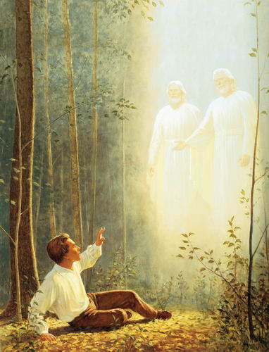
LESSON 58
The Great Apostasy
The Great Apostasy
The Great Apostasy
The Restoration

Slide 5
LESSON 58
Segment 2 (15 minutes)

Slide 6
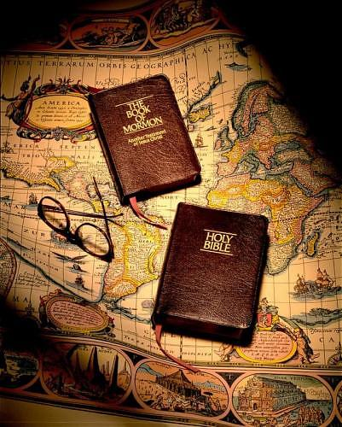
LESSON 58

Slide 7
LESSON 58
Doctrine Mastery Paragraph 4.3
God called Joseph Smith to be a latter-day witness of the living Christ. As the Prophet of the Restoration, Joseph Smith translated the Book of Mormon by the gift and power of God (see D&C 135:3). With the Bible, the Book of Mormon testifies of Jesus Christ and contains the fulness of the gospel (see Ezekiel 37:15–17). The Book of Mormon is also a witness of Joseph Smith’s prophetic calling and the truthfulness of the Restoration.
What do both the Book of Mormon and the Bible do?
With the Bible, the Book of Mormon testifies of Jesus Christ and contains the fulness of the gospel.

Slide 8
LESSON 58
“The Bible and the Book of Mormon are both witnesses of Jesus Christ. They teach that He is the Son of God, that He lived an exemplary life, that He atoned for all mankind, that He died upon the cross and rose again as the resurrected Lord. They teach that He is the Savior of the world. …
“Love for the Book of Mormon expands one’s love for the Bible and vice versa. Scriptures of the Restoration do not compete with the Bible; they complement the Bible” (Russell M. Nelson, “Scriptural Witnesses,” Ensign or Liahona, Nov. 2007, 43).
President
Russell M. Nelson
How do the Bible and the Book of Mormon work together to testify of Jesus Christ?
Why is it helpful to have multiple witnesses of Jesus Christ?
What do you think it means that the Book of Mormon contains the fulness of the gospel?

Slide 9
LESSON 58
“The Lord Himself has stated that the Book of Mormon contains the ‘fulness of the gospel of Jesus Christ’ (D&C 20:9). That does not mean it contains every teaching, every doctrine ever revealed. Rather, it means that in the Book of Mormon we will find the fulness of those doctrines required for our salvation. And they are taught plainly and simply so that even children can learn the ways of salvation and exaltation” (Ezra Taft Benson, “The Book of Mormon—Keystone of Our Religion,” Ensign, Nov. 1986, 6).
President
Ezra Taft Benson
How does knowing that the Book of Mormon contains the fulness of the gospel of Jesus Christ help you understand why is it important for all of Heavenly Father’s children to read and gain a testimony of the Book of Mormon for themselves?

Slide 10
LESSON 58
Segment 3 (15 minutes)

Slide 11
LESSON 58
Ezekiel 37:15-17
15 ¶ The word of the Lord came again unto me, saying,
16 Moreover, thou son of man, take thee one stick, and write upon it, For Judah, and for the children of Israel his companions: then take another stick, and write upon it, For Joseph, the stick of Ephraim, and for all the house of Israel his companions:
17 And join them one to another into one stick; and they shall become one in thine hand.
With the Bible, the Book of Mormon testifies of Jesus Christ and contains the fulness of the gospel.

Slide 12
LESSON 58
What did Ezekiel say would happen to these two sticks, or books?
In what ways are the Bible and the Book of Mormon “one” in our hands?
How do the Book of Mormon and the Bible work together to testify of the Savior Jesus Christ?
What are some scripture passages from the Bible or the Book of Mormon that have helped to strengthen your testimony of Jesus Christ and His gospel?

