Slide 1
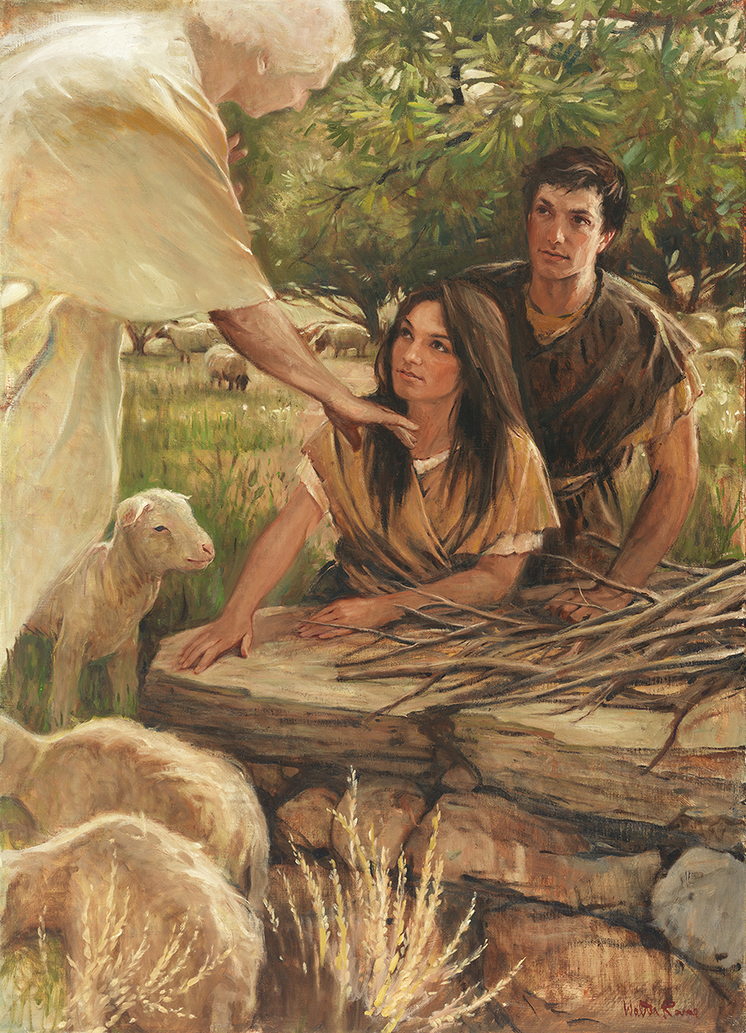
SEMINARY
Old Testament

Slide 2
LESSON 57
Exodus 25-31

Slide 3
LESSON 57
Exodus 25:1-8
“The Lord instructs the children of
Israel to build a sanctuary”

Slide 4
LESSON 57
How are we blessed by building temples?
Exodus 25:1-8
1 And the Lord spake unto Moses, saying,
2 Speak unto the children of Israel, that they bring me an offering: of every man that giveth it willingly with his heart ye shall take my offering.
3 And this is the offering which ye shall take of them; gold, and silver, and brass,
4 And blue, and purple, and scarlet, and fine linen, and goats’ hair,
5 And rams’ skins dyed red, and badgers’ skins, and shittim wood,
6 Oil for the light, spices for anointing oil, and for sweet incense,
7 Onyx stones, and stones to be set in the ephod, and in the breastplate.
8 And let them make me a sanctuary; that I may dwell among them.
Why did the Lord command the Israelites to build a tabernacle?
What can we learn about modern temples from this verse?
The Lord commands us to build temples so He can dwell among us.
When have you felt closer to God because you visited the temple grounds or participated in temple ordinances?

Slide 5
LESSON 57
Exodus 25:9-30:38
“The Lord reveals the pattern for building and furnishing the tabernacle”

Slide 6
LESSON 57
Exodus 25:9
According to all that I shew thee, after the pattern of the tabernacle, and the pattern of all the instruments thereof, even so shall ye make it.
Candlestick
Altar of
incense
Outer
Courtyard
Gate
Ark of testimony
The Tabernacle
The Holy Place
Veil
The Most Holy Place
Laver
Altar of
Sacrifice
Table of
Shewbread

Slide 7
LESSON 57
Exodus 26:33-34
33 ¶ And thou shalt hang up the veil under the taches, that thou mayest bring in thither within the veil the ark of the testimony: and the veil shall divide unto you between the holy place and the most holy.
34 And thou shalt put the mercy seat upon the ark of the testimony in the most holy place.
What were the two rooms called?
What did God command Moses to put in the most holy place?

Slide 8
LESSON 57
Exodus 25:21–22
21 And thou shalt put the mercy seat above upon the ark; and in the ark thou shalt put the testimony that I shall give thee.
22 And there I will meet with thee, and I will commune with thee from above the mercy seat, from between the two cherubims which are upon the ark of the testimony, of all things which I will give thee in commandment unto the children of Israel.
What would happen at the mercy seat?

Slide 9
LESSON 57
Candlestick (with seven lamps):
Exodus 25:31–32, 37-40; 26:35
Table of shewbread:
Exodus 25:23, 29-30; 26:35
31 ¶ And thou shalt make a candlestick of pure gold: of beaten work shall the candlestick be made: his shaft, and his branches, his bowls, his knops, and his flowers, shall be of the same.
32 And six branches shall come out of the sides of it; three branches of the candlestick out of the one side, and three branches of the candlestick out of the other side:
37 And thou shalt make the seven lamps thereof: and they shall light the lamps thereof, that they may give light over against it.
38 And the tongs thereof, and the snuffdishes thereof, shall be of pure gold.
39 Of a talent of pure gold shall he make it, with all these vessels.
40 And look that thou make them after their pattern, which was shewed thee in the mount.
Exodus 26:35
35 And thou shalt set the table without the veil, and the candlestick over against the table on the side of the tabernacle toward the south: and thou shalt put the table on the north side.
23 ¶ Thou shalt also make a table of shittim wood: two cubits shall be the length thereof, and a cubit the breadth thereof, and a cubit and a half the height thereof.
29 And thou shalt make the dishes thereof, and spoons thereof, and covers thereof, and bowls thereof, to cover withal: of pure gold shalt thou make them.
30 And thou shalt set upon the table shewbread before me alway.

Slide 10
LESSON 57
Laver (basin of water):
Exodus 30:17–21
Altar of sacrifice:
Exodus 27:1–8; 30:18
17 ¶ And the Lord spake unto Moses, saying,
18 Thou shalt also make a laver of brass, and his foot also of brass, to wash withal: and thou shalt put it between the tabernacle of the congregation and the altar, and thou shalt put water therein.
19 For Aaron and his sons shall wash their hands and their feet thereat:
20 When they go into the tabernacle of the congregation, they shall wash with water, that they die not; or when they come near to the altar to minister, to burn offering made by fire unto the Lord:
21 So they shall wash their hands and their feet, that they die not: and it shall be a statute for ever to them, even to him and to his seed throughout their generations.
1 And thou shalt make an altar of shittim wood, five cubits long, and five cubits broad; the altar shall be foursquare: and the height thereof shall be three cubits.
2 And thou shalt make the horns of it upon the four corners thereof: his horns shall be of the same: and thou shalt overlay it with brass.
3 And thou shalt make his pans to receive his ashes, and his shovels, and his basins, and his fleshhooks, and his firepans: all the vessels thereof thou shalt make of brass.
4 And thou shalt make for it a grate of network of brass; and upon the net shalt thou make four brasen rings in the four corners thereof.
5 And thou shalt put it under the compass of the altar beneath, that the net may be even to the midst of the altar.
6 And thou shalt make staves for the altar, staves of shittim wood, and overlay them with brass.
7 And the staves shall be put into the rings, and the staves shall be upon the two sides of the altar, to bear it.
8 Hollow with boards shalt thou make it: as it was shewed thee in the mount, so shall they make it.
Altar of incense:
Exodus 30:1–8
1 And thou shalt make an altar to burn incense upon: of shittim wood shalt thou make it.
2 A cubit shall be the length thereof, and a cubit the breadth thereof; foursquare shall it be: and two cubits shall be the height thereof: the horns thereof shall be of the same.
3 And thou shalt overlay it with pure gold, the top thereof, and the sides thereof round about, and the horns thereof; and thou shalt make unto it a crown of gold round about.
4 And two golden rings shalt thou make to it under the crown of it, by the two corners thereof, upon the two sides of it shalt thou make it; and they shall be for places for the staves to bear it withal.
5 And thou shalt make the staves of shittim wood, and overlay them with gold.
6 And thou shalt put it before the veil that is by the ark of the testimony, before the mercy seat that is over the testimony, where I will meet with thee.
7 And Aaron shall burn thereon sweet incense every morning: when he dresseth the lamps, he shall burn incense upon it.
8 And when Aaron lighteth the lamps at even, he shall burn incense upon it, a perpetual incense before the Lord throughout your generations.
Exodus 30:18
18 Thou shalt also make a laver of brass, and his foot also of brass, to wash withal: and thou shalt put it between the tabernacle of the congregation and the altar, and thou shalt put water therein.

Slide 11
LESSON 57
The Light of Christ and the Holy Ghost
[Candlestick]
The Savior’s body (similar to the symbolic meaning of the sacrament)
[Table of shewbread]
Giving ourselves completely to God, giving up sin, and relying on the great and last sacrifice of the Atonement of Jesus Christ.
[Altar of sacrifice]
Prayer (we can approach God through prayer, see Psalm 141:2)
[Altar of incense]
Cleansing, such as through repentance and baptism.
[Laver]

Slide 12
LESSON 57
How would you summarize what the ordinances and symbols of the temple teach us?
The ordinances and symbols of the temple teach us how to proceed faithfully through this life and eventually enter God’s presence.
How can understanding this truth influence how you worship in the temple?
In what ways has temple worship helped you proceed faithfully through this life and prepare to enter God’s presence?

Slide 13
LESSON 57
Exodus 31
“The Lord teaches about the Sabbath and gives
Moses the stone tables”

Slide 14
LESSON 57
Exodus 31:13-17
13 Speak thou also unto the children of Israel, saying, Verily my sabbaths ye shall keep: for it is a sign between me and you throughout your generations; that ye may know that I am the Lord that doth sanctify you.
14 Ye shall keep the sabbath therefore; for it is holy unto you: every one that defileth it shall surely be put to death: for whosoever doeth any work therein, that soul shall be cut off from among his people.
15 Six days may work be done; but in the seventh is the sabbath of rest, holy to the Lord: whosoever doeth any work in the sabbath day, he shall surely be put to death.
16 Wherefore the children of Israel shall keep the sabbath, to observe the sabbath throughout their generations, for a perpetual covenant.
17 It is a sign between me and the children of Israel for ever: for in six days the Lord made heaven and earth, and on the seventh day he rested, and was refreshed.
What sign did the Lord establish to remind us that He is the Lord “that doth sanctify [us]”?
The Sabbath day and keeping it holy is a sign between us and the Lord.
In what ways is the Sabbath day and keeping it holy a sign and reminder that God is our Lord and that He can sanctify us?
What connection does the Sabbath have to our being sanctified by the Lord?

Slide 15
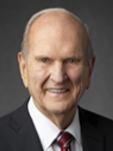
LESSON 57
“How do we hallow the Sabbath day? In my much younger years, I studied the work of others who had compiled lists of things to do and things not to do on the Sabbath. It wasn’t until later that I learned from the scriptures that my conduct and my attitude on the Sabbath constituted a sign between me and my Heavenly Father. With that understanding, I no longer needed lists of dos and don’ts. When I had to make a decision whether or not an activity was appropriate for the Sabbath, I simply asked myself, ‘What sign do I want to give to God?’ [see Exodus 31:13; Ezekiel 20:12, 20]. That question made my choices about the Sabbath day crystal clear” (Russell M. Nelson, “The Sabbath Is a Delight,” Ensign or Liahona, May 2015, 130).
President
Russell M. Nelson

Slide 16
LESSON 57
Exodus 31:18
¶ And he gave unto Moses, when he had made an end of communing with him upon mount Sinai, two tables of testimony, tables of stone, written with the finger of God.
What did God give to Moses?
What did God give to Moses?
What did God give to Moses?
What did God give to Moses?
What did God give to Moses?
What did God give to Moses?
What did God give to Moses?
What did God give to Moses?

Slide 17
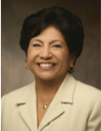
LESSON 57
Exodus 25-27, 30
“The symbols of the temple teach us truth”
“The temple is a house of learning. Much of the instruction imparted in the temple is symbolic and learned by the Spirit. This means we are taught from on high. Temple covenants and ordinances are a powerful symbol of Christ and His Atonement. We all receive the same instruction, but our understanding of the meaning of the ordinances and covenants will increase as we return to the temple often with the attitude of learning and contemplating the eternal truths taught” (Silvia H. Allred, “Holy Temples, Sacred Covenants,” Ensign or Liahona, Nov. 2008, 113).
Sister
Silvia H. Allred

Slide 18
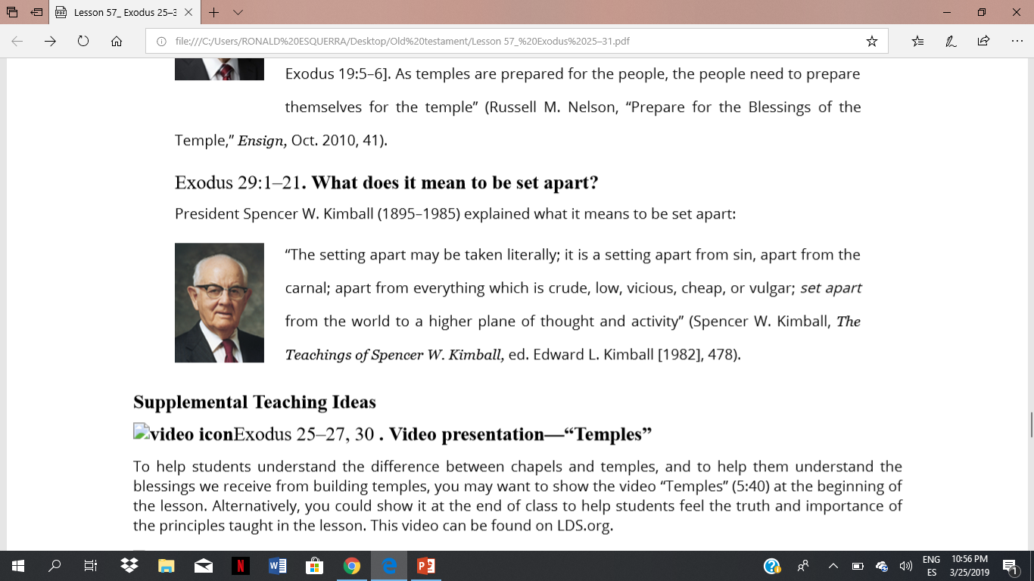
LESSON 57
Exodus 28:36.
“Holiness to the Lord”
“Inscribed on each temple are the words ‘holiness to the Lord’ [see Exodus 28:36; 39:30; Psalm 93:5]. That statement designates both the temple and its purposes as holy. Those who enter the temple are also to bear the attribute of holiness [see Exodus 19:5–6]. As temples are prepared for the people, the people need to prepare themselves for the temple” (Russell M. Nelson, “Prepare for the Blessings of the Temple,” Ensign, Oct. 2010, 41).
President
Russell M. Nelson
Exodus 29:1–21. What does it mean to be set apart?
“The setting apart may be taken literally; it is a setting apart from sin, apart from the carnal; apart from everything which is crude, low, vicious, cheap, or vulgar; set apart from the world to a higher plane of thought and activity” (Spencer W. Kimball, The Teachings of Spencer W. Kimball, ed. Edward L. Kimball [1982], 478)
President
Spencer W. Kimball

