Slide 1
SEMINARY
Old Testament

Slide 2
LESSON 53
The Restoration
(Part 1)

Slide 3
LESSON 53
Segment 1 (15 minutes)

Slide 4
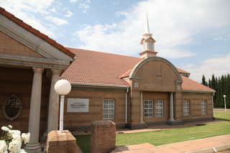
LESSON 53
What are some elements of The Church of Jesus Christ of Latter-day Saints that make it unique?
Have the Church and these elements of it always existed on the earth? Why or why not?

Slide 5
LESSON 53
Apostasy
Doctrine Mastery Paragraph 4.5
The need for the latter-day Restoration of God’s truths, priesthood authority, and Church arose because of apostasy. Apostasy occurs when one or more individuals turn away from the truths of the gospel.
What is apostasy?

Slide 6
LESSON 53
Doctrine Mastery Paragraph 4.6-4.7
4.6. Following the Savior’s crucifixion and the deaths of His Apostles, many people turned away from the truths the Savior had established (see 2 Thessalonians 2:1–3). Principles of the gospel and parts of the holy scriptures were corrupted or lost. Unauthorized changes were made in Church organization and priesthood ordinances. Because of this widespread wickedness, the Lord withdrew the authority and keys of the priesthood from the earth. Although there were many good and honest people who worshipped God according to the light they possessed and received answers to their prayers, the world was left without divine revelation through living prophets. This period is known as the Great Apostasy.
4.7. Other periods of general apostasy have occurred throughout the history of the world.
How would your life be different if these elements of the Church and the gospel were still lost today?

Slide 7
LESSON 53
Segment 2 (5 minutes)

Slide 8
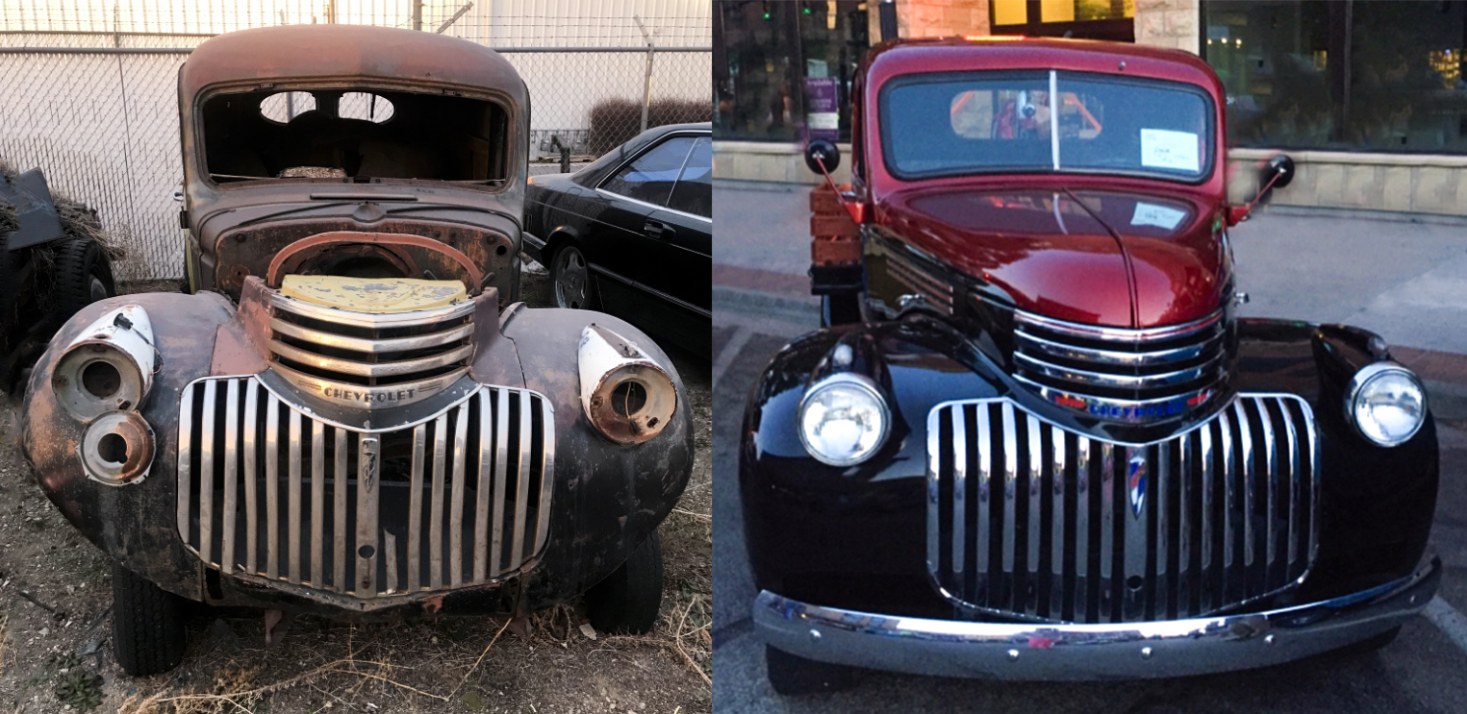
LESSON 53
Restoration
Doctrine Mastery Paragraph 4.1
God has restored His gospel in these latter days by reestablishing His truths, priesthood authority, and Church upon the earth. Ancient prophets foretold the latter-day Restoration of the gospel (see Isaiah 29:13–14; Acts 3:19–21).

Slide 9
LESSON 53
Who foretold the latter-day Restoration of the gospel?
Ancient prophets foretold the latter-day Restoration of the gospel.
Why do you think it is important to know that the Lord revealed to ancient prophets that there would be a latter-day Restoration of the gospel?
Which doctrinal mastery scripture passage in the Old Testament helps teach this key statement of doctrine?
Isaiah 29:13-14
13 ¶ Wherefore the Lord said, Forasmuch as this people draw near me with their mouth, and with their lips do honour me, but have removed their heart far from me, and their fear toward me is taught by the precept of men:
14 Therefore, behold, I will proceed to do a marvellous work among this people, even a marvellous work and a wonder: for the wisdom of their wise men shall perish, and the understanding of their prudent men shall be hid.

Slide 10
LESSON 53
Segment 3 (20 minutes)

Slide 11
LESSON 53
Isaiah 29:13-14
13 ¶ Wherefore the Lord said, Forasmuch as this people draw near me with their mouth, and with their lips do honour me, but have removed their heart far from me, and their fear toward me is taught by the precept of men:
14 Therefore, behold, I will proceed to do a marvellous work among this people, even a marvellous work and a wonder: for the wisdom of their wise men shall perish, and the understanding of their prudent men shall be hid.
How do these verses describe individuals who are in a state of apostasy?
What did the Lord say He would do to help those in a state of apostasy?
What does the phrase “a marvellous work and a wonder” refer to?
Why is it important to understand that the Restoration of the gospel was accomplished by the power of God and not by men?

Slide 12
LESSON 53
In what way is the latter-day Restoration of the gospel a “marvellous work and a wonder”?
How has the Restoration of the gospel blessed your life?

