Slide 1
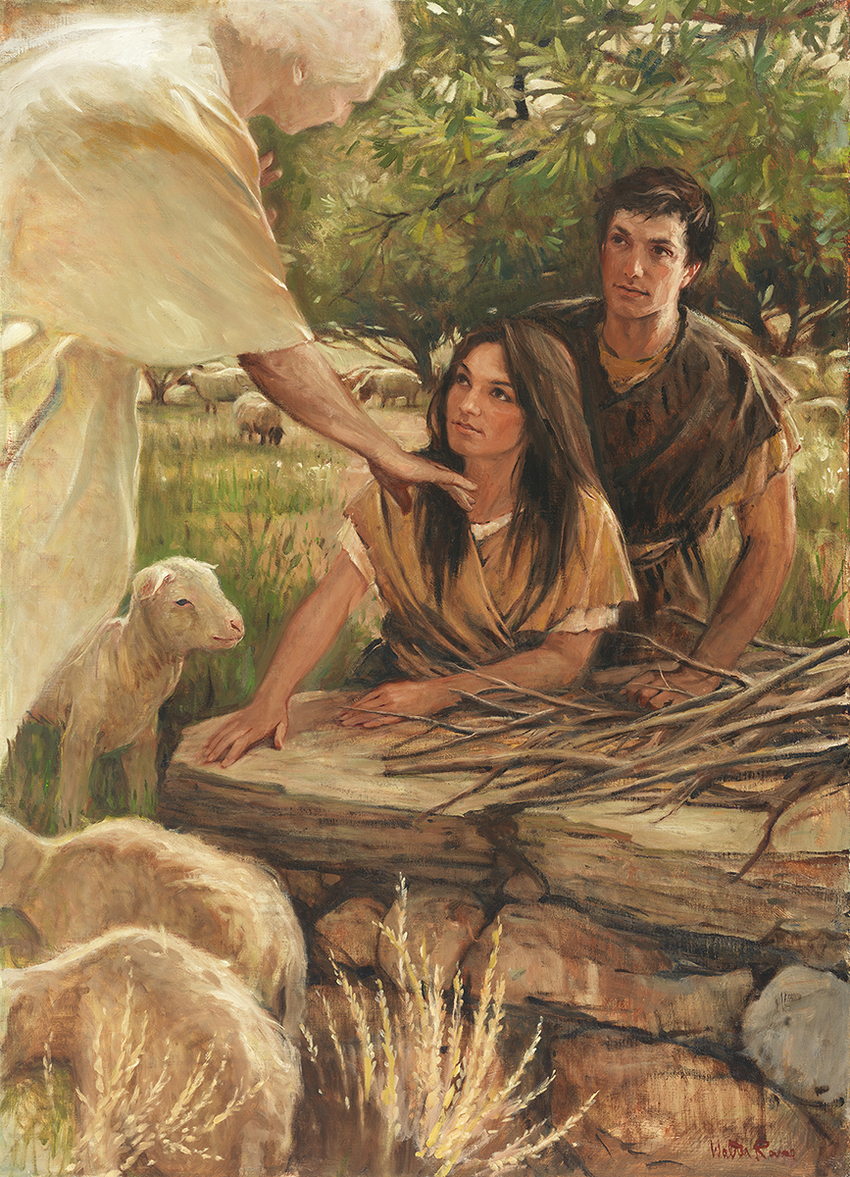
SEMINARY
Old Testament

Slide 2
LESSON 51
Exodus 16:1-17:7

Slide 3
LESSON 51
Exodus 16
“Israel murmurs for bread, and the Lord sends quail and bread from heaven”

Slide 4
LESSON 51
When did you last eat?
If you recently ate, why are you hungry now? Why do we have to eat regularly?
Exodus 16:1-3
1 And they took their journey from Elim, and all the congregation of the children of Israel came unto the wilderness of Sin, which is between Elim and Sinai, on the fifteenth day of the second month after their departing out of the land of Egypt.
2 And the whole congregation of the children of Israel murmured against Moses and Aaron in the wilderness:
3 And the children of Israel said unto them, Would to God we had died by the hand of the Lord in the land of Egypt, when we sat by the flesh pots, and when we did eat bread to the full; for ye have brought us forth into this wilderness, to kill this whole assembly with hunger.
What problem did Israel face in the wilderness?
Whom did the children of Israel murmur against?
Why did they wish they “had died by the hand of the Lord in the land of Egypt” (verse 3)?

Slide 5
LESSON 51
Exodus 16:4-5
4 ¶ Then said the Lord unto Moses, Behold, I will rain bread from heaven for you; and the people shall go out and gather a certain rate every day, that I may prove them, whether they will walk in my law, or no.
5 And it shall come to pass, that on the sixth day they shall prepare that which they bring in; and it shall be twice as much as they gather daily.
What specific instructions did the Lord give the people about gathering this bread from heaven?
In what ways might gathering only a limited amount of bread each day have been a test for the children of Israel?
What is one reason the Lord gives us commandments?
One reason the Lord gives us commandments is to test our obedience to Him.

Slide 6
LESSON 51
Exodus 16:6-8
6 And Moses and Aaron said unto all the children of Israel, At even, then ye shall know that the Lord hath brought you out from the land of Egypt:
7 And in the morning, then ye shall see the glory of the Lord; for that he heareth your murmurings against the Lord: and what are we, that ye murmur against us?
8 And Moses said, This shall be, when the Lord shall give you in the evening flesh to eat, and in the morning bread to the full; for that the Lord heareth your murmurings which ye murmur against him: and what are we? your murmurings are not against us, but against the Lord.
When we murmur against Church leaders?
When we murmur against Church leaders, we are actually murmuring against the Lord.
Why is murmuring against Church leaders also murmuring against the Lord?

Slide 7
LESSON 51
Exodus 16:13-15
13 And it came to pass, that at even the quails came up, and covered the camp: and in the morning the dew lay round about the host.
14 And when the dew that lay was gone up, behold, upon the face of the wilderness there lay a small round thing, as small as the hoar frost on the ground.
15 And when the children of Israel saw it, they said one to another, It is manna: for they wist not what it was. And Moses said unto them, This is the bread which the Lord hath given you to eat.

Slide 8
LESSON 51
Exodus 16:16-21
, 31
16 ¶ This is the thing which the Lord hath commanded, Gather of it every man according to his eating, an omer for every man, according to the number of your persons; take ye every man for them which are in his tents.
17 And the children of Israel did so, and gathered, some more, some less.
18 And when they did mete it with an omer, he that gathered much had nothing over, and he that gathered little had no lack; they gathered every man according to his eating.
19 And Moses said, Let no man leave of it till the morning.
20 Notwithstanding they hearkened not unto Moses; but some of them left of it until the morning, and it bred worms, and stank: and Moses was wroth with them.
21 And they gathered it every morning, every man according to his eating: and when the sun waxed hot, it melted.
31 And the house of Israel called the name thereof Manna: and it was like coriander seed, white; and the taste of it was like wafers made with honey.

Slide 9
LESSON 51
How much manna were the Israelites told to gather?
What happened if they tried to save it until the next day?
How often did the children of Israel need to gather the manna?
What happened to the manna that wasn’t gathered?
What spiritual lessons can we learn from the Lord’s instructions about manna?
If we rely on the Lord daily, He will bless us with the spiritual nourishment needed for that day. As we remember the Lord daily, our trust in Him will grow.

Slide 10
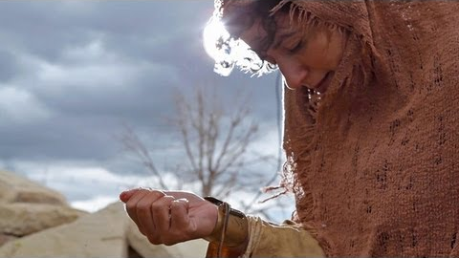
LESSON 51

Slide 11
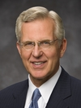
LESSON 51
“By providing a daily sustenance, one day at a time, Jehovah was trying to teach faith to a nation that over a period of some 400 years had lost much of the faith of their fathers. He was teaching them to trust Him, to ‘look unto [Him] in every thought; doubt not, fear not’ (D&C 6:36). He was providing enough for one day at a time. Except for the sixth day, they could not store manna for use in any succeeding day or days. In essence, the children of Israel had to walk with Him today and trust that He would grant a sufficient amount of food for the next day on the next day, and so on. In that way He could never be too far from their minds and hearts” (D. Todd Christofferson, “Look to God Each Day,” Liahona, Feb. 2015, 49).
Elder
D. Todd Christofferson
Why did the Lord provide manna one day at a time?
What are some things we can do to remember the Lord daily?
Why would remembering and seeking the Lord only one day a week fail to provide adequately for our spiritual needs throughout the rest of the week?
What difference does it make in your life when you remember the Lord and seek Him daily?

Slide 12
LESSON 51
Exodus 16:22-26
22 ¶ And it came to pass, that on the sixth day they gathered twice as much bread, two omers for one man: and all the rulers of the congregation came and told Moses.
23 And he said unto them, This is that which the Lord hath said, To morrow is the rest of the holy sabbath unto the Lord: bake that which ye will bake to day, and seethe that ye will seethe; and that which remaineth over lay up for you to be kept until the morning.
24 And they laid it up till the morning, as Moses bade: and it did not stink, neither was there any worm therein.
25 And Moses said, Eat that to day; for to day is a sabbath unto the Lord: to day ye shall not find it in the field.
26 Six days ye shall gather it; but on the seventh day, which is the sabbath, in it there shall be none.
Why did the Israelites need to gather twice the amount of manna on the sixth day?

Slide 13
LESSON 51
Exodus 16:27-31
27 ¶ And it came to pass, that there went out some of the people on the seventh day for to gather, and they found none.
28 And the Lord said unto Moses, How long refuse ye to keep my commandments and my laws?
29 See, for that the Lord hath given you the sabbath, therefore he giveth you on the sixth day the bread of two days; abide ye every man in his place, let no man go out of his place on the seventh day.
30 So the people rested on the seventh day.
31 And the house of Israel called the name thereof Manna: and it was like coriander seed, white; and the taste of it was like wafers made with honey.
What did some people do even after being instructed to gather double on the sixth day? What do those actions reveal about these people?
How can resting on the Sabbath help us remember the Lord?

Slide 14
LESSON 51
Exodus 17:1-7
“The Lord provides water
for the Israelites”

Slide 15
LESSON 51
Exodus 17:1-4
1 And all the congregation of the children of Israel journeyed from the wilderness of Sin, after their journeys, according to the commandment of the Lord, and pitched in Rephidim: and there was no water for the people to drink.
2 Wherefore the people did chide with Moses, and said, Give us water that we may drink. And Moses said unto them, Why chide ye with me? wherefore do ye tempt the Lord?
3 And the people thirsted there for water; and the people murmured against Moses, and said, Wherefore is this that thou hast brought us up out of Egypt, to kill us and our children and our cattle with thirst?
4 And Moses cried unto the Lord, saying, What shall I do unto this people? they be almost ready to stone me.
What additional hardship did the children of Israel encounter?
In what other way do you think the Israelites could have responded to this trial?

Slide 16
LESSON 51
Exodus 17:5-7
5 And the Lord said unto Moses, Go on before the people, and take with thee of the elders of Israel; and thy rod, wherewith thou smotest the river, take in thine hand, and go.
6 Behold, I will stand before thee there upon the rock in Horeb; and thou shalt smite the rock, and there shall come water out of it, that the people may drink. And Moses did so in the sight of the elders of Israel.
7 And he called the name of the place Massah, and Meribah, because of the chiding of the children of Israel, and because they tempted the Lord, saying, Is the Lord among us, or not?
How is Jesus Christ like a rock? How is He like bread? What does Jesus Christ provide that is like living water? What do these symbols teach us about the Savior?
What principles do you think the children of Israel could have learned about the Savior from their experiences with the manna and water?
How is Jesus Christ like a rock? How is He like bread? What does Jesus Christ provide that is like living water? What do these symbols teach us about the Savior?
The Lord is the source of all spiritual nourishment.

