Slide 1
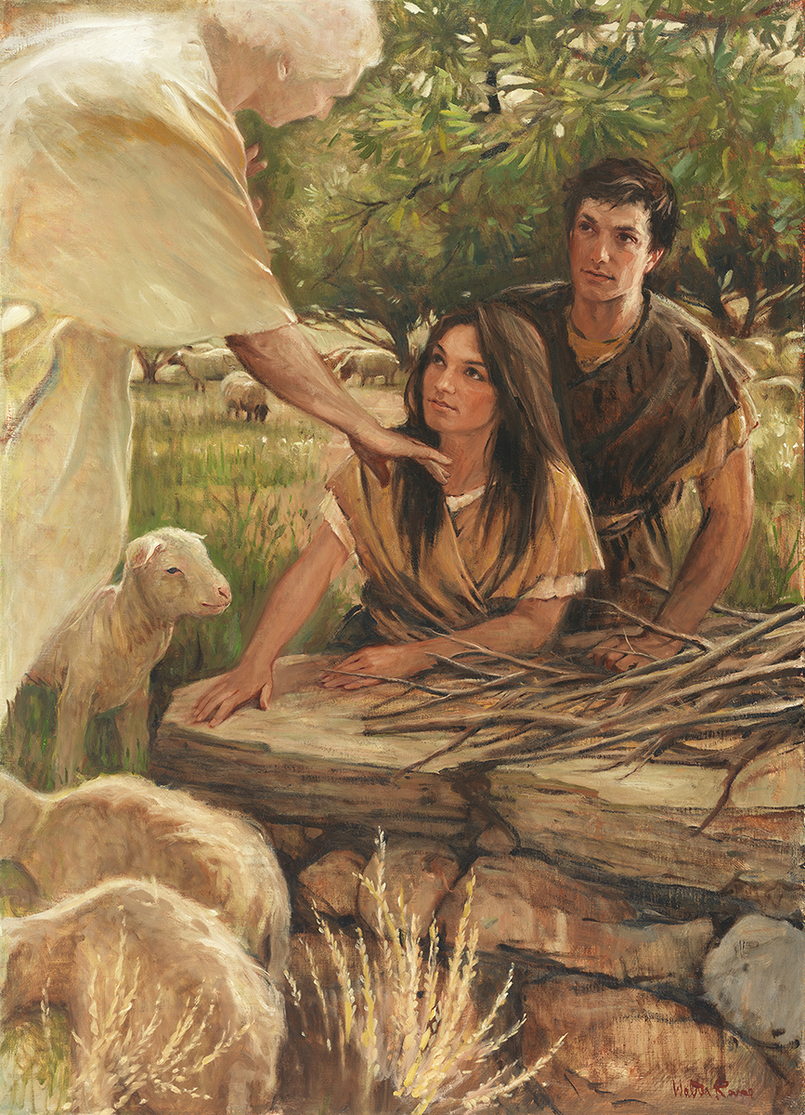
SEMINARY
Old Testament

Slide 2
LESSON 50
Exodus 14-15

Slide 3
LESSON 50
Exodus 14:1-14
“The Egyptian army pursues
the Israelites”

Slide 4
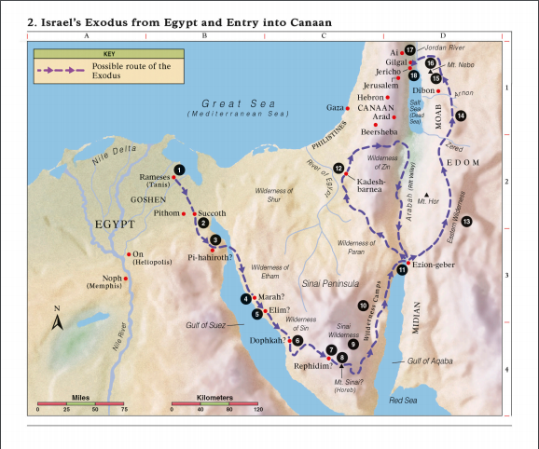
LESSON 50

Slide 5
LESSON 50
Exodus 14:1-2
1 And the Lord spake unto Moses, saying,
2 Speak unto the children of Israel, that they turn and encamp before Pi-hahiroth, between Migdol and the sea, over against Baal-zephon: before it shall ye encamp by the sea.
What do you notice about the way the Lord led the children of Israel?
Exodus 14:3-4
3 For Pharaoh will say of the children of Israel, They are entangled in the land, the wilderness hath shut them in.
4 And I will harden Pharaoh’s heart, that he shall follow after them; and I will be honoured upon Pharaoh, and upon all his host; that the Egyptians may know that I am the Lord. And they did so.

Slide 6
LESSON 50
Exodus 14:5-9
5 ¶ And it was told the king of Egypt that the people fled: and the heart of Pharaoh and of his servants was turned against the people, and they said, Why have we done this, that we have let Israel go from serving us?
6 And he made ready his chariot, and took his people with him:
7 And he took six hundred chosen chariots, and all the chariots of Egypt, and captains over every one of them.
8 And the Lord hardened the heart of Pharaoh king of Egypt, and he pursued after the children of Israel: and the children of Israel went out with an high hand.
9 But the Egyptians pursued after them, all the horses and chariots of Pharaoh, and his horsemen, and his army, and overtook them encamping by the sea, beside Pi-hahiroth, before Baal-zephon.
How might you have reacted if you had seen Pharaoh’s army coming after you and your family while you were trapped against the sea?

Slide 7

LESSON 50
“The children of Israel [were in a] horrible predicament. … There were chariots behind them, sand dunes on every side, and just a lot of water immediately ahead. … In this case it was literally a matter of life and death” (Jeffrey R. Holland, “Cast Not Away Therefore Your Confidence” [Brigham Young University devotional, Mar. 2, 1999], 4, speeches.byu.edu).
Elder
Jeffrey R. Holland
Exodus 14:10-12
10 ¶ And when Pharaoh drew nigh, the children of Israel lifted up their eyes, and, behold, the Egyptians marched after them; and they were sore afraid: and the children of Israel cried out unto the Lord.
11 And they said unto Moses, Because there were no graves in Egypt, hast thou taken us away to die in the wilderness? wherefore hast thou dealt thus with us, to carry us forth out of Egypt?
12 Is not this the word that we did tell thee in Egypt, saying, Let us alone, that we may serve the Egyptians? For it had been better for us to serve the Egyptians, than that we should die in the wilderness.
How would you describe the people’s attitude toward Moses?

Slide 8
LESSON 50
Exodus 14:13-14
13 ¶ And Moses said unto the people, Fear ye not, stand still, and see the salvation of the Lord, which he will shew to you to day: for the Egyptians whom ye have seen to day, ye shall see them again no more for ever.
14 The Lord shall fight for you, and ye shall hold your peace.
What do you think Moses meant when he said, “Stand still, and see the salvation of the Lord, … for the Egyptians whom ye have seen to day, ye shall see them again no more for ever”?
What do you think it means that “the Lord shall fight for you”?

Slide 9
LESSON 50
Exodus 14:15-31
“The children of Israel pass through the Red Sea, and the Egyptian army is drowned”

Slide 10
LESSON 50
Exodus 14:15-18
15 ¶ And the Lord said unto Moses, Wherefore criest thou unto me? speak unto the children of Israel, that they go forward:
16 But lift thou up thy rod, and stretch out thine hand over the sea, and divide it: and the children of Israel shall go on dry ground through the midst of the sea.
17 And I, behold, I will harden the hearts of the Egyptians, and they shall follow them: and I will get me honour upon Pharaoh, and upon all his host, upon his chariots, and upon his horsemen.
18 And the Egyptians shall know that I am the Lord, when I have gotten me honour upon Pharaoh, upon his chariots, and upon his horsemen.
What did the Lord command Moses to tell the people?
What did the Lord tell Moses to do?

Slide 11
LESSON 50
Exodus 14:19-20
, 21-29
19 ¶ And the angel of God, which went before the camp of Israel, removed and went behind them; and the pillar of the cloud went from before their face, and stood behind them:
20 And it came between the camp of the Egyptians and the camp of Israel; and it was a cloud and darkness to them, but it gave light by night to these: so that the one came not near the other all the night.
21 And Moses stretched out his hand over the sea; and the Lord caused the sea to go back by a strong east wind all that night, and made the sea dry land, and the waters were divided.
22 And the children of Israel went into the midst of the sea upon the dry ground: and the waters were a wall unto them on their right hand, and on their left.
23 ¶ And the Egyptians pursued, and went in after them to the midst of the sea, even all Pharaoh’s horses, his chariots, and his horsemen.
24 And it came to pass, that in the morning watch the Lord looked unto the host of the Egyptians through the pillar of fire and of the cloud, and troubled the host of the Egyptians,
25 And took off their chariot wheels, that they drave them heavily: so that the Egyptians said, Let us flee from the face of Israel; for the Lord fighteth for them against the Egyptians.
26 ¶ And the Lord said unto Moses, Stretch out thine hand over the sea, that the waters may come again upon the Egyptians, upon their chariots, and upon their horsemen.
27 And Moses stretched forth his hand over the sea, and the sea returned to his strength when the morning appeared; and the Egyptians fled against it; and the Lord overthrew the Egyptians in the midst of the sea.
28 And the waters returned, and covered the chariots, and the horsemen, and all the host of Pharaoh that came into the sea after them; there remained not so much as one of them.
29 But the children of Israel walked upon dry land in the midst of the sea; and the waters were a wall unto them on their right hand, and on their left.

Slide 12
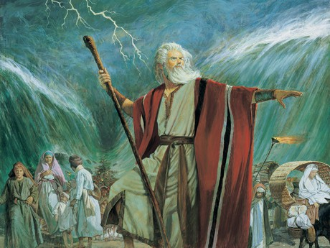
LESSON 50
What did the Israelites have to do to be saved from the Egyptians?
What principle can the Israelites’ situation teach us about the relationship between exercising faith and receiving the Lord’s help in overcoming our challenges?
as we exercise faith by doing what the Lord commands, He will provide a way for us to overcome our challenges.
What are some of the challenges or hardships that surround us today?
When have you exercised faith in the Lord or seen or read about someone else exercising faith in the Lord? How did the Lord provide a way for this person to overcome his or her challenge?

Slide 13
LESSON 50
Exodus 14:30-31
30 Thus the Lord saved Israel that day out of the hand of the Egyptians; and Israel saw the Egyptians dead upon the sea shore.
31 And Israel saw that great work which the Lord did upon the Egyptians: and the people feared the Lord, and believed the Lord, and his servant Moses.
What happened to the Israelites because they recognized the works of the Lord?
What blessing may we receive as we seek to recognize the works of the Lord in our lives?
Recognizing the works of the Lord in our lives can help increase our trust and faith in Him.
What do you think you could do to recognize the Lord’s hand in your life more often?
When have you recognized the Lord’s power in your life and as a result felt your faith and trust in Him increase?

Slide 14
LESSON 50
Exodus 15
“Israel praises the Lord and the Lord inspires Moses to heal the waters of Marah”

Slide 15
LESSON 50
What will you choose to bring and why?
Exodus 15:24
And the people murmured against Moses, saying, What shall we drink?
What could the Israelites have done instead of murmuring?

Slide 16
LESSON 50
Exodus 15:25-27
25 And he cried unto the Lord; and the Lord shewed him a tree, which when he had cast into the waters, the waters were made sweet: there he made for them a statute and an ordinance, and there he proved them,
26 And said, If thou wilt diligently hearken to the voice of the Lord thy God, and wilt do that which is right in his sight, and wilt give ear to his commandments, and keep all his statutes, I will put none of these diseases upon thee, which I have brought upon the Egyptians: for I am the Lord that healeth thee.
27 ¶ And they came to Elim, where were twelve wells of water, and threescore and ten palm trees: and they encamped there by the waters.
What are the differences between how Moses responded to the situation and how the people responded to it?
What principle can we learn from this account?
If we seek the Lord’s guidance through prayer when facing difficulties, He can inspire us to know how to proceed.
When has the Lord inspired you as you have sought His guidance in a difficult matter?

