Slide 1
SEMINARY
Old Testament

Slide 2
LESSON 48
Exodus 7–11

Slide 3
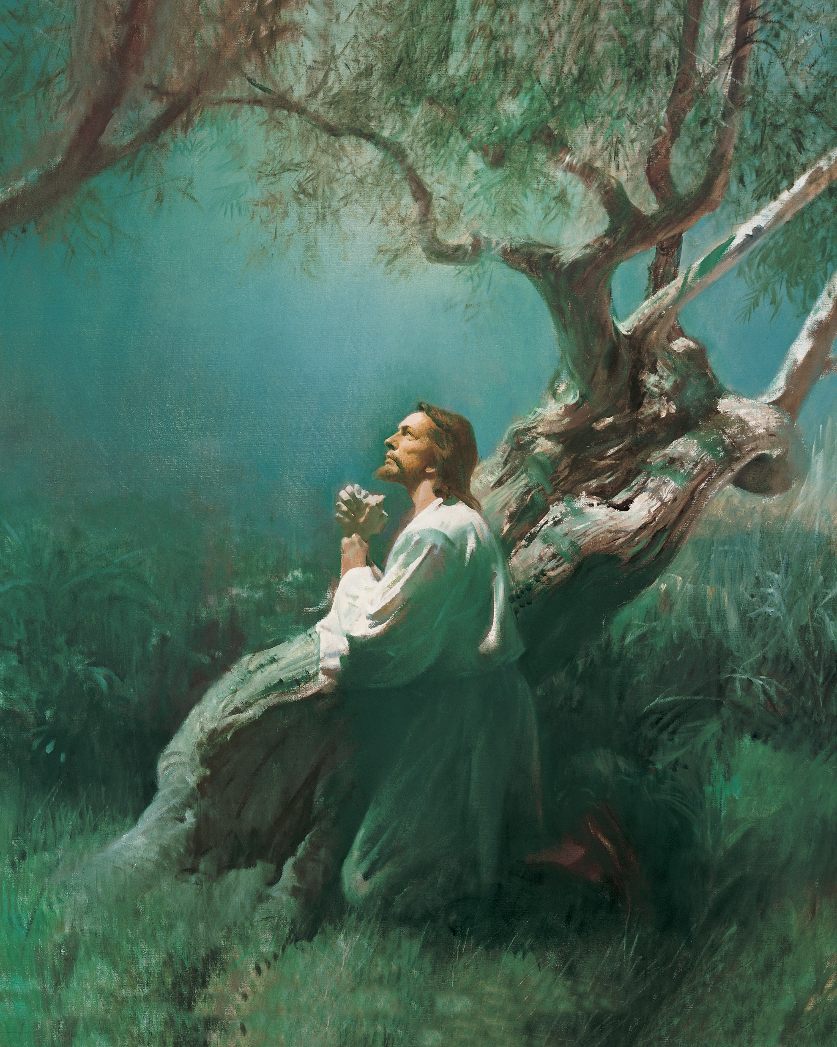
LESSON 48
The Atonement of Jesus Christ
Doctrine Mastery Paragraph 3.4
As part of His Atonement, Jesus Christ not only suffered for our sins, but He also took upon Himself the pains, temptations, sicknesses, and infirmities of all mankind (see Isaiah 53:3–5; Alma 7:11–13). He understands our suffering because He has experienced it. As we come to Him in faith, the Savior will strengthen us to bear our burdens and accomplish tasks that we could not do on our own (see Matthew 11:28–30; Ether 12:27).

Slide 4
LESSON 48
Exodus 7:1-13
“God sends Moses and Aaron to free the children of Israel from bondage”

Slide 5
LESSON 48
Pharaoh said he was willing to let the children of Israel go free because he respected the Lord’s power. (See Exodus 5:1–2.)
After Moses and Aaron asked Pharaoh to let the children of Israel go, the Israelites were eager to listen to Moses and follow his leadership. (See Exodus 5:19–21.)
Moses was confident in his abilities and excited about his responsibility to free the children of Israel from bondage. (See Exodus 3:11.)
Moses was “slow of speech” and wondered why the Lord had sent him to free the children of Israel. (See Exodus 4:10; 5:22–23; 6:12, 30.)
What might have been difficult about the Lord’s command to Moses and Aaron? Why?

Slide 6
LESSON 48
Exodus 7:6
And Moses and Aaron did as the Lord commanded them, so did they.
What impresses you about how they chose to act in faith?
Exodus 7:7-8
7 And Moses was fourscore years old, and Aaron fourscore and three years old, when they spake unto Pharaoh.
8 ¶ And the Lord spake unto Moses and unto Aaron, saying,
How do you think you might have responded if you had been in Pharaoh’s position and had just seen Aaron’s rod turn into a serpent?

Slide 7
LESSON 48
Exodus 7:11-12
11 Then Pharaoh also called the wise men and the sorcerers: now the magicians of Egypt, they also did in like manner with their enchantments.
12 For they cast down every man his rod, and they became serpents: but Aaron’s rod swallowed up their rods.
The “magicians of Pharaoh’s court had power given them from Satan to duplicate many of the miracles wrought by Moses” (Bruce R. McConkie, Mormon Doctrine, 2nd ed. [1966], 462).
What can we learn from Aaron’s rod swallowing the rods of the magicians?
The Lord’s power is greater than the power of mankind, the devil, and the false gods mankind worships.

Slide 8
LESSON 48
Exodus 7:13
And he hardened Pharaoh’s heart, that he hearkened not unto them; as the Lord had said.
Why do you think it is important to know that Pharaoh, not the Lord, hardened Pharaoh’s heart?

Slide 9
LESSON 48
“The Lord sends 10 plagues
upon Egypt”

Slide 10
LESSON 48
Exodus 5:2
And Pharaoh said, Who is the Lord, that I should obey his voice to let Israel go? I know not the Lord, neither will I let Israel go.
The 10 Plagues
Exodus 7:14–25
Exodus 9:8–12
Exodus 8:1–15
Exodus 9:13–35
Exodus 8:16–19
Exodus 10:1–20
Exodus 8:20–32
Exodus 10:21–29
Exodus 9:1–7
Exodus 11:4–10; 12:29–33

Slide 11
LESSON 48
How did these 10 plagues show God’s power over mankind, the devil, and the false gods that mankind worships?
How might understanding that God is more powerful than man and the devil help strengthen your faith in God?
When have you or someone you know seen that God’s power is greater than any other power?
How did Pharaoh respond to each of the plagues?
if we refuse to soften our hearts and do not repent of our sins, then we will bring negative consequences upon ourselves and others.
What are some negative consequences that could result from a person’s decision to harden his or her heart and not repent?

Slide 12
LESSON 48
What are some ways that a person could soften his or her heart?
How might we be blessed by choosing to repent and follow the Lord sooner rather than later?
“If you have sinned, the sooner you repent, the sooner you begin to make your way back and find the peace and joy that come with forgiveness. If you delay repentance, you may lose blessings, opportunities, and spiritual guidance. You may also become further entangled in sinful behavior, making it more difficult to find your way back” (For the Strength of Youth[booklet, 2011], 28).

Slide 13
LESSON 48
When have you experienced a softening of your heart? What did you learn about the Lord through this experience?
2. If you feel that you need to soften your heart in some way, what is something you could do to begin that process?

