Slide 1
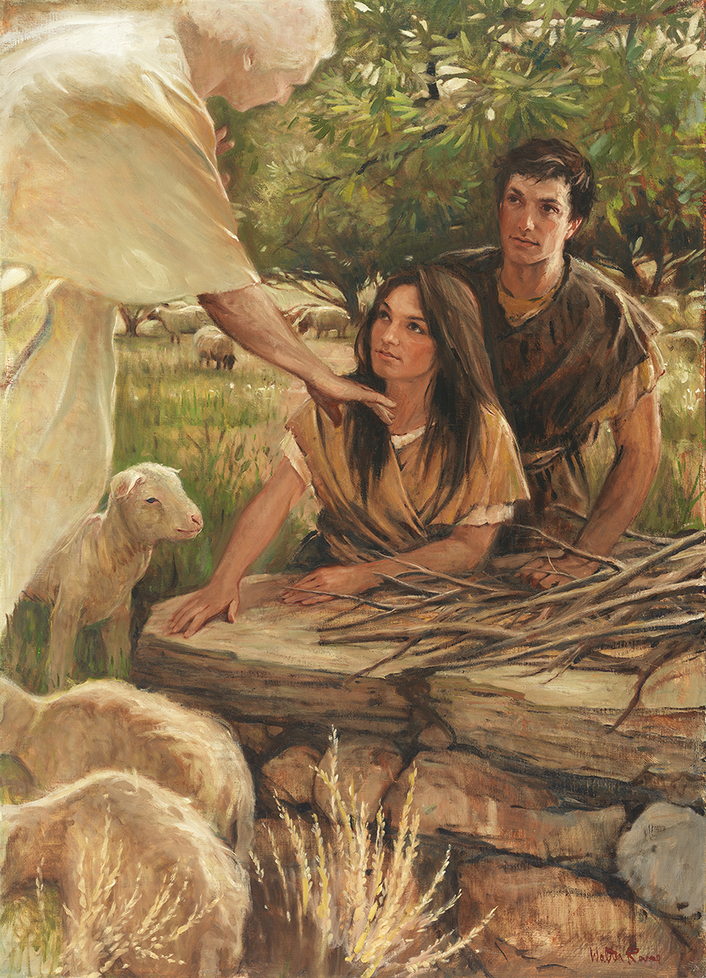
SEMINARY
Old Testament

Slide 2
LESSON 46
Exodus 5–6

Slide 3
LESSON 46
Exodus 5
“Pharaoh responds to Moses and Aaron’s command to free Israel by increasing the Israelites’ burdens”

Slide 4
LESSON 46
Exodus 5:1-2
1 And afterward Moses and Aaron went in, and told Pharaoh, Thus saith the Lord God of Israel, Let my people go, that they may hold a feast unto me in the wilderness.
2 And Pharaoh said, Who is the Lord, that I should obey his voice to let Israel go? I know not the Lord, neither will I let Israel go.
What was the result of their visit with Pharaoh?
What does Pharaoh’s response tell us about him?

Slide 5
What may we experience even when we are following the Lord’s commands?
LESSON 46
Exodus 5:3-9
3 And they said, The God of the Hebrews hath met with us: let us go, we pray thee, three days’ journey into the desert, and sacrifice unto the Lord our God; lest he fall upon us with pestilence, or with the sword.
4 And the king of Egypt said unto them, Wherefore do ye, Moses and Aaron, let the people from their works? get you unto your burdens.
5 And Pharaoh said, Behold, the people of the land now are many, and ye make them rest from their burdens.
6 And Pharaoh commanded the same day the taskmasters of the people, and their officers, saying,
7 Ye shall no more give the people straw to make brick, as heretofore: let them go and gather straw for themselves.
8 And the tale of the bricks, which they did make heretofore, ye shall lay upon them; ye shall not diminish ought thereof: for they be idle; therefore they cry, saying, Let us go and sacrifice to our God.
9 Let there more work be laid upon the men, that they may labour therein; and let them not regard vain words.
What happened after Moses and Aaron asked Pharaoh to let the Israelites go?
Even when we are following the Lord’s commands, we may experience opposition.
Why do you think we may experience opposition even when we are following the Lord’s commands?

Slide 6
LESSON 46
Exodus 5:20-21
20 ¶ And they met Moses and Aaron, who stood in the way, as they came forth from Pharaoh:
21 And they said unto them, The Lord look upon you, and judge; because ye have made our savour to be abhorred in the eyes of Pharaoh, and in the eyes of his servants, to put a sword in their hand to slay us.
How did the Israelite officers respond to Moses?
How might you feel at this moment?
What questions might you have for the Lord?

Slide 7
LESSON 46
Exodus 5:22-23
22 And Moses returned unto the Lord, and said, Lord, wherefore hast thou so evil entreated this people? why is it that thou hast sent me?
23 For since I came to Pharaoh to speak in thy name, he hath done evil to this people; neither hast thou delivered thy people at all.
What did Moses ask the Lord?

Slide 8
LESSON 46
Exodus 6:1-13
“The Lord declares that He will fulfill His covenants and deliver Israel out of Egypt”

Slide 9
LESSON 46
Why do you think the Lord doesn’t immediately solve all of our difficulties, even when we are being obedient?
Exodus 6:1-5
1 Then the Lord said unto Moses, Now shalt thou see what I will do to Pharaoh: for with a strong hand shall he let them go, and with a strong hand shall he drive them out of his land.
2 And God spake unto Moses, and said unto him, I am the Lord:
3 And I appeared unto Abraham, unto Isaac, and unto Jacob, by the name of God Almighty, but by my name JEHOVAH was I not known to them.
4 And I have also established my covenant with them, to give them the land of Canaan, the land of their pilgrimage, wherein they were strangers.
5 And I have also heard the groaning of the children of Israel, whom the Egyptians keep in bondage; and I have remembered my covenant.
What did the Lord say in verse 1 that might have been reassuring to Moses?
What do you think it means that the Lord would use a “strong hand”?
Why would the Lord deliver Israel?

Slide 10
LESSON 46
The Lord remembers and fulfills His covenants.
How might having faith that the Lord remembers and fulfills His covenants have helped Moses and the Israelites at this difficult time?
I will …

Slide 11
LESSON 46
Exodus 6:6-8
6 Wherefore say unto the children of Israel, I am the Lord, and I will bring you out from under the burdens of the Egyptians, and I will rid you out of their bondage, and I will redeem you with a stretched out arm, and with great judgments:
7 And I will take you to me for a people, and I will be to you a God: and ye shall know that I am the Lord your God, which bringeth you out from under the burdens of the Egyptians.
8 And I will bring you in unto the land, concerning the which I did swear to give it to Abraham, to Isaac, and to Jacob; and I will give it you for an heritage: I am the Lord.
What did the Lord say He would do for the children of Israel?
If you had been in the Israelites’ position, which “I will” statement might have been most meaningful to you?
What truth do you see in verse 6 that can apply to us as well as the ancient Israelites?
The Lord has power to redeem us from bondage and to lighten or remove our burdens.
What are some things that can put us in bondage?
What types of burdens can the Savior lighten or remove from our lives?

Slide 12
LESSON 46
Exodus 6:7
And I will take you to me for a people, and I will be to you a God: and ye shall know that I am the Lord your God, which bringeth you out from under the burdens of the Egyptians.
What would the children of Israel come to know as the Lord delivered them from their difficulties?
What truth can we learn from the Lord’s promise in verse 7?
As we experience the Lord’s help during our difficulties, we can come to know Him.
How can being delivered by the Lord help us come to know Him?

Slide 13
LESSON 46
Exodus 6:9
¶ And Moses spake so unto the children of Israel: but they hearkened not unto Moses for anguish of spirit, and for cruel bondage.
How did the children of Israel respond to Moses’s message?
Why do you think they reacted that way? What might have caused them to have “anguish of spirit”?
Exodus 6:10-12
10 And the Lord spake unto Moses, saying,
11 Go in, speak unto Pharaoh king of Egypt, that he let the children of Israel go out of his land.
12 And Moses spake before the Lord, saying, Behold, the children of Israel have not hearkened unto me; how then shall Pharaoh hear me, who am of uncircumcised lips?
Why do you think Moses was concerned about doing what the Lord asked?

Slide 14
LESSON 46
Exodus 6:13
And the Lord spake unto Moses and unto Aaron, and gave them a charge unto the children of Israel, and unto Pharaoh king of Egypt, to bring the children of Israel out of the land of Egypt.
How did the Lord respond?
How did the Lord respond?

Slide 15
LESSON 46
Exodus 6:14-30
“The genealogy of Reuben, Simeon,
and Levi is explained”

