Slide 1
SEMINARY
Old Testament

Slide 2
LESSON 44
Genesis 50

Slide 3
LESSON 44
Genesis 50:1-14
“Jacob dies and is buried in Canaan”

Slide 4
LESSON 44
What are examples of events that could help bring a family closer together?
What are examples of events that might divide a family?
Genesis 50:1-2, 12-13
1 And Joseph fell upon his father’s face, and wept upon him, and kissed him.
2 And Joseph commanded his servants the physicians to embalm his father: and the physicians embalmed Israel.
12 And his sons did unto him according as he commanded them:
13 For his sons carried him into the land of Canaan, and buried him in the cave of the field of Machpelah, which Abraham bought with the field for a possession of a burying place of Ephron the Hittite, before Mamre.
How did Joseph respond to the death of his father?
What did Jacob’s sons do for him after he died?
How might Jacob’s death have helped to bring his family closer together? How might it have divided his family?

Slide 5
LESSON 44
Genesis 50:15-21
“Joseph comforts and shows mercy
toward his brothers”

Slide 6
LESSON 44
Genesis 50:15-18
15 ¶ And when Joseph’s brethren saw that their father was dead, they said, Joseph will peradventure hate us, and will certainly requite us all the evil which we did unto him.
16 And they sent a messenger unto Joseph, saying, Thy father did command before he died, saying,
17 So shall ye say unto Joseph, Forgive, I pray thee now, the trespass of thy brethren, and their sin; for they did unto thee evil: and now, we pray thee, forgive the trespass of the servants of the God of thy father. And Joseph wept when they spake unto him.
18 And his brethren also went and fell down before his face; and they said, Behold, we be thy servants.
What were Joseph’s brothers concerned about?
What were Joseph’s brothers concerned about?

Slide 7
LESSON 44
Genesis 50:19-21
19 And Joseph said unto them, Fear not: for am I in the place of God?
20 But as for you, ye thought evil against me; but God meant it unto good, to bring to pass, as it is this day, to save much people alive.
21 Now therefore fear ye not: I will nourish you, and your little ones. And he comforted them, and spake kindly unto them.
How did Joseph respond to his brothers?
What stands out to you about his response?
What do you think Joseph meant when he said, “Am I in the place of God?”
If you were in the position of Joseph’s brothers, how might you have felt after hearing his response?
What principles can we identify from Joseph’s response to his brothers?
When others sin against us, we should leave judgment to God. If we let go of past offenses, we can bring peace to ourselves and our families.

Slide 8
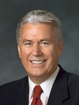
LESSON 44
“I have discovered one thing that most [happy families] have in common: they have a way of forgiving and forgetting the imperfections of others and of looking for the good.
“Those in unhappy families, on the other hand, often find fault, hold grudges, and can’t seem to let go of past offenses. …
“It is through our Savior’s sacrifice that we can gain exaltation and eternal life. As we accept His ways and overcome our pride by softening our hearts, we can bring reconciliation and forgiveness into our families and our personal lives. God will help us to be more forgiving, to be more willing to walk the second mile, to be first to apologize even if something wasn’t our fault, to lay aside old grudges and nurture them no more” (Dieter F. Uchtdorf, “One Key to a Happy Family,” Ensign or Liahona, Oct. 2012, 5-6).
What did President Uchtdorf say could help us live in peace with our families?

Slide 9
LESSON 44
Genesis 50:22-26;
Joseph Smith Translation, Genesis 50:24-38
“Joseph prophesies of Joseph Smith and the
Restoration of the gospel”

Slide 10
LESSON 44
Do you think it is possible to die with joy?
Why or why not?
Genesis 50:22
¶ And Joseph dwelt in Egypt, he, and his father’s house: and Joseph lived an hundred and ten years.
Joseph Smith Translation, Genesis 50:24
And Joseph said unto his brethren, I die, and go unto my fathers; and I go down to my grave with joy. The God of my father Jacob be with you, to deliver you out of affliction in the days of your bondage; for the Lord hath visited me, and I have obtained a promise of the Lord, that out of the fruit of my loins, the Lord God will raise up a righteous branch out of my loins; and unto thee, whom my father Jacob hath named Israel, a prophet; (not the Messiah who is called Shilo;) and this prophet shall deliver my people out of Egypt in the days of thy bondage.
Why do you think he said he would die with joy?

Slide 11
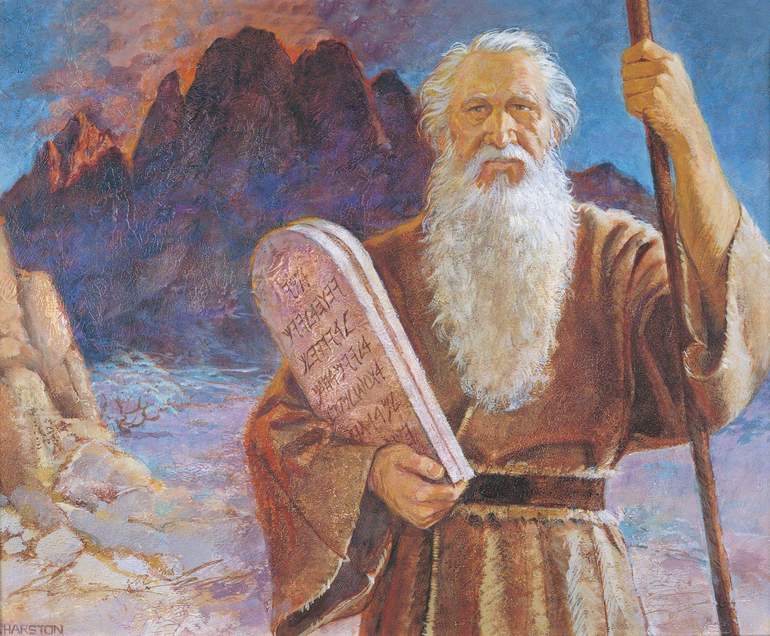
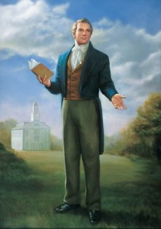
LESSON 44
What group of people do you think this could be referring to?

Slide 12
LESSON 44
Joseph Smith Translation, Genesis 50:25
And it shall come to pass that they shall be scattered again; and a branch shall be broken off, and shall be carried into a far country; nevertheless they shall be remembered in the covenants of the Lord, when the Messiah cometh; for he shall be made manifest unto them in the latter days, in the Spirit of power; and shall bring them out of darkness into light; out of hidden darkness, and out of captivity unto freedom.
What promises did the Lord make concerning these descendants of Joseph?
Joseph Smith Translation, Genesis 50:26-27
26 A seer shall the Lord my God raise up, who shall be a choice seer unto the fruit of my loins.
27 Thus saith the Lord God of my fathers unto me, A choice seer will I raise up out of the fruit of thy loins, and he shall be esteemed highly among the fruit of thy loins; and unto him will I give commandment that he shall do a work for the fruit of thy loins, his brethren.
A seer is “a person authorized of God to see with spiritual eyes things that God has hidden from the world (Moses 6:35–38). He is a revelator and a prophet (Mosiah 8:13–16)”
What do you think the description of the Prophet Joseph Smith being “a choice seer” means?

Slide 13
What is the “work” the Lord gave Joseph Smith to do?
LESSON 44
Joseph Smith Translation, Genesis 50:28-29, 32-33
28 And he shall bring them to the knowledge of the covenants which I have made with thy fathers; and he shall do whatsoever work I shall command him.
29 And I will make him great in mine eyes, for he shall do my work; and he shall be great like unto him whom I have said I would raise up unto you, to deliver my people, O house of Israel, out of the land of Egypt; for a seer will I raise up to deliver my people out of the land of Egypt; and he shall be called Moses. And by this name he shall know that he is of thy house; for he shall be nursed by the king’s daughter, and shall be called her son.
32 And out of weakness shall he be made strong, in that day when my work shall go forth among all my people, which shall restore them, who are of the house of Israel, in the last days.
33 And that seer will I bless, and they that seek to destroy him shall be confounded; for this promise I give unto you; for I will remember you from generation to generation; and his name shall be called Joseph, and it shall be after the name of his father; and he shall be like unto you; for the thing which the Lord shall bring forth by his hand shall bring my people unto salvation.
What covenants would Joseph Smith bring to our knowledge?
Through the Prophet Joseph Smith, the Lord restored His gospel to the earth.

Slide 14
LESSON 44
Joseph Smith Translation, Genesis 50:30-31
30 And again, a seer will I raise up out of the fruit of thy loins, and unto him will I give power to bring forth my word unto the seed of thy loins; and not to the bringing forth of my word only, saith the Lord, but to the convincing them of my word, which shall have already gone forth among them in the last days;
31 Wherefore the fruit of thy loins shall write, and the fruit of the loins of Judah shall write; and that which shall be written by the fruit of thy loins, and also that which shall be written by the fruit of the loins of Judah, shall grow together unto the confounding of false doctrines, and laying down of contentions, and establishing peace among the fruit of thy loins, and bringing them to a knowledge of their fathers in the latter days; and also to the knowledge of my covenants, saith the Lord.
What words of God did the Lord give the Prophet Joseph Smith power to bring forth?
What do you think these two records are?
What did the Lord say would happen to these two records?
What impact will they have on the world?

Slide 15
LESSON 44
The Book of Mormon and Bible bring peace, truth, and a knowledge of the gospel of Jesus Christ to the world.
What knowledge has the Book of Mormon given to the world?
How have the Book of Mormon and the Bible helped you draw closer to your Savior, Jesus Christ, and His gospel?
Joseph Smith Translation, Genesis 50:27
Thus saith the Lord God of my fathers unto me, A choice seer will I raise up out of the fruit of thy loins, and he shall be esteemed highly among the fruit of thy loins; and unto him will I give commandment that he shall do a work for the fruit of thy loins, his brethren.
What do you think this phrase means?
What do you respect or admire about the Prophet Joseph Smith?
In what ways has your life been blessed because the Lord restored the gospel of Jesus Christ through Joseph Smith?

