Slide 1
SEMINARY
Old Testament

Slide 2
LESSON 43
The Atonement of Jesus Christ
(Part 1)

Slide 3
LESSON 43
Segment 1 (15 minutes)

Slide 4
LESSON 43
The Atonement of Jesus Christ
Doctrine Mastery Paragraph 3.1
Jesus Christ was foreordained in the premortal council to be our Savior and Redeemer. He came to earth and willingly suffered and died to redeem all mankind from the negative effects of the Fall and to pay the penalty for our sins. Jesus Christ’s triumph over spiritual and physical death by His suffering, death, and Resurrection is called the Atonement. His sacrifice benefits each of us and demonstrates the infinite worth of each and every one of Heavenly Father’s children (see D&C 18:10–11).
When was Jesus Christ chosen to be our Savior and Redeemer?
What does the Savior’s sacrifice teach us about our eternal value?

Slide 5
LESSON 43
The Atonement of Jesus Christ
Doctrine Mastery Paragraph 3.2
It is only through Jesus Christ that we can be saved because He was the only one capable of making an infinite and eternal Atonement for all mankind (see Alma 34:9–10). Only He had the power to overcome physical death. From His mortal mother, Mary, He inherited the ability to die. From God, His immortal Father, He inherited the power to live forever or to lay down His life and to take it up again. He alone could redeem us from our sins. Because He lived a perfect, sinless life, He was free from the demands of justice and could pay the debt for those who repent.
In what ways was Jesus Christ “the only one capable of making an infinite and eternal Atonement”?

Slide 6
LESSON 43
The Atonement of Jesus Christ
Doctrine Mastery Paragraph 3.3
The Atonement of Jesus Christ included His suffering for the sins of mankind in the Garden of Gethsemane, the shedding of His blood, His suffering and death on the cross, and His literal Resurrection. He was the first to be resurrected. He rose from the tomb with a glorified, immortal body of flesh and bone (see Luke 24:36–39). Because of His Atonement all mankind will be resurrected with perfect, immortal bodies and be brought back into God’s presence to be judged. Jesus Christ’s atoning sacrifice provided the only way for us to be cleansed and forgiven of our sins so that we can dwell in God’s presence eternally (see Isaiah 1:18; D&C 19:16–19).
What events are included in the Savior’s Atonement?
What did Jesus Christ make possible for us through His Atonement?

Slide 7
LESSON 43
The Atonement of Jesus Christ
Doctrine Mastery Paragraph 3.4
As part of His Atonement, Jesus Christ not only suffered for our sins, but He also took upon Himself the pains, temptations, sicknesses, and infirmities of all mankind (see Isaiah 53:3–5; Alma 7:11–13). He understands our suffering because He has experienced it. As we come to Him in faith, the Savior will strengthen us to bear our burdens and accomplish tasks that we could not do on our own (see Matthew 11:28–30; Ether 12:27).
What else did Jesus Christ do for us while making His atoning sacrifice?

Slide 8
LESSON 43
The Atonement of Jesus Christ
Doctrine Mastery Paragraph 3.5
In paying the penalty for our sins, Jesus Christ did not eliminate our personal responsibility. In order to accept His sacrifice, be cleansed from our sins, and inherit eternal life, we must exercise faith in Him, repent, be baptized, receive the Holy Ghost, and endure faithfully to the end of our lives.
What must we do for the Atonement of Jesus Christ to fully take effect in our lives?

Slide 9
LESSON 43
Faith in Jesus Christ
Doctrine Mastery Paragraph 3.6-7
3.6. The first principle of the gospel is faith in the Lord Jesus Christ. Our faith can lead to salvation only when it is centered in Jesus Christ (see Helaman 5:12).
3.7. Having faith in Jesus Christ includes having a firm belief that He is the Only Begotten Son of God and the Savior of the world. We recognize that the only way we can return to live with our Heavenly Father is by relying on His Son’s infinite Atonement and by trusting Jesus Christ and following His teachings. More than passive belief, true faith in Jesus Christ leads to action and is expressed by the way we live (see James 2:17–18). Our faith can increase as we pray, study the scriptures, and obey God’s commandments.
In addition to believing in Jesus Christ, how can we express true faith in Him?

Slide 10
What does it mean to repent?
LESSON 43
Repentance
Doctrine Mastery Paragraph 3.8-9
3.8. Faith in Jesus Christ and our love for Him and Heavenly Father lead us to repent. Repentance is part of Heavenly Father’s plan for all of His children who are accountable for their choices. This gift is made possible through the Atonement of Jesus Christ. Repentance is a change of mind and heart. It includes turning away from sin and turning our thoughts, actions, and desires toward God and aligning our will with His (see Mosiah 3:19).
3.9. Repentance includes recognizing our sins; feeling remorse, or godly sorrow, for committing sin; confessing our sins to Heavenly Father and, if necessary, to others; forsaking sin; seeking to restore, as far as possible, all that has been damaged as a result of our sins; and living a life of obedience to God’s commandments (see D&C 58:42–43). The Lord promises to forgive us of our sins at baptism, and we renew that covenant each time we sincerely partake of the sacrament with the intent of remembering the Savior and keeping His commandments.
What does it mean to repent?

Slide 11
LESSON 43
Repentance
Doctrine Mastery Paragraph 3.10
Through sincere repentance and the grace offered through Jesus Christ’s Atonement, we can receive God’s forgiveness and feel peace. We feel the influence of the Spirit in greater abundance, and we are more prepared to live eternally with our Heavenly Father and His Son.
What are some of the promised blessings we can receive as we sincerely repent of our sins?

Slide 12
LESSON 43
Segment 2 (5 minutes)

Slide 13
LESSON 43
Jesus Christ’s atoning sacrifice provided the only way for us to be cleansed and forgiven of our sins so that we can dwell in God’s presence eternally.
“As descendants of Adam and Eve, all people inherit the effects of the Fall. In our fallen state, we are subject to opposition and temptation. When we give in to temptation, we are alienated from God, and if we continue in sin, we experience spiritual death, being separated from His presence. We are all subject to temporal death, which is the death of the physical body (see Alma 42:6–9; D&C 29:41-42).
“The only way for us to be saved is for someone else to rescue us. We need someone who can satisfy the demands of justice-standing in our place to assume the burden of the Fall and to pay the price for our sins. Jesus Christ has always been the only one capable of making such a sacrifice” (“Atonement of Jesus Christ,” Gospel Topics, topics.lds.org).
Why is Jesus Christ’s atoning sacrifice necessary in order for us to return and dwell with Heavenly Father eternally?

Slide 14
LESSON 43
Segment 3 (15 minutes)

Slide 15
LESSON 43
Jesus Christ’s atoning sacrifice provided the only way for us to be cleansed and forgiven of our sins so that we can dwell in God’s presence eternally.
Isaiah 1:18
Come now, and let us reason together, saith the Lord: though your sins be as scarlet, they shall be as white as snow; though they be red like crimson, they shall be as wool.
What symbols did the Lord use to describe the people’s sins?

Slide 16
LESSON 43
Why do you think scarlet and crimson can be symbolic of sin?

Slide 17
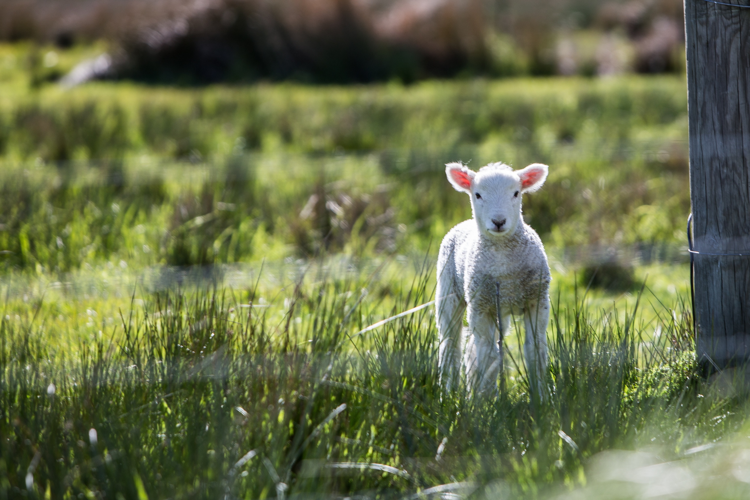
LESSON 43

Slide 18
LESSON 43
In what ways are snow and wool good symbols of what will happen to our sins if we repent?
What are some reasons why people may not want to repent or think they cannot repent of their sins?
How could understanding the truths and symbolism taught in Isaiah 1:18 help someone who has one of these concerns?

Slide 19
LESSON 43
Segment 4 (10 minutes)

Slide 20
LESSON 43
Carol F. McConkie, former First Counselor in the Young Women General Presidency, said:
“Our hope for holiness is centered in Christ, in His mercy and His grace. With faith in Jesus Christ and His Atonement, we may become clean, without spot, when we deny ourselves of ungodliness [see Moroni 10:32–33] and sincerely repent. We are baptized by water for the remission of sins. Our souls are sanctified when we receive the Holy Ghost with open hearts. Weekly, we partake of the ordinance of the sacrament. In a spirit of repentance, with sincere desires for righteousness, we covenant that we are willing to take upon us the name of Christ, remember Him, and keep His commandments so that we may always have His Spirit to be with us. Over time, as we continually strive to become one with the Father, the Son, and the Holy Ghost, we become partakers of Their divine nature [see 2 Peter 1:4]” (Carol F. McConkie, “The Beauty of Holiness,” Ensign or Liahona, May 2017, 10).

Slide 21
LESSON 43
What must we do to be cleansed through the Savior’s atoning sacrifice?
In what ways do these things help us to be cleansed of our sins and become worthy to dwell in God’s presence eternally?

