Slide 1
SEMINARY
Old Testament

Slide 2
LESSON 5
“The Bible”

Slide 3
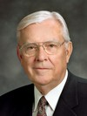
LESSON 5
Miracles
Why might you consider the Bible a miracle?
“My brothers and sisters, the Holy Bible is a miracle! It is a miracle that the Bible’s 4,000 years of sacred and secular history were recorded and preserved by the prophets, apostles, and inspired churchmen. …
“It is not by chance or coincidence that we have the Bible today” (M. Russell Ballard, “The Miracle of the Holy Bible, ”Ensign or Liahona, May 2007, 80).
Miracles
Elder
M. Russell Ballard
How is the Bible a miracle?
Its writings have been preserved for thousands of years.

Slide 4
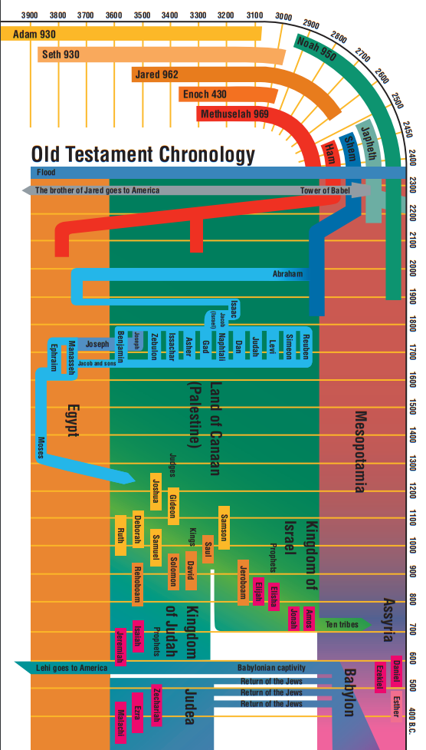
LESSON 5

Slide 5
LESSON 5
Moses 1:40
And now, Moses, my son, I will speak unto thee concerning this earth upon which thou standest; and thou shalt write the things which I shall speak.
How did Moses and other writers of the Bible know what to write?
President M. Russell Ballard Said:
We love the Bible and other scriptures. … [We believe] in the Bible as the revealed word of God”.

Slide 6
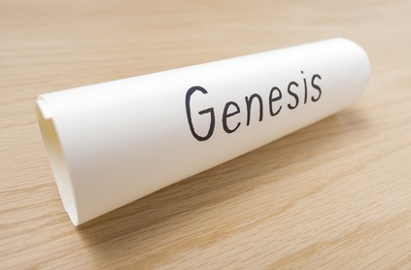
LESSON 5
The structure of the Old Testament
If you were in charge of compiling all of these scrolls into one book, how would you organize them?

Slide 7
LESSON 5
The Law | The History | The Poetry | The Prophets
(Genesis–Deuteronomy) | (Joshua–Esther) | (Job–Song of Solomon) | (Isaiah–Malachi)

Slide 8
LESSON 5
“Joseph Smith taught that ‘many important points touching the salvation of men, had been taken from the Bible, or lost before it was compiled.’ He also said that the Bible was correct as ‘it came from the pen of the original writers,’ but that ‘ignorant translators, careless transcribers, or designing and corrupt priests have committed many errors.’ (History of the Church, 1:245; 6:57.)” (Bible Dictionary, “Bible”).
We believe the Bible to be the word of God as far as it is translated correctly; we also believe the Book of Mormon to be the word of God.
Articles of Faith 1:8

Slide 9
LESSON 5
“Without the Bible, we would not know of His Church then, nor would we have the fulness of His gospel now. …
“. …Do not discount or devalue the Holy Bible. It is the sacred, holy record of the Lord’s life … [and] the bedrock of all Christianity” (M. Russell Ballard, “The Miracle of the Holy Bible,”81, 82).
Elder
M. Russell Ballard

Slide 10
LESSON 5
Why is the Bible of such great worth?

Slide 11
LESSON 5
Memorizing the books of the Old Testament

