Slide 1
SEMINARY
Old Testament

Slide 2
LESSON 40
Genesis 40-43

Slide 3
LESSON 40
Genesis 40-41
“The Lord helps Joseph
interpret dreams”

Slide 4
LESSON 40
What are some significant events in the future that you think the Lord wants you to prepare for?
What are some ways the Lord helps us prepare for future events?

Slide 5
LESSON 40
Narrator: Genesis 41:8
Butler: Genesis 41:9–13
Narrator: Genesis 41:14
Pharaoh: Genesis 41:15
Joseph: Genesis 41:16
Pharaoh: Genesis 41:17–24
Joseph: Genesis 41:25–36
Narrator: Genesis 41:37
Pharaoh: Genesis 41:38–41

Slide 6
LESSON 40
Genesis 41:53-57
53 ¶ And the seven years of plenteousness, that was in the land of Egypt, were ended.
54 And the seven years of dearth began to come, according as Joseph had said: and the dearth was in all lands; but in all the land of Egypt there was bread.
55 And when all the land of Egypt was famished, the people cried to Pharaoh for bread: and Pharaoh said unto all the Egyptians, Go unto Joseph; what he saith to you, do.
56 And the famine was over all the face of the earth: And Joseph opened all the storehouses, and sold unto the Egyptians; and the famine waxed sore in the land of Egypt.
57 And all countries came into Egypt to Joseph for to buy corn; because that the famine was so sore in all lands.
What was the result of Pharaoh’s decision to follow Joseph’s counsel?
What principle can we identify from this account?
If we follow the counsel of the prophets and inspired leaders, then we will be better prepared to face difficulties.

Slide 7
LESSON 40
In what ways have prophets in our day asked us to prepare for future spiritual or temporal challenges?
How have you or someone you know been blessed for following prophetic counsel to prepare for spiritual or temporal challenges?

Slide 8
LESSON 40
Genesis 42:1-20
“Joseph’s brothers travel to Egypt
to buy grain”

Slide 9
LESSON 40
Genesis 42:6-8
6 And Joseph was the governor over the land, and he it was that sold to all the people of the land: and Joseph’s brethren came, and bowed down themselves before him with their faces to the earth.
7 And Joseph saw his brethren, and he knew them, but made himself strange unto them, and spake roughly unto them; and he said unto them, Whence come ye? And they said, From the land of Canaan to buy food.
8 And Joseph knew his brethren, but they knew not him.
Whom did Jacob’s sons encounter? Why do you think they did not recognize him?
What had happened the last time Joseph was with his brothers?
What feelings might you have had if you were Joseph and you saw your brothers for the first time in over 20 years?

Slide 10
LESSON 40
Genesis 42:21-38
“Joseph sends his brothers home to
retrieve Benjamin”

Slide 11
LESSON 40
Do you think feeling guilty is good or bad? What is the purpose of guilt? When might feeling guilt be a blessing?
Genesis 42:21-23
21 ¶ And they said one to another, We are verily guilty concerning our brother, in that we saw the anguish of his soul, when he besought us, and we would not hear; therefore is this distress come upon us.
22 And Reuben answered them, saying, Spake I not unto you, saying, Do not sin against the child; and ye would not hear? therefore, behold, also his blood is required.
23 And they knew not that Joseph understood them; for he spake unto them by an interpreter.
Who is the brother they were referring to in these verses?
What evidence do you see in verses 21-23 that Joseph’s brothers were still suffering for what they had done more than 20 years previously when they sold Joseph into slavery and then lied to their father about it?
Why do you think Joseph’s brothers would have felt guilt about what they had done to Joseph so many years earlier?

Slide 12
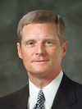
LESSON 40
“All of us have experienced the pain associated with a physical injury or wound. When we are in pain, we typically seek relief and are grateful for the medication and treatments that help to alleviate our suffering. Consider sin as a spiritual wound that causes guilt. … Guilt is to our spirit what pain is to our body—a warning of danger and a protection from additional damage” (David A. Bednar, “We Believe in Being Chaste,” Ensign or Liahona, May 2013, 44).
What are some purposes of guilt?
Elder
David A. Bednar
How does guilt protect us from additional damage?
Guilt can motivate us to repent, seek forgiveness, and avoid future sin.

Slide 13
LESSON 40
“The Savior is often referred to as the Great Physician. … From the Atonement of the Savior flows the soothing salve that can heal our spiritual wounds and remove guilt. However, this salve can only be applied through the principles of faith in the Lord Jesus Christ, repentance, and consistent obedience. The results of sincere repentance are peace of conscience, comfort, and spiritual healing and renewal” (David A. Bednar, “We Believe in Being Chaste,” Ensign or Liahona, May 2013, 44).
Elder
David A. Bednar
What counsel did Elder Bednar give to those who are suffering guilt because of their sins?
What is the promise to all who sincerely repent?

Slide 14
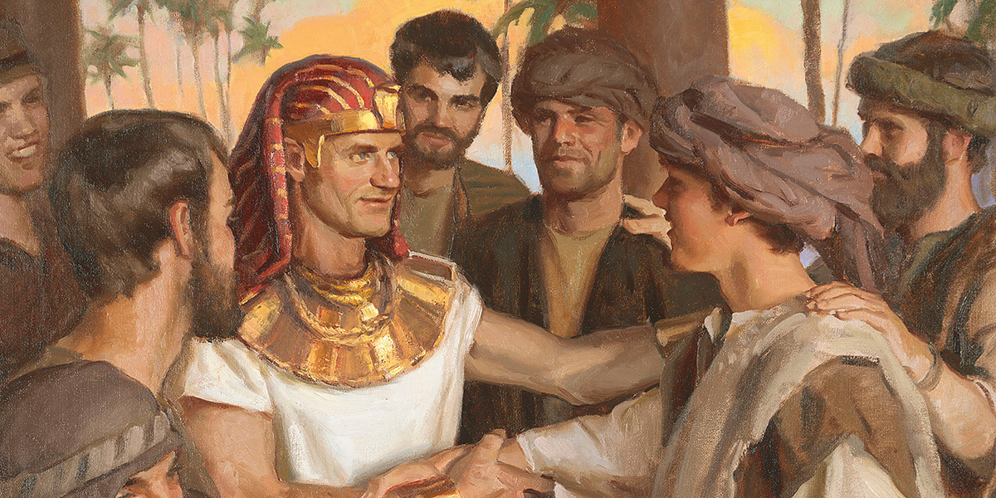
LESSON 40
Genesis 42:24
And he turned himself about from them, and wept; and returned to them again, and communed with them, and took from them Simeon, and bound him before their eyes.

Slide 15
LESSON 40
Genesis 42:36-38
36 And Jacob their father said unto them, Me have ye bereaved of my children: Joseph is not, and Simeon is not, and ye will take Benjamin away: all these things are against me.
37 And Reuben spake unto his father, saying, Slay my two sons, if I bring him not to thee: deliver him into my hand, and I will bring him to thee again.
38 And he said, My son shall not go down with you; for his brother is dead, and he is left alone: if mischief befall him by the way in the which ye go, then shall ye bring down my gray hairs with sorrow to the grave.
Why do you think Jacob was reluctant to send Benjamin to Egypt?

Slide 16
LESSON 40
Genesis 43
“Jacob’s sons return to Egypt with Benjamin and dine with Joseph”

Slide 17
LESSON 40
Genesis 43:26-34
26 ¶ And when Joseph came home, they brought him the present which was in their hand into the house, and bowed themselves to him to the earth.
27 And he asked them of their welfare, and said, Is your father well, the old man of whom ye spake? Is he yet alive?
28 And they answered, Thy servant our father is in good health, he is yet alive. And they bowed down their heads, and made obeisance.
29 And he lifted up his eyes, and saw his brother Benjamin, his mother’s son, and said, Is this your younger brother, of whom ye spake unto me? And he said, God be gracious unto thee, my son.
30 And Joseph made haste; for his bowels did yearn upon his brother: and he sought where to weep; and he entered into his chamber, and wept there.
31 And he washed his face, and went out, and refrained himself, and said, Set on bread.
32 And they set on for him by himself, and for them by themselves, and for the Egyptians, which did eat with him, by themselves: because the Egyptians might not eat bread with the Hebrews; for that is an abomination unto the Egyptians.
33 And they sat before him, the firstborn according to his birthright, and the youngest according to his youth: and the men marvelled one at another.
34 And he took and sent messes unto them from before him: but Benjamin’s mess was five times so much as any of theirs. And they drank, and were merry with him.

