Slide 1
SEMINARY
Old Testament

Slide 2
LESSON 4
Studying the Scriptures

Slide 3
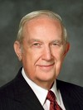
LESSON 4
“[The scriptures] can become stalwart friends that are not limited by geography or calendar. They are always available when needed. Learning, pondering, searching, and memorizing scriptures is like filling a filing cabinet with friends, values, and truths that can be called upon anytime, anywhere in the world…
“… [Memorizing a scripture] is like discovering a new individual who can help in time of need, give inspiration and comfort, and be a source of motivation for needed change” (Richard G. Scott, “The Power of Scripture,” Ensign or Liahona, Nov. 2011, 6).
Elder
Richard G. Scott
How can the scriptures become like a good friend to you?

Slide 4
LESSON 4
If we study the scriptures, they will …
Deuteronomy 17:19
And it shall be with him, and he shall read therein all the days of his life: that he may learn to fear the Lord his God, to keep all the words of this law and these statutes, to do them:
Joshua 1:8
This book of the law shall not depart out of thy mouth; but thou shalt meditate therein day and night, that thou mayest observe to do according to all that is written therein: for then thou shalt make thy way prosperous, and then thou shalt have good success.
Psalms 119:105
Thy word is a lamp unto my feet, and a light unto my path.
2 Nephi 32:2
Angels speak by the power of the Holy Ghost; wherefore, they speak the words of Christ. Wherefore, I said unto you, feast upon the words of Christ; for behold, the words of Christ will tell you all things what ye should do.
Jacob 2:8
And it supposeth me that they have come up hither to hear the pleasing word of God, yea, the word which healeth the wounded soul.

Slide 5
LESSON 4
If we study the scriptures, they will …
… help us learn to fear (respect) God and keep His commandments.
… tell us what to do to be prosperous and successful.
… light our path.
… tell us all things that we should do.
… heal our wounded souls.
… lead us to do that which is just (righteous).
Why would this new plan not be a wise way to care for your teeth?
How can this example relate to our study of the scriptures?

Slide 6
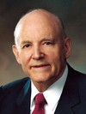
LESSON 4
“It is certain that one who studies the scriptures every day accomplishes far more than one who devotes considerable time one day and then lets days go by before continuing” (Howard W. Hunter, “Reading the Scriptures,” Ensign, Nov. 1979, 64).
President
Howard W. Hunter

Slide 7
LESSON 4
“How to study the scriptures”

Slide 8
LESSON 4
Understanding the context and content of the scriptures.
Elder Richard G. Scott taught that there are “diamonds of truth that … must be carefully mined from the pages of the Old Testament”.
What has helped you understand the context or content of a scripture passage?

Slide 9
LESSON 4
How does this correction affect our understanding of what is happening in this verse?
Symbolism:
What could fire possibly symbolize in scripture?
What could the live coal possibly symbolize?

Slide 10
LESSON 4
Isaiah 6:5-7
5 ¶ Then said I, Woe is me! for I am undone; because I am a man of unclean lips, and I dwell in the midst of a people of unclean lips: for mine eyes have seen the King, the Lord of hosts.
6 Then flew one of the seraphims unto me, having a live coal in his hand, which he had taken with the tongs from off the altar:
7 And he laid it upon my mouth, and said, Lo, this hath touched thy lips; and thine iniquity is taken away, and thy sin purged.
Word definitions:
St Luke 16:13
¶ No servant can serve two masters: for either he will hate the one, and love the other; or else he will hold to the one, and despise the other. Ye cannot serve God and mammon.
What can you do when you read a word you don’t understand in the scriptures?

Slide 11
LESSON 4
Identifying and understanding doctrines and principles.
What is the moral or point of this story?
What can I learn from these passages?
What gospel truths are taught in this passage?

Slide 12
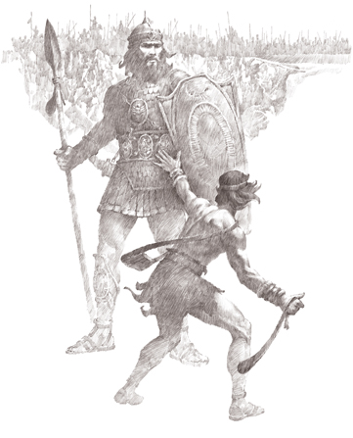
LESSON 4
1 Samuel 17:32-37
32 ¶ And David said to Saul, Let no man’s heart fail because of him; thy servant will go and fight with this Philistine.
33 And Saul said to David, Thou art not able to go against this Philistine to fight with him: for thou art but a youth, and he a man of war from his youth.
34 And David said unto Saul, Thy servant kept his father’s sheep, and there came a lion, and a bear, and took a lamb out of the flock:
35 And I went out after him, and smote him, and delivered it out of his mouth: and when he arose against me, I caught him by his beard, and smote him, and slew him.
36 Thy servant slew both the lion and the bear: and this uncircumcised Philistine shall be as one of them, seeing he hath defied the armies of the living God.
37 David said moreover, The Lord that delivered me out of the paw of the lion, and out of the paw of the bear, he will deliver me out of the hand of this Philistine. And Saul said unto David, Go, and the Lord be with thee.
What gospel lesson do you learn from this passage?
If I exercise faith in the Lord, He will help me overcome life’s challenges.

Slide 13
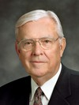
LESSON 4
Feeling the truth and importance of doctrines and principles.
How have you or someone you know been able to overcome a challenge by exercising faith in the Lord?
Applying gospel doctrines and principles to our lives.
“As you receive counsel and instruction, extract principles that will be eternally important in your lives and then make them part of your lives” (M. Russell Ballard, “How to Solve Problems,” New Era, July 2013, 48).
Elder
M. Russell Ballard
When have you identified a doctrine or principle from the scriptures and then made it a part of your life?

