Slide 1
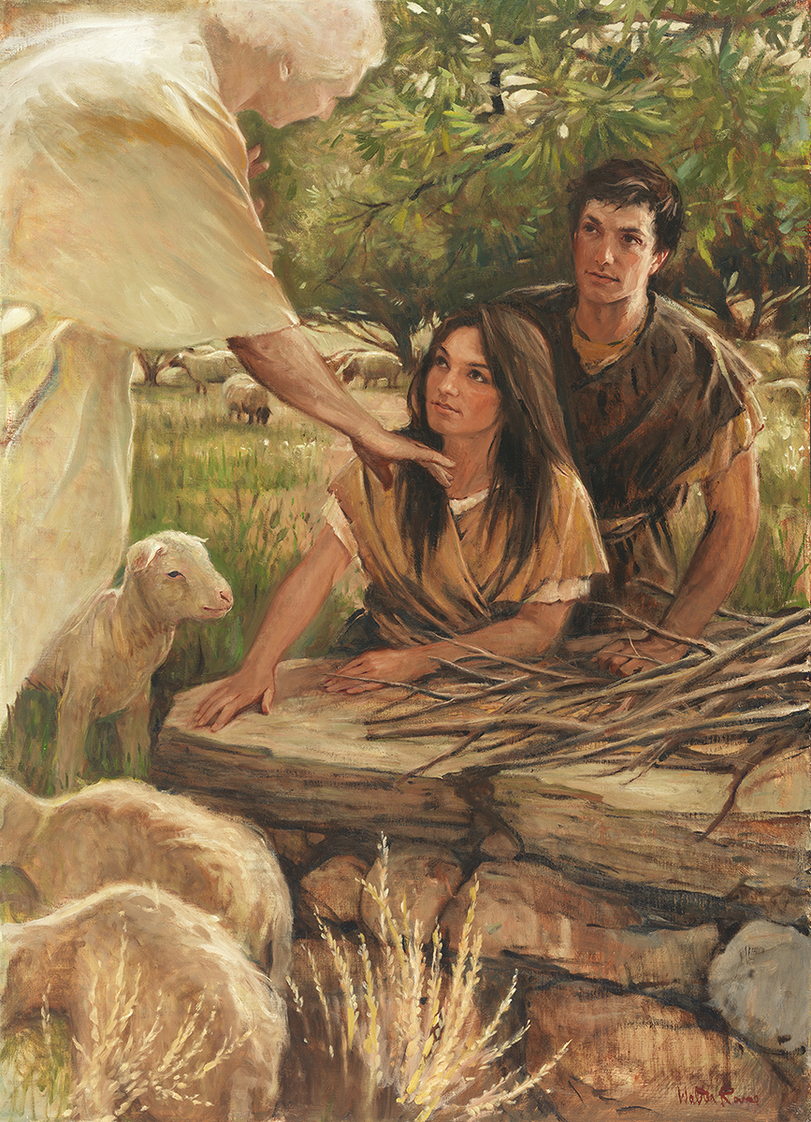
SEMINARY
Old Testament

Slide 2
LESSON 35
Genesis 31-32

Slide 3
LESSON 35
Genesis 31:1-55
“The Lord commands Jacob to
return to Canaan”

Slide 4
LESSON 35
a. Change the command so it will be simple and easy for you to accomplish.
b. Bless your efforts by providing a way for you to fulfill the command, even if it is difficult.
c. Intervene and do all the work for you.
d. Require you to do it entirely on your own without any help.

Slide 5
LESSON 35
Genesis 31:1-3
1 And he heard the words of Laban’s sons, saying, Jacob hath taken away all that was our father’s; and of that which was our father’s hath he gotten all this glory.
2 And Jacob beheld the countenance of Laban, and, behold, it was not toward him as before.
3 And the Lord said unto Jacob, Return unto the land of thy fathers, and to thy kindred; and I will be with thee.
Why might “return[ing] unto the land of [his] fathers” (verse 3) have been difficult for Jacob?
What did the Lord promise Jacob according to verse 3?
What can we learn from the Lord’s words to Jacob?
The Lord will be with us when we do what He asks.
How can believing this principle help us do what the Lord asks, even when it is difficult?
Why do you think Jacob and his family decided to leave without telling Laban?

Slide 6
LESSON 35
Genesis 31:24-29
24 And God came to Laban the Syrian in a dream by night, and said unto him, Take heed that thou speak not to Jacob either good or bad.
25 ¶ Then Laban overtook Jacob. Now Jacob had pitched his tent in the mount: and Laban with his brethren pitched in the mount of Gilead.
26 And Laban said to Jacob, What hast thou done, that thou hast stolen away unawares to me, and carried away my daughters, as captives taken with the sword?
27 Wherefore didst thou flee away secretly, and steal away from me; and didst not tell me, that I might have sent thee away with mirth, and with songs, with tabret, and with harp?
28 And hast not suffered me to kiss my sons and my daughters? thou hast now done foolishly in so doing.
29 It is in the power of my hand to do you hurt: but the God of your father spake unto me yesternight, saying, Take thou heed that thou speak not to Jacob either good or bad.
What did Laban claim he would have done if Jacob had not left in secret?
What do you think Laban might have been planning to do to Jacob before the Lord spoke to him in the dream?
how did the Lord fulfill His promise that He would “be with [Jacob]” (verse 3)?

Slide 7
LESSON 35
Genesis 31:41-42
41 Thus have I been twenty years in thy house; I served thee fourteen years for thy two daughters, and six years for thy cattle: and thou hast changed my wages ten times.
42 Except the God of my father, the God of Abraham, and the fear of Isaac, had been with me, surely thou hadst sent me away now empty. God hath seen mine affliction and the labour of my hands, and rebuked thee yesternight.
What evidence do you see in these verses that the Lord had fulfilled His promise to be with Jacob?

Slide 8
LESSON 35
Genesis 32:1-21
“Jacob worries that Esau will seek revenge against him and his family”

Slide 9
LESSON 35
What would you think if you were given that advice?
Genesis 32:1-5
1 And Jacob went on his way, and the angels of God met him.
2 And when Jacob saw them, he said, This is God’s host: and he called the name of that place Mahanaim.
3 And Jacob sent messengers before him to Esau his brother unto the land of Seir, the country of Edom.
4 And he commanded them, saying, Thus shall ye speak unto my lord Esau; Thy servant Jacob saith thus, I have sojourned with Laban, and stayed there until now:
5 And I have oxen, and asses, flocks, and menservants, and women servants: and I have sent to tell my lord, that I may find grace in thy sight.
Why do you think Jacob sent messengers to Esau?

Slide 10
What did Jacob learn from the messengers?
LESSON 35
Genesis 32:6-8
6 ¶ And the messengers returned to Jacob, saying, We came to thy brother Esau, and also he cometh to meet thee, and four hundred men with him.
7 Then Jacob was greatly afraid and distressed: and he divided the people that was with him, and the flocks, and herds, and the camels, into two bands;
8 And said, If Esau come to the one company, and smite it, then the other company which is left shall escape.
How did he respond to this news?
Why might Jacob have been “greatly afraid and distressed” (verse 7) when he heard that Esau was coming with 400 men?

Slide 11
LESSON 35
Genesis 32:9-12
9 ¶ And Jacob said, O God of my father Abraham, and God of my father Isaac, the Lord which saidst unto me, Return unto thy country, and to thy kindred, and I will deal well with thee:
10 I am not worthy of the least of all the mercies, and of all the truth, which thou hast shewed unto thy servant; for with my staff I passed over this Jordan; and now I am become two bands.
11 Deliver me, I pray thee, from the hand of my brother, from the hand of Esau: for I fear him, lest he will come and smite me, and the mother with the children.
12 And thou saidst, I will surely do thee good, and make thy seedas the sand of the sea, which cannot be numbered for multitude.
What stands out to you about Jacob’s prayer?
How does Jacob’s prayer illustrate his faith in the principle written on the board?

Slide 12
LESSON 35
Genesis 32:13-18
13 ¶ And he lodged there that same night; and took of that which came to his hand a present for Esau his brother;
14 Two hundred she goats, and twenty he goats, two hundred ewes, and twenty rams,
15 Thirty milch camels with their colts, forty kine, and ten bulls, twenty she asses, and ten foals.
16 And he delivered them into the hand of his servants, every drove by themselves; and said unto his servants, Pass over before me, and put a space betwixt drove and drove.
17 And he commanded the foremost, saying, When Esau my brother meeteth thee, and asketh thee, saying, Whose art thou? and whither goest thou? and whose are these before thee?
18 Then thou shalt say, They be thy servant Jacob’s; it is a present sent unto my lord Esau: and, behold, also he is behind us.
What did Jacob do after he prayed for help?
What should we do, after praying for help, when we face difficulties?
When we face difficulties, we should earnestly pray for help and then do what we can to overcome them.
How can praying help us know what we can do to overcome our challenges?
Why is it important that, after we pray, we also do what we can to overcome our challenges?

Slide 13
LESSON 35
“Jacob seeks a blessing from the Lord, and the Lord changes Jacob’s name to Israel”

Slide 14
Wrestle
LESSON 35
Genesis 32:24-26
24 ¶ And Jacob was left alone; and there wrestled a man with him until the breaking of the day.
25 And when he saw that he prevailed not against him, he touched the hollow of his thigh; and the hollow of Jacob’s thigh was out of joint, as he wrestled with him.
26 And he said, Let me go, for the day breaketh. And he said, I will not let thee go, except thou bless me.
Why might “wrestling” be a good way to describe what we must do as we seek blessings from the Lord?
Wrestle
What can we learn from Jacob’s example about obtaining blessings from the Lord?
At times, we may need to put forth great effort as we seek the Lord’s help and blessings.
Why do you think the Lord requires us to put forth great effort before we receive some blessings?

Slide 15
LESSON 35
Genesis 32:27-30
27 And he said unto him, What is thy name? And he said, Jacob.
28 And he said, Thy name shall be called no more Jacob, but Israel: for as a prince hast thou power with God and with men, and hast prevailed.
29 And Jacob asked him, and said, Tell me, I pray thee, thy name. And he said, Wherefore is it that thou dost ask after my name? And he blessed him there.
30 And Jacob called the name of the place Peniel: for I have seen God face to face, and my life is preserved.
Israel
What did the Lord change Jacob’s name to?
“one who prevails with God”
What does it mean to “prevail” with God (verse 28)?

