Slide 1
SEMINARY
Old Testament

Slide 2
LESSON 34
Genesis 28-30

Slide 3
LESSON 34
Genesis 28:1-22
“Jacob is promised the blessings
of Abraham”

Slide 4
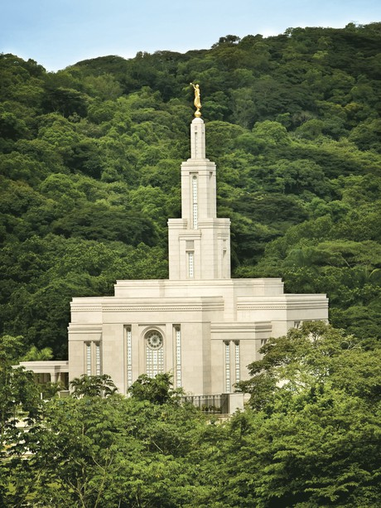
LESSON 34
What are some of the blessings that come to those who choose to be sealed for eternity in the temple?
Genesis 28:1–2
1 And Isaac called Jacob, and blessed him, and charged him, and said unto him, Thou shalt not take a wife of the daughters of Canaan.
2 Arise, go to Padan-aram, to the house of Bethuel thy mother’s father; and take thee a wife from thence of the daughters of Labanthy mother’s brother.

Slide 5
LESSON 34
Genesis 28:1–2
3 And God Almighty bless thee, and make thee fruitful, and multiply thee, that thou mayest be a multitude of people;
4 And give thee the blessing of Abraham, to thee, and to thy seed with thee; that thou mayest inherit the land wherein thou art a stranger, which God gave unto Abraham.
What was Jacob promised if he married in the covenant?
What can we learn from Genesis 28:1-4 about what we must do to receive the blessings of Abraham?
If we marry in the covenant and remain faithful, then we will receive the blessings of Abraham.
What does it mean to receive the blessings of Abraham?

Slide 6
LESSON 34
Genesis 28:10-13
Genesis 28:10-13
10 ¶ And Jacob went out from Beer-sheba, and went toward Haran.
11 And he lighted upon a certain place, and tarried there all night, because the sun was set; and he took of the stones of that place, and put them for his pillows, and lay down in that place to sleep.
12 And he dreamed, and behold a ladder set up on the earth, and the top of it reached to heaven: and behold the angels of God ascending and descending on it.
13 And, behold, the Lord stood above it, and said, I am the Lord God of Abraham thy father, and the God of Isaac: the land where on thou liest, to thee will I give it, and to thy seed;
10 ¶ And Jacob went out from Beer-sheba, and went toward Haran.
11 And he lighted upon a certain place, and tarried there all night, because the sun was set; and he took of the stones of that place, and put them for his pillows, and lay down in that place to sleep.
12 And he dreamed, and behold a ladder set up on the earth, and the top of it reached to heaven: and behold the angels of God ascending and descending on it.
13 And, behold, the Lord stood above it, and said, I am the Lord God of Abraham thy father, and the God of Isaac: the land where on thou liest, to thee will I give it, and to thy seed;
What did Jacob see in his dream?
What do you think Jacob might have learned from the image of a ladder extending from the earth to the Lord’s presence?

Slide 7
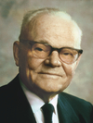
LESSON 34
“Jacob realized that the covenants he made with the Lord there were the rungs on the ladder that he himself would have to climb in order to obtain the promised blessings—blessings that would entitle him to enter heaven and associate with the Lord” (Marion G. Romney, “Temples—The Gates to Heaven,” Ensign, Mar. 1971, 16).
President
Marion G. Romney
Why is it important to receive the saving ordinances of the gospel and keep their associated covenants?
We must receive the saving ordinances of the gospel and keep their associated covenants in order to return to the presence of the Lord.

Slide 8
LESSON 34
Genesis 28:13-15
13 And, behold, the Lord stood above it, and said, I am the Lord God of Abraham thy father, and the God of Isaac: the land where on thou liest, to thee will I give it, and to thy seed;
14 And thy seed shall be as the dust of the earth, and thou shalt spread abroad to the west, and to the east, and to the north, and to the south: and in thee and in thy seed shall all the families of the earth be blessed.
15 And, behold, I am with thee, and will keep thee in all places whither thou goest, and will bring thee again into this land; for I will not leave thee, until I have done that which I have spoken to thee of.
How might the Lord’s promise, “I am with thee,” in verse 15 have helped him?

Slide 9
LESSON 34
Genesis 28:16-19, 22
16 ¶ And Jacob awaked out of his sleep, and he said, Surely the Lord is in this place; and I knew it not.
17 And he was afraid, and said, How dreadful is this place! this is none other but the house of God, and this is the gate of heaven.
18 And Jacob rose up early in the morning, and took the stone that he had put for his pillows, and set it up for a pillar, and poured oil upon the top of it.
19 And he called the name of that place Beth-el: but the name of that city was called Luz at the first.
22 And this stone, which I have set for a pillar, shall be God’s house: and of all that thou shalt give me I will surely give the tenth unto thee.
What did Jacob call the place where he had his dream?
What places serve as “the gate of heaven” for us today?
The temple is the house of God and the gate to eternal life.

Slide 10
LESSON 34
Genesis 29:1-29
“Jacob works for Laban for 14 years
so he can marry Rachel”

Slide 11
LESSON 34
Genesis 29:15-20
15 ¶ And Laban said unto Jacob, Because thou art my brother, shouldest thou therefore serve me for nought? tell me, what shall thy wages be?
16 And Laban had two daughters: the name of the elder was Leah, and the name of the younger was Rachel.
17 Leah was tender eyed; but Rachel was beautiful and well favoured.
18 And Jacob loved Rachel; and said, I will serve thee seven years for Rachel thy younger daughter.
19 And Laban said, It is better that I give her to thee, than that I should give her to another man: abide with me.
20 And Jacob served seven years for Rachel; and they seemed unto him but a few days, for the love he had to her.
What was Jacob willing to do so he could marry Rachel?
What can we learn from Jacob’s example about obtaining the blessings the Lord has promised us?
We must work diligently and be patient as we seek to obtain the blessings the Lord has promised us.

Slide 12
LESSON 34
Genesis 29:30-30:43
“Children are born to Jacob, and the
Lord prospers him”

Slide 13
LESSON 34
Genesis 29:30-35
30 And he went in also unto Rachel, and he loved also Rachel more than Leah, and served with him yet seven other years.
31 ¶ And when the Lord saw that Leah was hated, he opened her womb: but Rachel was barren.
32 And Leah conceived, and bare a son, and she called his name Reuben: for she said, Surely the Lord hath looked upon my affliction; now therefore my husband will love me.
33 And she conceived again, and bare a son; and said, Because the Lord hath heard that I was hated, he hath therefore given me this son also: and she called his name Simeon.
34 And she conceived again, and bare a son; and said, Now this time will my husband be joined unto me, because I have born him three sons: therefore was his name called Levi.
35 And she conceived again, and bare a son: and she said, Now will I praise the Lord: therefore she called his name Judah; and left bearing.

Slide 14
LESSON 34
Genesis 30:1-2
1 And when Rachel saw that she bare Jacob no children, Rachel envied her sister; and said unto Jacob, Give me children, or else I die.
2 And Jacob’s anger was kindled against Rachel: and he said, Am I in God’s stead, who hath withheld from thee the fruit of the womb?
What difficulty did Leah have in her life?
How did the Lord help Leah cope with her challenge?
What challenge did Rachel have in her life?
What feelings did Rachel struggle with during this difficult time?

Slide 15
LESSON 34
We know that God does not forget us, so what do you think it means that “God remembered Rachel”?
What does the phrase “God hearkened to her” tell us about what Rachel had been doing during her struggles?
What can we learn from verse 22 that could help us when we experience challenges?
When we experience challenges, we should realize that God does not forget us.

