Slide 1
SEMINARY
Old Testament

Slide 2
LESSON 31
Genesis 23-24

Slide 3
LESSON 31
Genesis 23:1–24:9
“After Sarah dies, Abraham places his servant under oath to find a suitable wife for Isaac”

Slide 4
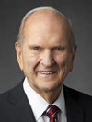
LESSON 31
What are some important choices this couple will need to make if they want to build a relationship that will last?
“A couple in love can choose a marriage of the highest quality or a lesser type that will not endure. Or they can choose neither. …
“The best choice is a celestial marriage” (Russell M. Nelson, “Celestial Marriage,” Ensign or Liahona, Nov. 2008, 92, 94).
President
Russell M. Nelson
Why is celestial marriage in the temple—or eternal marriage—the best kind of marriage?
What did Isaac need to do in order for these promises to be fulfilled?

Slide 5
LESSON 31
Genesis 24:1-3
1 And Abraham was old, and well stricken in age: and the Lord had blessed Abraham in all things.
2 And Abraham said unto his eldest servant of his house, that ruled over all that he had, Put, I pray thee, thy hand under my thigh:
3 And I will make thee swear by the Lord, the God of heaven, and the God of the earth, that thou shalt not take a wife unto my son of the daughters of the Canaanites, among whom I dwell:
Who did Abraham not want Isaac to marry?
Who did Abraham not want Isaac to marry?
Genesis 24:4
But thou shalt go unto my country, and to my kindred, and take a wife unto my son Isaac.
What assignment did Abraham give to his servant?

Slide 6
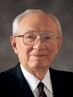
LESSON 31
What do Abraham’s instructions to his servant teach us about the importance of obtaining the blessings of eternal marriage?
It is worth great effort and sacrifice to obtain the blessings of eternal marriage.
What efforts and sacrifices might today’s youth have to make in order to obtain the blessings of eternal marriage?
“There is no substitute for marrying in the temple. It is the only place under the heavens where marriage can be solemnized for eternity. Don’t cheat yourself. Don’t cheat your companion. Don’t shortchange your lives. Marry the right person in the right place at the right time” (Gordon B. Hinckley, “Life’s Obligations,” Ensign, Feb. 1999, 2).
President
Gordon B. Hinckley

Slide 7
LESSON 31
Genesis 24:10-60
“Abraham’s servant meets Rebekah
and her family”

Slide 8
LESSON 31
Genesis 24:10-14
10 ¶ And the servant took ten camels of the camels of his master, and departed; for all the goods of his master were in his hand: and he arose, and went to Mesopotamia, unto the city of Nahor.
11 And he made his camels to kneel down without the city by a well of water at the time of the evening, even the time that women go out to draw water.
12 And he said, O Lord God of my master Abraham, I pray thee, send me good speed this day, and shew kindness unto my master Abraham.
13 Behold, I stand here by the well of water; and the daughters of the men of the city come out to draw water:
14 And let it come to pass, that the damsel to whom I shall say, Let down thy pitcher, I pray thee, that I may drink; and she shall say, Drink, and I will give thy camels drink also: let the same be she that thou hast appointed for thy servant Isaac; and thereby shall I know that thou hast shewed kindness unto my master.
How was the servant’s prayer answered?

Slide 9
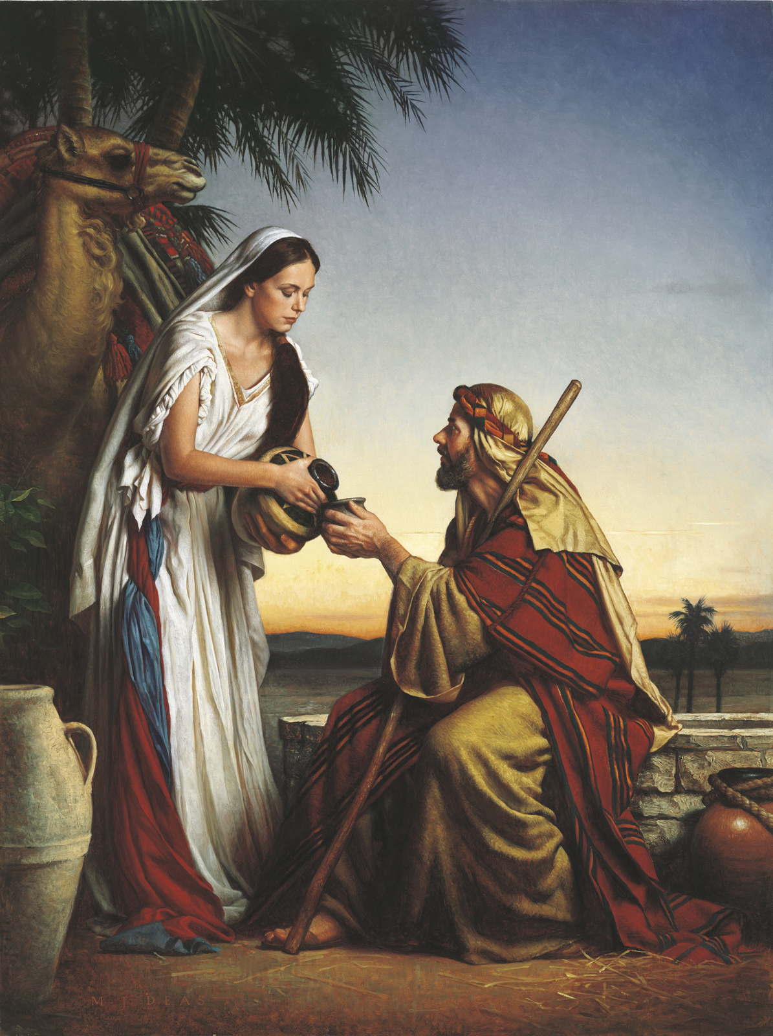
LESSON 31
Character Traits of Rebekah
”virtuous, eager to serve, generous, hardworking”
What impresses you most about Rebekah?

Slide 10
LESSON 31
Genesis 24:26-28
26 And the man bowed down his head, and worshipped the Lord.
27 And he said, Blessed be the Lord God of my master Abraham, who hath not left destitute my master of his mercy and his truth: I being in the way, the Lord led me to the house of my master’s brethren.
28 And the damsel ran, and told them of her mother’s house these things.
Genesis 24:57-60
57 And they said, We will call the damsel, and inquire at her mouth.
58 And they called Rebekah, and said unto her, Wilt thou go with this man? And she said, I will go.
59 And they sent away Rebekah their sister, and her nurse, and Abraham’s servant, and his men.
60 And they blessed Rebekah, and said unto her, Thou art our sister, be thou the mother of thousands of millions, and let thy seed possess the gate of those which hate them.
Why do you think Rebekah would commit to leave her family immediately to go and marry Isaac, even though she had never met him?
What qualities did Rebekah exemplify when she stated, “I will go”?

Slide 11
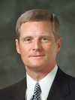
LESSON 31
How do you think Rebekah’s righteous qualities helped prepare her to enter the covenant of eternal marriage?
What principle can we learn from Rebekah’s example?
If we develop righteous qualities now, we will be better prepared for eternal marriage.
“If you hope to have an eternal companion who has certain spiritual qualities, then you must strive to develop those spiritual qualities in yourself. Then someone who has those qualities will be attracted to you” (David A. Bednar, in “Understanding Heavenly Father’s Plan,” lds.org/prophets-and-apostles/unto-all-the-world/understanding-heavenly-fathers-plan).
Elder
David A. Bednar

Slide 12
LESSON 31
Genesis 24:61-67
“Isaac and Rebekah are sealed
in eternal marriage”

Slide 13
LESSON 31
Genesis 24:61-67
61 ¶ And Rebekah arose, and her damsels, and they rode upon the camels, and followed the man: and the servant took Rebekah, and went his way.
62 And Isaac came from the way of the well Lahai-roi; for he dwelt in the south country.
63 And Isaac went out to meditate in the field at the eventide: and he lifted up his eyes, and saw, and, behold, the camels were coming.
64 And Rebekah lifted up her eyes, and when she saw Isaac, she lighted off the camel.
65 For she had said unto the servant, What man is this that walketh in the field to meet us? And the servant had said, It is my master: therefore she took a veil, and covered herself.
66 And the servant told Isaac all things that he had done.
67 And Isaac brought her into his mother Sarah’s tent, and took Rebekah, and she became his wife; and he loved her: and Isaac was comforted after his mother’s death.
What principle can we learn from the example of Isaac and Rebekah as we seek the blessings of eternal marriage?

Slide 14
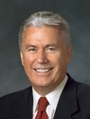
How does this statement help you understand Heavenly Father’s love for His children who may not have the opportunity to receive the blessings of eternal marriage in this life?
LESSON 31
“Now, there are those among you fine young members of the Church who might never marry. Although they are worthy in every way, they may never find someone to whom they will be sealed [in] the temple of the Lord in this life. …
“… I cannot tell you why one individual’s prayers are answered one way while someone else’s are answered differently. But this I can tell you: the righteous desires of your hearts will be fulfilled. …
“… The brief span of this life is nothing in comparison with eternity. And if only we can hope and exercise faith and joyfully endure to the end, … there, in that great heavenly future, we will have the fulfillment of the righteous desires of our hearts, and so very much more than we can scarcely comprehend now” (Dieter F. Uchtdorf, “The Reflection in the Water” [Church Educational System fireside for young adults, Nov. 1, 2009], lds.org/media-library).

