Slide 1
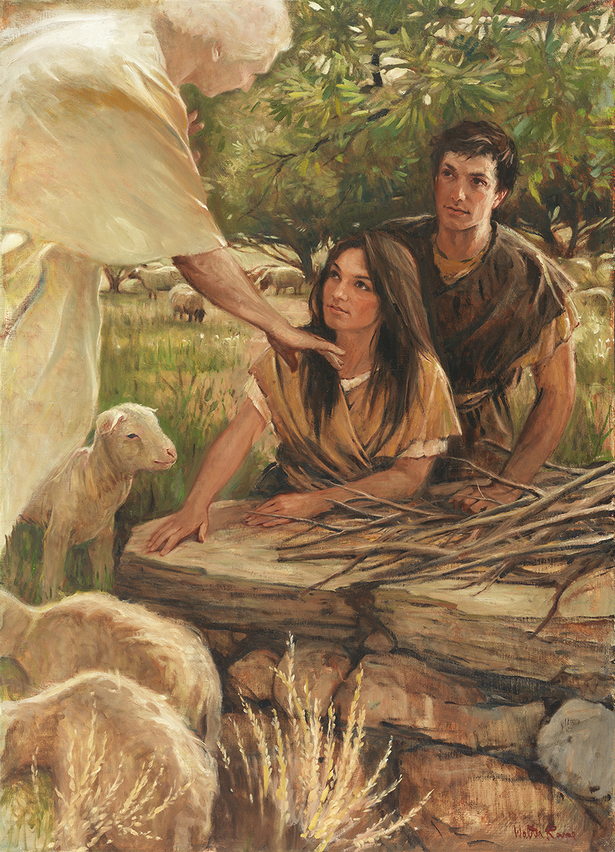
SEMINARY
Old Testament

Slide 2
LESSON 30
Genesis 20:1-21:8
“Abraham and Sarah travel to Gerar, and Isaac is born in fulfillment of God’s promise”

Slide 3
LESSON 30
How would your relationship with this person influence whether you believed they would keep their promise?
Genesis 21:1-5
1 And the Lord visited Sarah as he had said, and the Lord did unto Sarah as he had spoken.
2 For Sarah conceived, and bare Abraham a son in his old age, at the set time of which God had spoken to him.
3 And Abraham called the name of his son that was born unto him, whom Sarah bare to him, Isaac.
4 And Abraham circumcised his son Isaac being eight days old, as God had commanded him.
5 And Abraham was an hundred years old, when his son Isaac was born unto him.
What can we learn from this account about God’s promises?
God always keeps His promises to the faithful according to His timetable.
How might knowing that God fulfills His promises to the faithful influence the choices you make?

Slide 4
LESSON 30
Genesis 21:6-8
6 ¶ And Sarah said, God hath made me to laugh, so that all that hear will laugh with me.
7 And she said, Who would have said unto Abraham, that Sarah should have given children suck? for I have born him a son in his old age.
8 And the child grew, and was weaned: and Abraham made a great feast the same day that Isaac was weaned.

Slide 5
LESSON 30
Genesis 21:9-34
“Ishmael and Hagar are sent away
into the wilderness”

Slide 6
LESSON 30
Genesis 22:1-14
“Abraham is commanded
to sacrifice Isaac”

Slide 7
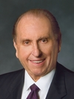
LESSON 30
“The greatest lesson we can learn in mortality is that when God speaks and we obey, we will always be right” (Thomas S. Monson, “They Marked the Path to Follow,” Ensign, Oct. 2007, 7).
President
Thomas S. Monson
What do you think is the greatest lesson we can learn in mortality?

Slide 8
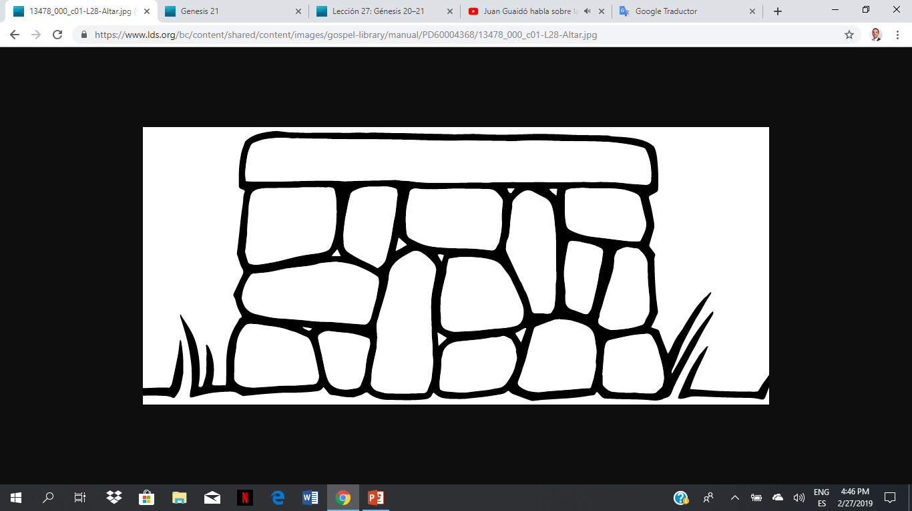
LESSON 30
Genesis 22:1-2
1 And it came to pass after these things, that God did tempt Abraham, and said unto him, Abraham: and he said, Behold, here I am.
2 And he said, Take now thy son, thine only son Isaac, whom thou lovest, and get thee into the land of Moriah; and offer him there for a burnt offering upon one of the mountains which I will tell thee of.
What did the Lord command Abraham to do?
What words or phrases in verse 2 can help us understand how difficult this command must have been for Abraham?
What promises had the Lord made to Abraham that would have made sacrificing his son an even more difficult trial of faith than it already was?

Slide 9
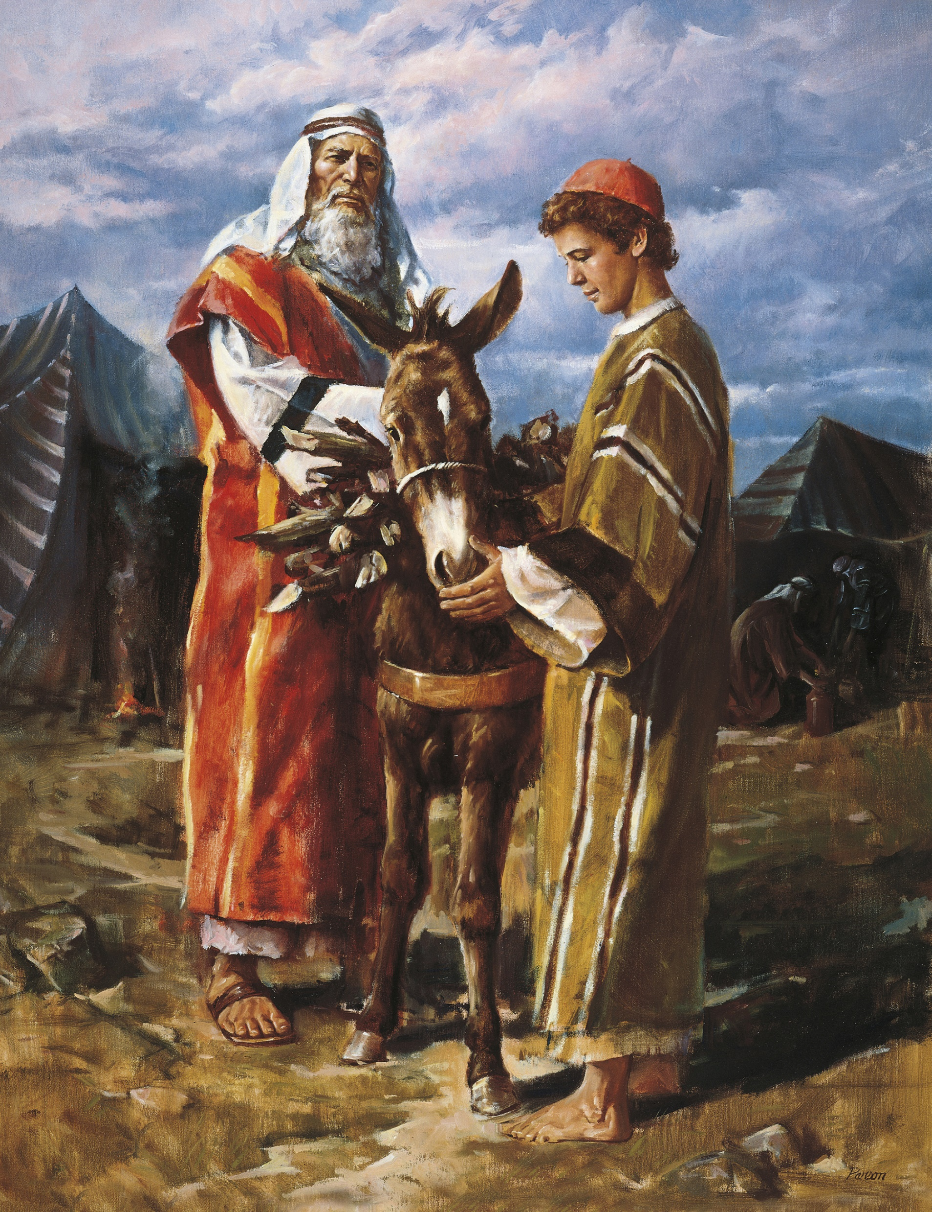
What can we learn about Abraham from his response to this heart-wrenching command?
LESSON 30
Genesis 22:3
¶ And Abraham rose up early in the morning, and saddled his ass, and took two of his young men with him, and Isaac his son, and clave the wood for the burnt offering, and rose up, and went unto the place of which God had told him.
What stands out to you about Abraham’s response?

Slide 10
LESSON 30
Genesis 22:4-8
4 Then on the third day Abraham lifted up his eyes, and saw the place afar off.
5 And Abraham said unto his young men, Abide ye here with the ass; and I and the lad will go yonder and worship, and come again to you.
6 And Abraham took the wood of the burnt offering, and laid it upon Isaac his son; and he took the fire in his hand, and a knife; and they went both of them together.
7 And Isaac spake unto Abraham his father, and said, My father: and he said, Here am I, my son. And he said, Behold the fire and the wood: but where is the lamb for a burnt offering?
8 And Abraham said, My son, God will provide himself a lamb for a burnt offering: so they went both of them together.
How did Abraham respond to Isaac?

Slide 11
LESSON 30
Genesis 22:9-10
9 And they came to the place which God had told him of; and Abraham built an altar there, and laid the wood in order, and bound Isaac his son, and laid him on the altar upon the wood.
10 And Abraham stretched forth his hand, and took the knife to slay his son.
Why do you think Abraham was willing to obey the command to sacrifice his son Isaac?
Genesis 22:11-12
11 And the angel of the Lord called unto him out of heaven, and said, Abraham, Abraham: and he said, Here am I.
12 And he said, Lay not thine hand upon the lad, neither do thou any thing unto him: for now I know that thou fearest God, seeing thou hast not withheld thy son, thine only son from me.
How do you imagine Abraham and Isaac might have felt after receiving this message?
What had Abraham shown about his feelings toward God?

Slide 12
LESSON 30
What can we learn from Abraham and Isaac’s experience about what we can do to show the Lord that we love Him?
When we are willing to do what the Lord commands us, we show our reverence and love for Him.
How does our willingness to obey these commandments show the Lord that we love Him?

Slide 13
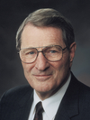
LESSON 30
“The submission of one’s will is really the only uniquely personal thing we have to place on God’s altar. The many other things we ‘give,’ brothers and sisters, are actually the things He has already given or loaned to us. However, when you and I finally submit ourselves, by letting our individual wills be swallowed up in God’s will, then we are really giving something to Him!” (Neal A. Maxwell, “Swallowed Up in the Will of the Father,” Ensign, Nov. 1995, 24).
Elder
Neal A. Maxwell
Which commandments can you begin obeying or obey more willingly to show your love for the Lord?

Slide 14
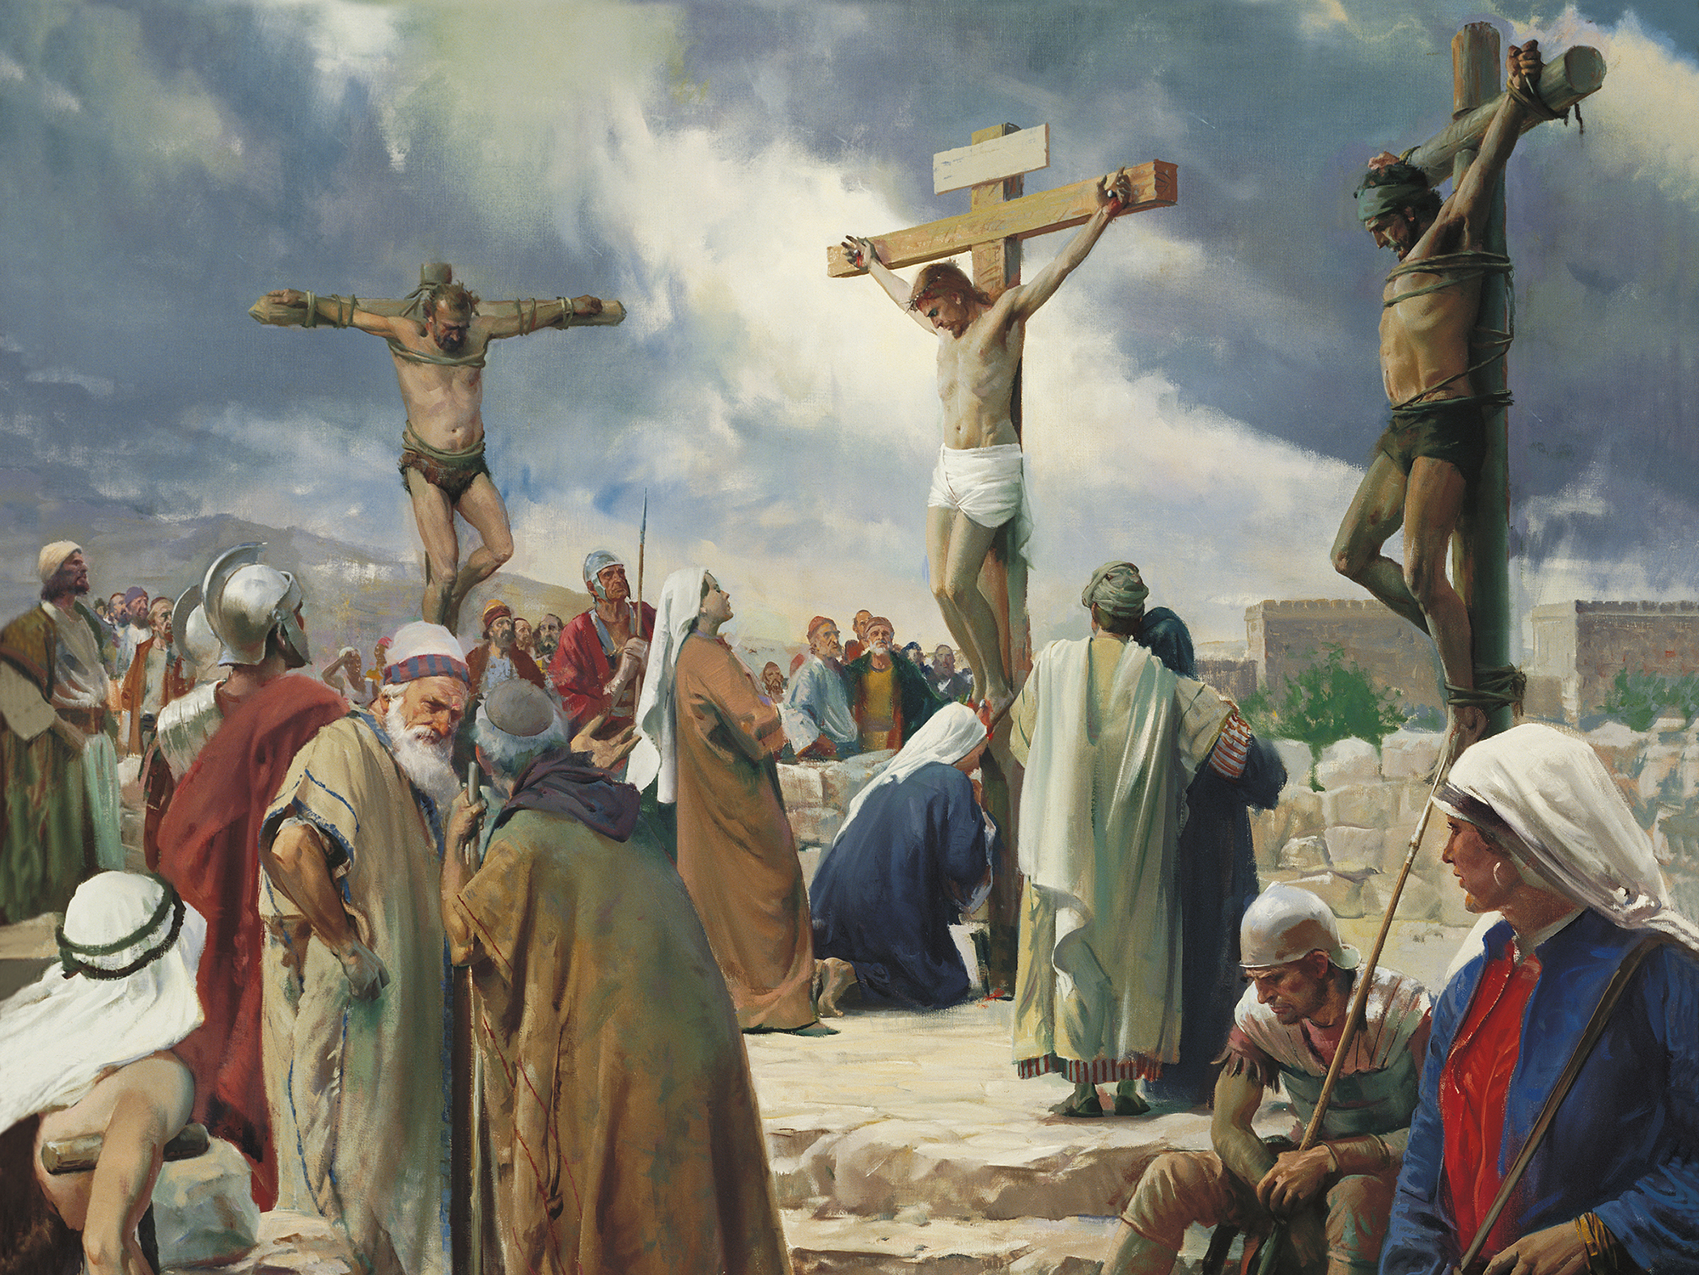
LESSON 30

Slide 15
LESSON 30
Similarities between the Two Sacrifices
Abraham’s Sacrifice of Isaac | Heavenly Father’s Sacrifice of Jesus Christ
Isaac was to be sacrificed in place of a lamb. | Jesus Christ was the Lamb of God and was sacrificed for our sins.
Abraham willingly. | Heavenly Father willingly.
Isaac carried. | Jesus Christ carried.
What can Abraham’s sacrifice of Isaac teach us about Heavenly Father’s sacrifice of Jesus Christ?
Who was Heavenly Father showing His love for by sacrificing His Son, Jesus Christ?
Heavenly Father demonstrated His love for us through the sacrifice of His Son, Jesus Christ.
How does the sacrifice of Jesus Christ demonstrate Heavenly Father’s love for you?

Slide 16
LESSON 30
Genesis 22:15-24
“The Lord reconfirms the promises of the Abrahamic covenant”

Slide 17
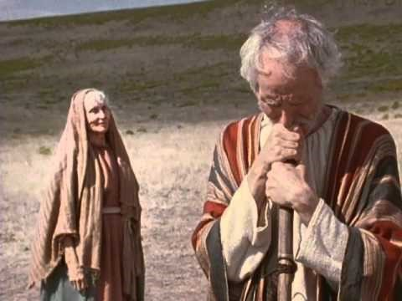
LESSON 30

