Slide 1
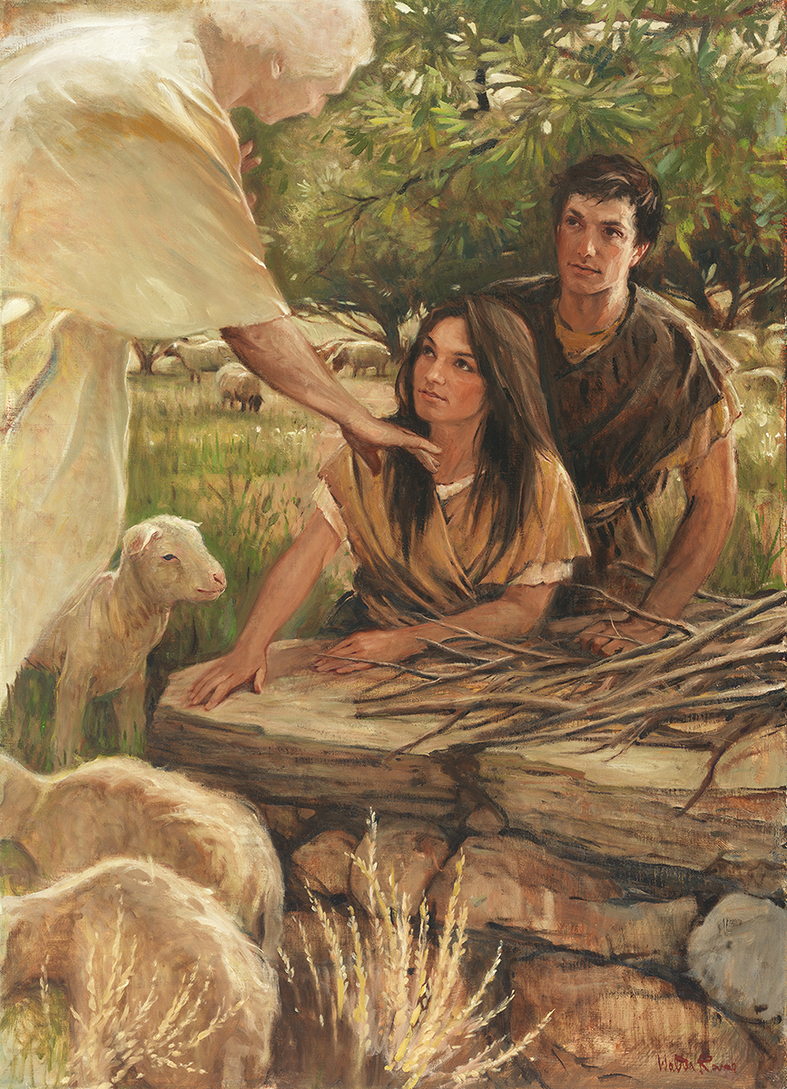
SEMINARY
Old Testament

Slide 2
LESSON 29
Genesis 19
Genesis 19

Slide 3
LESSON 29
Genesis 19:1-29
“Holy messengers remove Lot’s family from Sodom before God destroys Sodom and Gomorrah”

Slide 4
LESSON 29
Have you ever heard of someone who had something bad happen to them because they were in the wrong place or with people who were making inappropriate choices?
Genesis 19:1, 4-7
1 And there came two angels to Sodom at even; and Lot sat in the gate of Sodom: and Lot seeing them rose up to meet them; and he bowed himself with his face toward the ground;
º
4 ¶ But before they lay down, the men of the city, even the men of Sodom, compassed the house round, both old and young, all the people from every quarter:
5 And they called unto Lot, and said unto him, Where are the men which came in to thee this night? bring them out unto us, that we may know them.
6 And Lot went out at the door unto them, and shut the door after him,
7 And said, I pray you, brethren, do not so wickedly.
What did the men of Sodom request of Lot?
How do the actions of the men of Sodom help demonstrate the wickedness of the people in this city?

Slide 5
LESSON 29
Genesis 19:12-13
, 14-16
12 ¶ And the men said unto Lot, Hast thou here any besides? son in law, and thy sons, and thy daughters, and whatsoever thou hast in the city, bring them out of this place:
13 For we will destroy this place, because the cry of them is waxen great before the face of the Lord; and the Lord hath sent us to destroy it.
14 And Lot went out, and spake unto his sons in law, which married his daughters, and said, Up, get you out of this place; for the Lord will destroy this city. But he seemed as one that mocked unto his sons in law.
15 ¶ And when the morning arose, then the angels hastened Lot, saying, Arise, take thy wife, and thy two daughters, which are here; lest thou be consumed in the iniquity of the city.
16 And while he lingered, the men laid hold upon his hand, and upon the hand of his wife, and upon the hand of his two daughters; the Lord being merciful unto him: and they brought him forth, and set him without the city.
What evidence do you see in these verses that Lot and his family were reluctant to leave Sodom?

Slide 6

LESSON 29
Genesis 19:24-26
24 Then the Lord rained upon Sodom and upon Gomorrah brimstone and fire from the Lord out of heaven;
25 And he overthrew those cities, and all the plain, and all the inhabitants of the cities, and that which grew upon the ground.
26 ¶ But his wife looked back from behind him, and she became a pillar of salt.
“Apparently what was wrong with Lot’s wife was that she wasn’t just looking back; in her heart she wanted to go back. …
“It is possible that Lot’s wife looked back with resentment toward the Lord for what He was asking her to leave behind” (Jeffrey R. Holland, “Remember Lot’s Wife”[Brigham Young University devotional, Jan. 13, 2009], 2, speeches.byu.edu).
Elder
Jeffrey R. Holland
What are some possible reasons why Lot’s wife was turned into a pillar of salt?

Slide 7
LESSON 29
What principles can we learn from the example of Lot’s wife about forsaking sin and evil influences?
To forsake sin and evil influences, we must leave them entirely and not look back.
What are some ways a person might be tempted to “look back” upon sins or evil influences that were previously a part of his or her life? Why is it dangerous to do so?
What are some things a person can do to leave sins or evil influences entirely behind?

Slide 8
LESSON 29
Genesis 19:30-38
“Lot’s daughters devise a wicked plan to ensure the continuation of Lot’s posterity”

Slide 9
LESSON 29
What are some consequences Lot and his family experienced for choosing to live in Sodom?
How do you think life might have been different for Lot and his family if he had not chosen to associate with Sodom and the other wicked cities in the plains?
What principles can we learn from Lot’s decisions to place himself and his family close to unrighteous influences?
If we choose to associate with unrighteous influences, then we may experience consequences we will regret. Our choices affect not only ourselves but others as well.
What are some consequences that can come to us personally from associating with these unrighteous influences?
What are some consequences that might affect others?

Slide 10

LESSON 29
“Some years ago, John was accepted at a prestigious Japanese university. …
“Soon after John’s arrival, word of a party to be held on the rooftop of a private residence spread among the foreign student population. That evening, John and two friends made their way to the advertised address.
“Following an elevator ride to the top floor of the building, John and his friends … began mingling with the others. As the night wore on, the atmosphere changed. The noise, music volume, and alcohol amplified, as did John’s uneasiness. Then suddenly someone began organizing the students into a large circle with the intent of sharing marijuana cigarettes. John grimaced and quickly informed his two friends that it was time to leave. Almost in ridicule, one of them replied, ‘John, this is easy—we’ll just stand in the circle, and when it is our turn, we’ll just pass it along rather than smoke it. That way we won’t have to embarrass ourselves in front of everyone by leaving.’ This sounded easy to John, but it did not sound right. He knew he had to announce his intention and act. In a moment he mustered his courage and told them that they could do as they wished, but he was leaving. One friend decided to stay and joined the circle; the other reluctantly followed John down the stairs to board the elevator. Much to their surprise, when the elevator doors opened, Japanese police officers poured out and hurried to ascend the stairs to the rooftop. John and his friend boarded the elevator and departed.
“When the police appeared at the top of the stairs, the students quickly threw the illegal drugs off the roof so they wouldn’t be caught. After securing the stairway, however, the officers lined up everyone on the roof and asked each student to extend both hands. The officers then walked down the line, carefully smelling each student’s thumbs and index fingers. All who had held the marijuana, whether they had smoked it or not, were presumed guilty, and there were huge consequences. Almost without exception, the students who had remained on the rooftop were expelled from their respective universities. …
“… As for John, the consequences in his life have been immeasurable. His time in Japan that year led him to a happy marriage and the subsequent birth of two sons. He has been a very successful businessman and recently became a professor at a Japanese university. Imagine how different his life would have been had he not had the courage to leave the party on that important evening in Japan. …
“… There will be times when you, like John, will have to demonstrate your righteous courage in plain view of your peers, the consequence of which may be ridicule and embarrassment. … Be courageous! Be strong!” (Gary E. Stevenson, “Be Valiant in Courage, Strength, and Activity,” Ensign or Liahona, Nov. 2012, 51–52).
Elder
Gary E. Stevenson

Slide 11
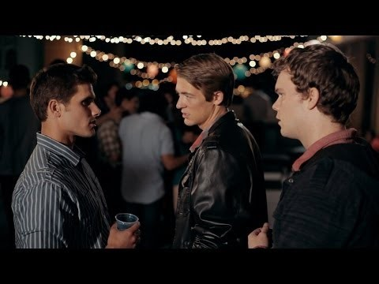
LESSON 29

