Slide 1
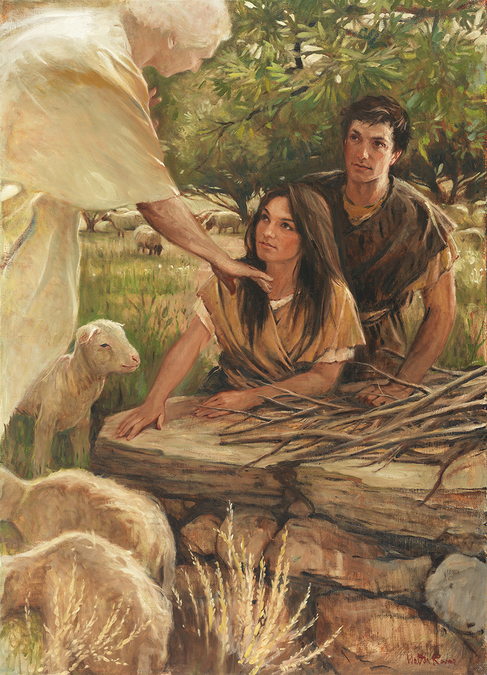
SEMINARY
Old Testament

Slide 2
LESSON 28
Genesis 18

Slide 3
LESSON 28
Genesis 18:1-15
“Messengers from God reiterate the promise that Abraham and Sarah will have a son”

Slide 4
LESSON 28
What makes these events miraculous?
Genesis 18:2-5
2 And he lift up his eyes and looked, and, lo, three men stood by him: and when he saw them, he ran to meet them from the tent door, and bowed himself toward the ground,
3 And said, My Lord, if now I have found favour in thy sight, pass not away, I pray thee, from thy servant:
4 Let a little water, I pray you, be fetched, and wash your feet, and rest yourselves under the tree:
5 And I will fetch a morsel of bread, and comfort ye your hearts; after that ye shall pass on: for therefore are ye come to your servant. And they said, So do, as thou hast said.

Slide 5
What might you have thought and felt when you heard this news?
LESSON 28
Genesis 18:9-10
9 ¶ And they said unto him, Where is Sarah thy wife? And he said, Behold, in the tent.
10 And he said, I will certainly return unto thee according to the time of life; and, lo, Sarah thy wife shall have a son. And Sarah heard it in the tent door, which was behind him.
Genesis 18:13-15
13 And the Lord said unto Abraham, Wherefore did Sarah laugh, saying, Shall I of a surety bear a child, which am old?
14 Is any thing too hard for the Lord? At the time appointed I will return unto thee, according to the time of life, and Sarah shall have a son.
15 Then Sarah denied, saying, I laughed not; for she was afraid. And he said, Nay; but thou didst laugh.
What did Abraham and Sarah learn about the Lord?
Nothing is too hard for the Lord. The Lord is able to do all things.

Slide 6
LESSON 28
Genesis 18:16-33
“Abraham asks the Lord if Sodom can be spared if enough righteous people are found there”

Slide 7
LESSON 28
Genesis 18:20
And the Lord said, Because the cry of Sodom and Gomorrah is great, and because their sin is very grievous;
How does the Lord view all sexual transgression?
All sexual sins, including homosexual behavior, are very serious.

Slide 8
LESSON 28
“We encourage all to bear in mind our Heavenly Father’s purposes in creating the earth and providing for our mortal birth and experience here as His children. ‘God created man in his own image, in the image of God created he him; male and female created he them. And God blessed them, and God said unto them, Be fruitful, and multiply, and replenish the earth’ (Genesis 1:27–28). ‘Therefore shall a man leave his father and his mother, and shall cleave unto his wife: and they shall be one flesh’ (Genesis 2:24). Marriage between a man and a woman was instituted by God and is central to His plan for His children and for the well-being of society. Strong families, guided by a loving mother and father, serve as the fundamental institution for nurturing children, instilling faith, and transmitting to future generations the moral strengths and values that are important to civilization and crucial to eternal salvation. “Changes in the civil law do not, indeed cannot, change the moral law that God has established. God expects us to uphold and keep His commandments regardless of divergent opinions or trends in society. His law of chastity is clear: sexual relations are proper only between a man and a woman who are legally and lawfully wedded as husband and wife. We urge you to review and teach Church members the doctrine contained in ‘The Family: A Proclamation to the World.’
What doctrinal truths can help us understand why homosexual behavior is a serious sin?
In what ways does homosexual behavior go against Heavenly Father’s plan?

Slide 9
LESSON 28
Genesis 18:22-26
22 And the men turned their faces from thence, and went toward Sodom: but Abraham stood yet before the Lord.
23 ¶ And Abraham drew near, and said, Wilt thou also destroy the righteous with the wicked?
24 Peradventure there be fifty righteous within the city: wilt thou also destroy and not spare the place for the fifty righteous that are therein?
25 That be far from thee to do after this manner, to slay the righteous with the wicked: and that the righteous should be as the wicked, that be far from thee: Shall not the Judge of all the earth do right?
26 And the Lord said, If I find in Sodom fifty righteous within the city, then I will spare all the place for their sakes.
How did the Lord respond to Abraham’s questions?

Slide 10
LESSON 28
How did the Lord respond to Abraham’s righteous concern for others?
The Lord listens to our righteous pleas for others.
How can remembering and believing this principle help you when you have a family member or friend who needs help?
When have you experienced the Lord answering your righteous prayers on behalf of others?
What principle about the Lord can we identify from His response to Abraham?

