Slide 1
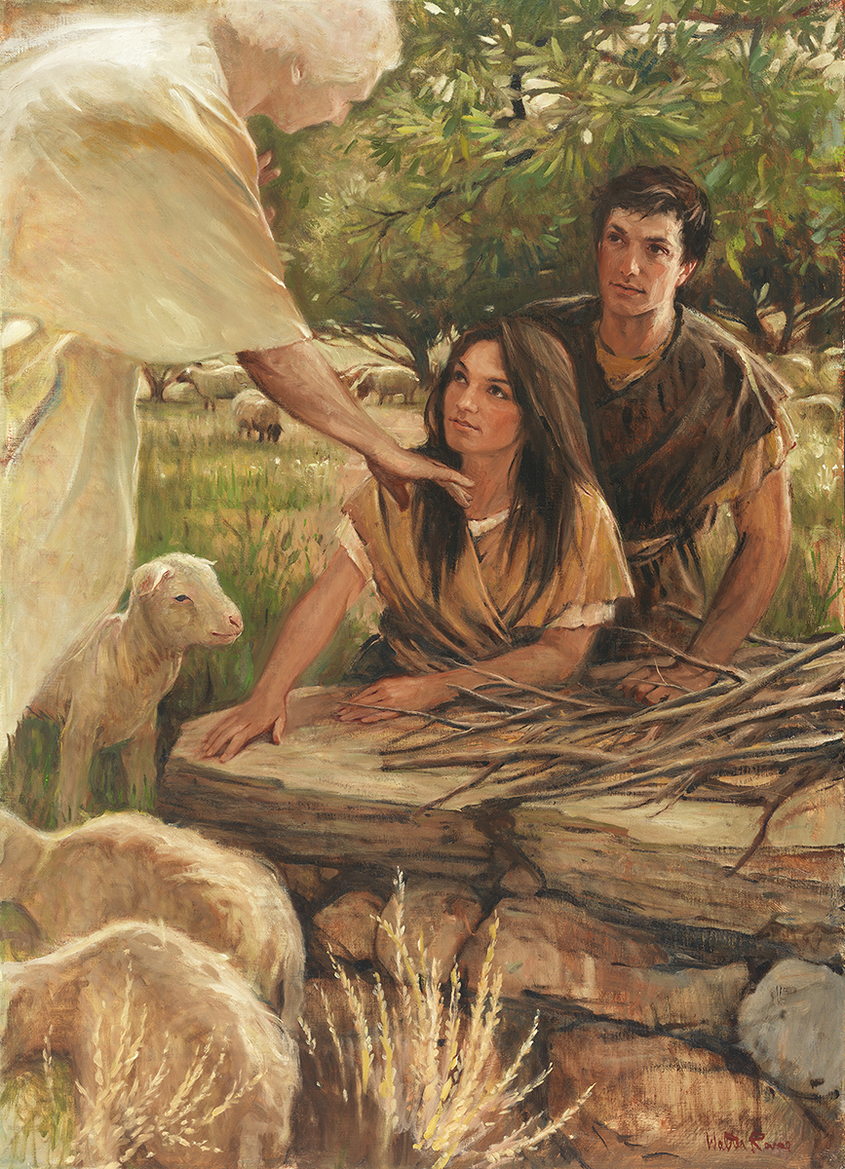
SEMINARY
Old Testament

Slide 2
LESSON 25
Genesis 13–14

Slide 3
LESSON 25
Genesis 13:1-18
“Abram offers a peaceful solution to the strife between his herdmen and Lot’s herdmen”

Slide 4
LESSON 25
How could a situation like this cause conflict in a family?
Genesis 13:5-7
5 ¶ And Lot also, which went with Abram, had flocks, and herds, and tents.
6 And the land was not able to bear them, that they might dwell together: for their substance was great, so that they could not dwell together.
7 And there was a strife between the herdmen of Abram’s cattle and the herdmen of Lot’s cattle: and the Canaanite and the Perizzite dwelled then in the land.
What was the disagreement?
What do you think would be a good solution to this situation?

Slide 5
LESSON 25
Genesis 13:8-9
8 And Abram said unto Lot, Let there be no strife, I pray thee, between me and thee, and between my herdmen and thy herdmen; for we be brethren.
9 Is not the whole land before thee? separate thyself, I pray thee, from me: if thou wilt take the left hand, then I will go to the right; or if thou depart to the right hand, then I will go to the left.
What did Abram suggest?
What do Abram’s actions teach us about being a peacemaker?
Being a peacemaker may require us to place others’ interests above our own.
Who do you know that, like Abram, is good at putting others’ interests above his or her own?

Slide 6
LESSON 25
Genesis 13:10-11
, 12-13
10 And Lot lifted up his eyes, and beheld all the plain of Jordan, that it was well watered every where, before the Lord destroyed Sodom and Gomorrah, even as the garden of the Lord, like the land of Egypt, as thou comest unto Zoar.
11 Then Lot chose him all the plain of Jordan; and Lot journeyed east: and they separated themselves the one from the other.
12 Abram dwelled in the land of Canaan, and Lot dwelled in the cities of the plain, and pitched his tent toward Sodom.
13 But the men of Sodom were wicked and sinners before the Lord exceedingly.
What did Lot do when he arrived at his new dwelling place?
Sodom
Gomorrah
Genesis 13:18
Then Abram removed his tent, and came and dwelt in the plain of Mamre, which is in Hebron, and built there an altar unto the Lord.

Slide 7
LESSON 25
Genesis 13:1-12
“Lot is captured while living in Sodom”

Slide 8
LESSON 25
Which of these decisions would you say are important?
Which would you categorize as small or insignificant?
What do you think might have been some of the potential consequences of Lot’s decision to live near Sodom?
Genesis 14:11-12
11 And they took all the goods of Sodom and Gomorrah, and all their victuals, and went their way.
12 And they took Lot, Abram’s brother’s son, who dwelt in Sodom, and his goods, and departed.
Where were Lot and his family living?
What does this account teach us about some of the decisions we make?
Seemingly small choices can lead to large consequences.

Slide 9
LESSON 25
Genesis 14:13-24
“Abram rescues Lot and meets Melchizedek and the king of Sodom upon his return”

Slide 10
LESSON 25
Genesis 14:17-18
, 19-21
17 ¶ And the king of Sodom went out to meet him after his return from the slaughter of Chedorlaomer, and of the kings that were with him, at the valley of Shaveh, which is the king’s dale.
18 And Melchizedek king of Salem brought forth bread and wine: and he was the priest of the most high God.
19 And he blessed him, and said, Blessed be Abram of the most high God, possessor of heaven and earth:
20 And blessed be the most high God, which hath delivered thine enemies into thy hand. And he gave him tithes of all.
21 And the king of Sodom said unto Abram, Give me the persons, and take the goods to thyself.

Slide 11
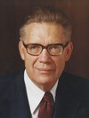
LESSON 25
Elder Bruce R. McConkie (1915–85) of the Quorum of the Twelve Apostles wrote that this event “may well have … prefigured [the sacrament of the Lord’s Supper], some two thousand years before its formal institution among men, … when Jesus and his apostolic witnesses celebrated the feast of the Passover during the week of [the Atonement and Crucifixion]” (Bruce R. McConkie, The Promised Messiah: The First Coming of Christ [1978], 384).
Elder
Bruce R. McConkie
What did Melchizedek offer Abram? (A blessing.) Did he accept it?
What did the king of Sodom offer Abram?

Slide 12
LESSON 25
Genesis 14:22-23
22 And Abram said to the king of Sodom, I have lift up mine hand unto the Lord, the most high God, the possessor of heaven and earth,
23 That I will not take from a thread even to a shoelatchet, and that I will not take any thing that is thine, lest thou shouldest say, I have made Abram rich:
How would you summarize Abram’s response to the king of Sodom?

Slide 13
LESSON 25
Why do you think Abram would not accept even a “thread” (or small reward) from the king of Sodom?
How might accepting a thread from the wicked king be like giving in to small temptations?
Resisting evil influences, regardless of how small, helps us stay true to God and free from sin.

Slide 14
LESSON 25
Genesis 14:25-40 (Joseph Smith Translation)
“Melchizedek blesses Abram”

Slide 15
LESSON 25
Doctrine and Covenants 107:2-3
2 Why the first is called the Melchizedek Priesthood is because Melchizedek was such a great high priest.
3 Before his day it was called the Holy Priesthood, after the Order of the Son of God.
Genesis 14:18-20
18 And Melchizedek king of Salem brought forth bread and wine: and he was the priest of the most high God.
19 And he blessed him, and said, Blessed be Abram of the most high God, possessor of heaven and earth:
20 And blessed be the most high God, which hath delivered thine enemies into thy hand. And he gave him tithes of all.

Slide 16
LESSON 25
JST, Genesis 14:25–31.
JST, Genesis 14:32-40
25 And Melchizedek lifted up his voice and blessed Abram.
26 Now Melchizedek was a man of faith, who wrought righteousness; and when a child he feared God, and stopped the mouths of lions, and quenched the violence of fire.
27 And thus, having been approved of God, he was ordained an high priest after the order of the covenant which God made with Enoch,
28 It being after the order of the Son of God; which order came, not by man, nor the will of man; neither by father nor mother; neither by beginning of days nor end of years; but of God;
29 And it was delivered unto men by the calling of his own voice, according to his own will, unto as many as believed on his name.
30 For God having sworn unto Enoch and unto his seed with an oath by himself; that every one being ordained after this order and calling should have power, by faith, to break mountains, to divide the seas, to dry up waters, to turn them out of their course;
31 To put at defiance the armies of nations, to divide the earth, to break every band, to stand in the presence of God; to do all things according to his will, according to his command, subdue principalities and powers; and this by the will of the Son of God which was from before the foundation of the world.
32 And men having this faith, coming up unto this order of God, were translated and taken up into heaven.
33 And now, Melchizedek was a priest of this order; therefore he obtained peace in Salem, and was called the Prince of peace.
34 And his people wrought righteousness, and obtained heaven, and sought for the city of Enoch which God had before taken, separating it from the earth, having reserved it unto the latter days, or the end of the world;
35 And hath said, and sworn with an oath, that the heavens and the earth should come together; and the sons of God should be tried so as by fire.
36 And this Melchizedek, having thus established righteousness, was called the king of heaven by his people, or, in other words, the King of peace.
37 And he lifted up his voice, and he blessed Abram, being the high priest, and the keeper of the storehouse of God;
38 Him whom God had appointed to receive tithes for the poor.
39 Wherefore, Abram paid unto him tithes of all that he had, of all the riches which he possessed, which God had given him more than that which he had need.
40 And it came to pass, that God blessed Abram, and gave unto him riches, and honor, and lands for an everlasting possession; according to the covenant which he had made, and according to the blessing wherewith Melchizedek had blessed him.

Slide 17
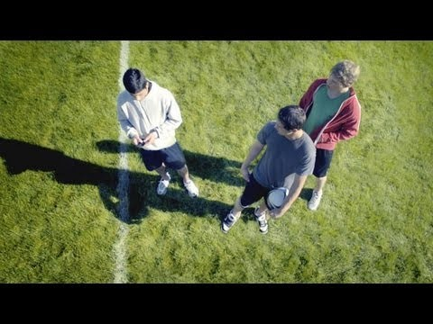
LESSON 25

