Slide 1
SEMINARY
Old Testament

Slide 2
LESSON 24
Abraham 3

Slide 3
LESSON 24
Abraham 3:1-21
“The Lord teaches Abraham about
the order of the stars”

Slide 4
LESSON 24
The world tells me I am great if …
Real qualities of greatness include …
Abraham 3:1-3
1 And I, Abraham, had the Urim and Thummim, which the Lord my God had given unto me, in Ur of the Chaldees;
2 And I saw the stars, that they were very great, and that one of them was nearest unto the throne of God; and there were many great ones which were near unto it;
3 And the Lord said unto me: These are the governing ones; and the name of the great one is Kolob, because it is near unto me, for I am the Lord thy God: I have set this one to govern all those which belong to the same order as that upon which thou standest.

Slide 5
LESSON 24
Which star is “nearest unto the throne of God” (verse 2)?
What phrase did the Lord use to describe Kolob?

Slide 6
LESSON 24
A Facsimile from the Book of Abraham Nº 2

Slide 7
LESSON 24
Abraham 3:18–19, 21
18 Howbeit that he made the greater star; as, also, if there be two spirits, and one shall be more intelligent than the other, yet these two spirits, notwithstanding one is more intelligent than the other, have no beginning; they existed before, they shall have no end, they shall exist after, for they are gnolaum, or eternal.
19 And the Lord said unto me: These two facts do exist, that there are two spirits, one being more intelligent than the other; there shall be another more intelligent than they; I am the Lord thy God, I am more intelligent than they all.
21 I dwell in the midst of them all; I now, therefore, have come down unto thee to declare unto thee the works which my hands have made, wherein my wisdom excelleth them all, for I rule in the heavens above, and in the earth beneath, in all wisdom and prudence, over all the intelligences thine eyes have seen from the beginning; I came down in the beginning in the midst of all the intelligences thou hast seen.
18 Howbeit that he made the greater star; as, also, if there be two spirits, and one shall be more intelligent than the other, yet these two spirits, notwithstanding one is more intelligent than the other, have no beginning; they existed before, they shall have no end, they shall exist after, for they are gnolaum, or eternal.
19 And the Lord said unto me: These two facts do exist, that there are two spirits, one being more intelligent than the other; there shall be another more intelligent than they; I am the Lord thy God, I am more intelligent than they all.
21 I dwell in the midst of them all; I now, therefore, have come down unto thee to declare unto thee the works which my hands have made, wherein my wisdom excelleth them all, for I rule in the heavens above, and in the earth beneath, in all wisdom and prudence, over all the intelligences thine eyes have seen from the beginning; I came down in the beginning in the midst of all the intelligences thou hast seen.
How would you summarize what Abraham learned about Jesus Christ?
Jesus Christ is the greatest and most intelligent of all Heavenly Father’s children.
How can knowing that Jesus Christ is the most intelligent and obedient of all our Heavenly Father’s children help you exercise faith in Him?

Slide 8
LESSON 24
Abraham 3:22–28
“The Lord shows Abraham the Council in Heaven”

Slide 9
LESSON 24
Who did Abraham see gathered together in heaven?
What did Abraham learn about himself from this vision?
What did Heavenly Father choose Abraham and other “noble and great” spirits to do on the earth?
Heavenly Father chose His noble and great children before they were born to become leaders in His kingdom on the earth.

Slide 10
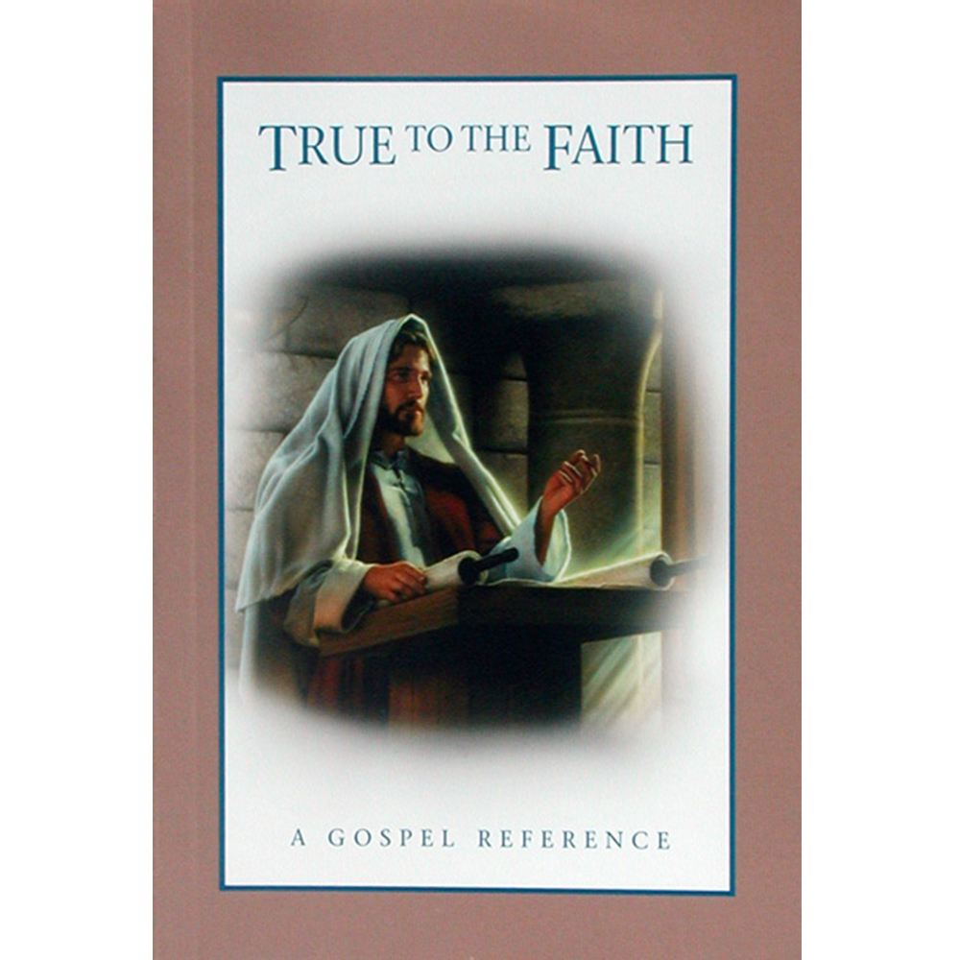
LESSON 24
Foreordination
“In the premortal spirit world, God appointed certain spirits to fulfill specific missions during their mortal lives. This is called foreordination. …
“The doctrine of foreordination applies to all members of the Church, not just to the Savior and His prophets. Before the creation of the earth, faithful women were given certain responsibilities and faithful men were foreordained to certain priesthood duties. Although you do not remember that time, you surely agreed to fulfill significant tasks in the service of your Father” (True to the Faith: A Gospel Reference [2004], 69, 70).

Slide 11
LESSON 24
How can knowing you were chosen in the premortal life to “fulfill significant tasks in the service of your [Heavenly] Father” influence your choices and actions in mortality?
What might prevent someone in mortality from fulfilling the tasks God foreordained or chose him or her to do?
Abraham 3:24-25
24 And there stood one among them that was like unto God, and he said unto those who were with him: We will go down, for there is space there, and we will take of these materials, and we will make an earth whereon these may dwell;
25 And we will prove them herewith, to see if they will do all things whatsoever the Lord their God shall command them;
What would you say the test of life is?
The test of life is to determine if we will do whatever God commands us.

Slide 12
LESSON 24
Abraham 3:26
And they who keep their first estate shall be added upon; and they who keep not their first estate shall not have glory in the same kingdom with those who keep their first estate; and they who keep their second estate shall have glory added upon their heads for ever and ever.
What blessing did Heavenly Father plan to give to those who kept their first estate?
What do you think it means to be “added upon”?
What were the consequences for spirits who chose not to keep their first estate?
What do you think it means to keep our second estate?
If we do all that Heavenly Father commands us to do, then…
…we will have glory added upon us forever.

Slide 13
LESSON 24
Abraham 3:27-28
27 And the Lord said: Whom shall I send? And one answered like unto the Son of Man: Here am I, send me. And another answered and said: Here am I, send me. And the Lord said: I will send the first.
28 And the second was angry, and kept not his first estate; and, at that day, many followed after him.
Who were the two spirits who responded to Heavenly Father’s question?
How did Lucifer react when Jesus Christ was chosen?

