Slide 1
SEMINARY
Old Testament

Slide 2
LESSON 23
Abraham 2; Genesis 12

Slide 3
LESSON 23
Abraham 2:1-11
“The Lord begins to explain the covenant He will make with Abraham”

Slide 4
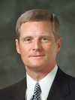
LESSON 23
“You may enjoy music, athletics, or be mechanically inclined, and someday you may work in a trade or a profession or in the arts. As important as such activities and occupations can be, they do not define who we are. First and foremost, we are spiritual beings. We are sons [and daughters] of_____________________ and the seed of ____________________ ” (David A. Bednar, “Becoming a Missionary,” Ensign or Liahona, Nov. 2005, 47).
God
Abraham
Elder
David A. Bednar
Why do you think he identified you as the “seed of Abraham”?

Slide 5
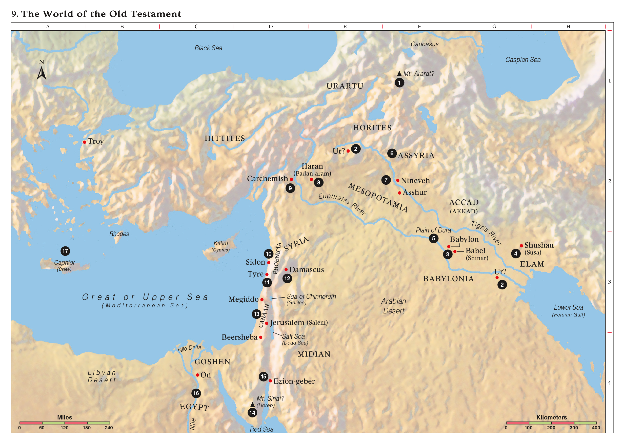
LESSON 23

Slide 6
What did Abraham’s posterity need to do in order to receive the land?
LESSON 23
Abraham 2:6
But I, Abraham, and Lot, my brother’s son, prayed unto the Lord, and the Lord appeared unto me, and said unto me: Arise, and take Lot with thee; for I have purposed to take thee away out of Haran, and to make of thee a minister to bear my name in a strange land which I will give unto thy seed after thee for an everlasting possession, when they hearken to my voice.
What did the Lord want Abraham to be?
What did the Lord promise to give Abraham and his seed?

Slide 7
LESSON 23
THE ABRAHAMIC COVENANT
Responsibilities | Blessings
Be a minister of Jesus Christ
Receive land for an everlasting possession
Hearken to the Lord’s voice

Slide 8
LESSON 23
Abraham 2:7-8
, 9
7 For I am the Lord thy God; I dwell in heaven; the earth is my footstool; I stretch my hand over the sea, and it obeys my voice; I cause the wind and the fire to be my chariot; I say to the mountains—Depart hence—and behold, they are taken away by a whirlwind, in an instant, suddenly.
8 My name is Jehovah, and I know the end from the beginning; therefore my hand shall be over thee.
9 And I will make of thee a great nation, and I will bless thee above measure, and make thy name great among all nations, and thou shalt be a blessing unto thy seed after thee, that in their hands they shall bear this ministry and Priesthood unto all nations;
What did the Lord promise would come from Abraham?

Slide 9
LESSON 23
Abraham 3:14
And it was in the night time when the Lord spake these words unto me: I will multiply thee, and thy seed after thee, like unto these; and if thou canst count the number of sands, so shall be the number of thy seeds.
Innumerable posterity
Abraham 2:10
And I will bless them through thy name; for as many as receive this Gospel shall be called after thy name, and shall be accounted thy seed, and shall rise up and bless thee, as their father;
Who will be called after the name of Abraham?

Slide 10
LESSON 23
Abraham 2:9, 11
9 And I will make of thee a great nation, and I will bless thee above measure, and make thy name great among all nations, and thou shalt be a blessing unto thy seed after thee, that in their hands they shall bear this ministry and Priesthood unto all nations;
11 And I will bless them that bless thee, and curse them that curse thee; and in thee (that is, in thy Priesthood) and in thy seed (that is, thy Priesthood), for I give unto thee a promise that this right shall continue in thee, and in thy seed after thee (that is to say, the literal seed, or the seed of the body) shall all the families of the earth be blessed, even with the blessings of the Gospel, which are the blessings of salvation, even of life eternal.
As the seed of Abraham, we have a responsibility to minister to and bless all the families of the earth with the blessings of the gospel.
How would you summarize what we are to do for others as the seed of Abraham?

Slide 11
LESSON 23
What would you want your family to do with the medicine?
What might you say to a family member who felt too busy or nervous to help distribute the medicine?
How might our need to assist others in this situation be like our responsibility as the seed of Abraham?
“Truly, great responsibility rests upon the seed of Abraham in these latter days. …
“… We are here upon the earth at this time to magnify the priesthood and to preach the gospel. That is who we are, and that is why we are here” (David A. Bednar, “Becoming a Missionary,” Ensign or Liahona, Nov. 2005, 47).
Elder
David A. Bednar
How else can we bless the families of the earth?
What can we do to bless our own families and the families of our friends and neighbors?
How do you feel about being numbered among the seed of Abraham?

Slide 12
LESSON 23
“Abraham journeys through the
promised land of Canaan”

Slide 13
LESSON 23
Earnestly…
sincere, serious, or intense
Abraham 2:12-13
12 Now, after the Lord had withdrawn from speaking to me, and withdrawn his face from me, I said in my heart: Thy servant has sought thee earnestly; now I have found thee;
13 Thou didst send thine angel to deliver me from the gods of Elkenah, and I will do well to hearken unto thy voice, therefore let thy servant rise up and depart in peace.
What conclusions did Abraham draw from his experience with the Lord?
How did Abraham seek the Lord earnestly?
What can we learn from Abraham’s earnest seeking of the Lord (see Abraham 2:12)?
If we seek the Lord earnestly, we will find Him.
What are some examples of how we can earnestly seek the Lord?

Slide 14
LESSON 23
Abraham 2:22–25; Genesis 12:14–20
“The Lord warns Abraham
about the Egyptians”

Slide 15
LESSON 23

