Slide 1
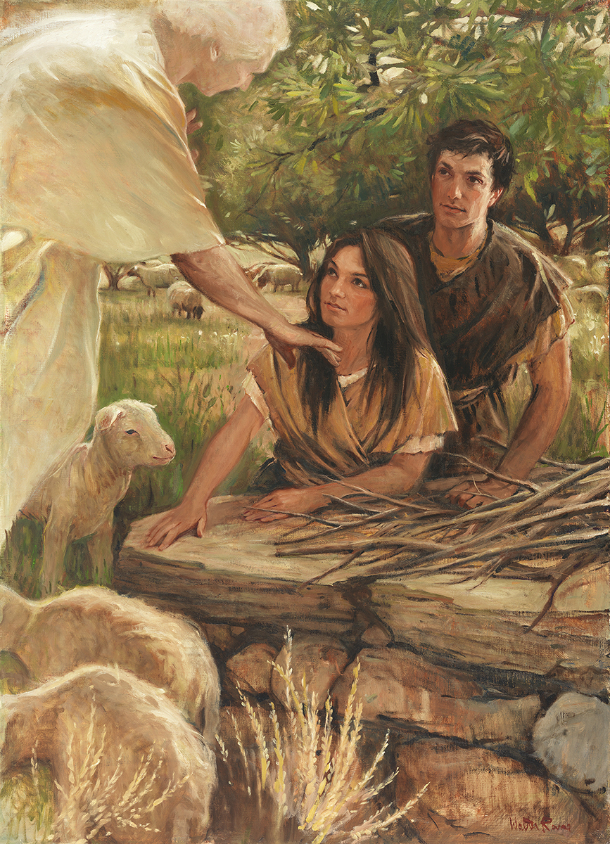
SEMINARY
Old Testament

Slide 2
LESSON 1
“Introduction to the Old Testament”

Slide 3
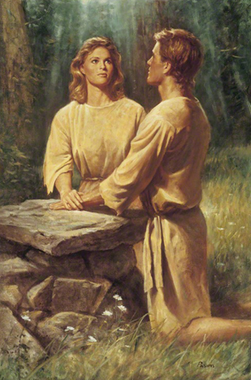
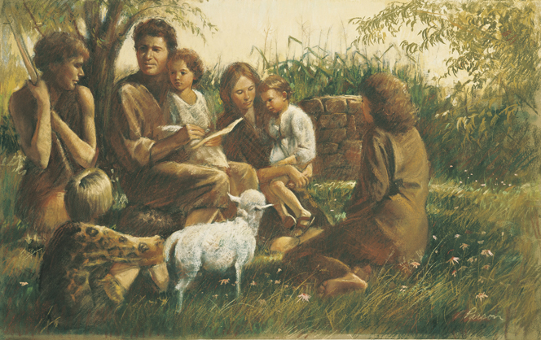
LESSON 1
Adam and Eve Teaching Their Children
Adam and Eve Kneeling at an Altar

Slide 4
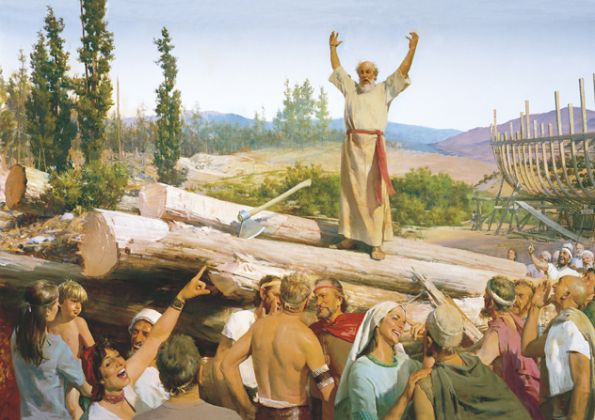
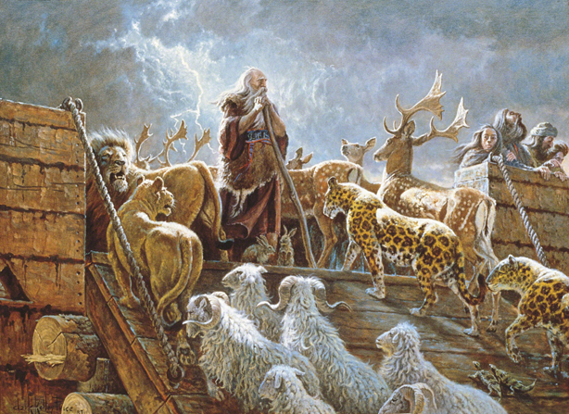
LESSON 1
Building the Ark (Noah’s Preaching Scorned)
Noah and the Ark with Animals (The Lord
Fulfilleth All His Words)

Slide 5
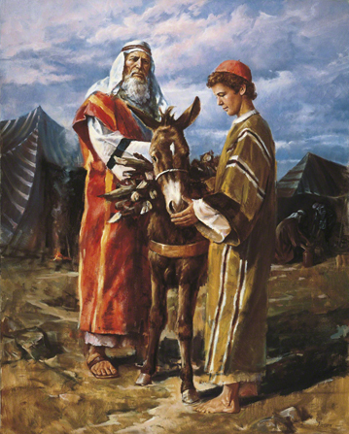
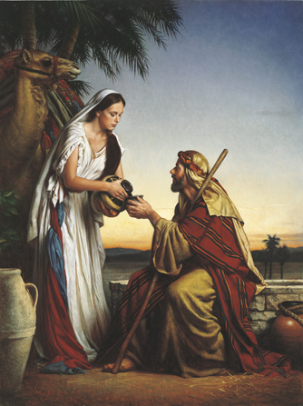
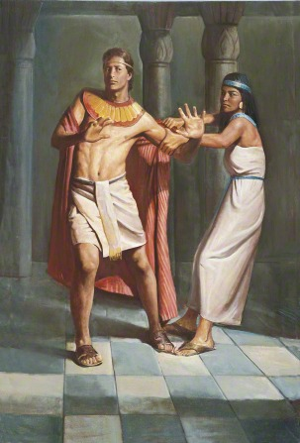
LESSON 1
Abraham Taking Isaac to
Be Sacrificed
Rebekah at the Well
Joseph Resists Potiphar’s Wife
(Joseph and Potiphar’s Wife)

Slide 6
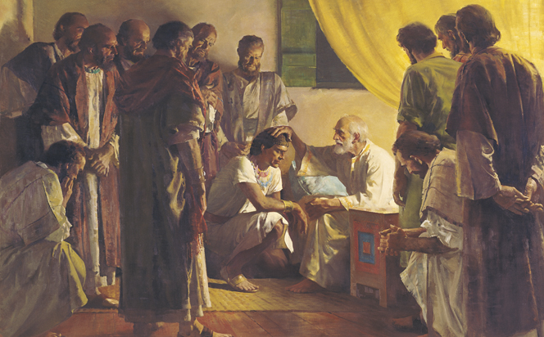
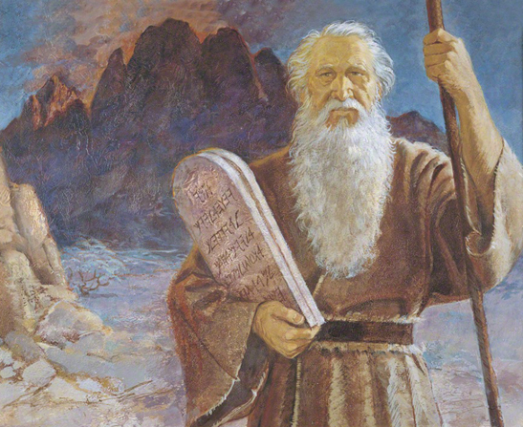
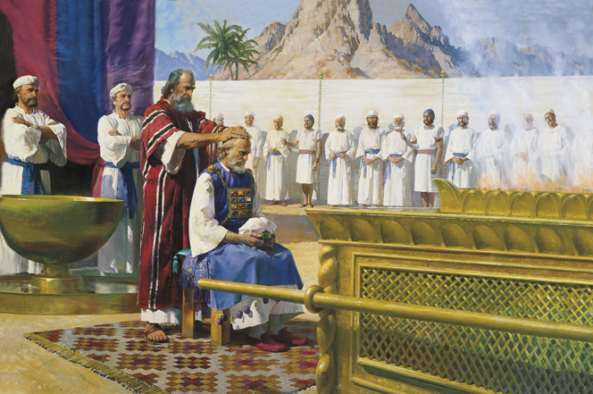
LESSON 1
Jacob Blessing His Sons (Jacob Blessing Joseph)
Moses and the Tablets
Moses Calls Aaron to the Ministry

Slide 7
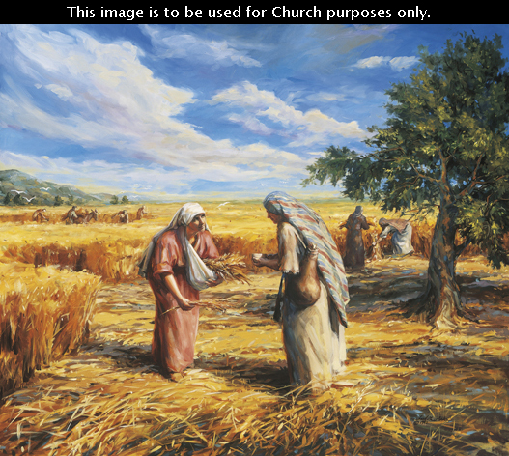
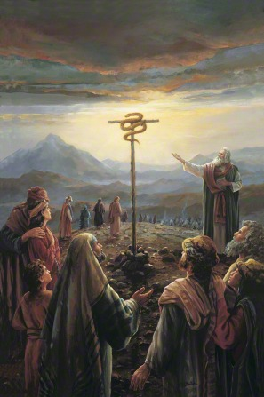
LESSON 1
Ruth Gleaning in the Fields (Ruth and Naomi)
Moses and the Brass Serpent
Boy Samuel Called by the Lord (God Appears
in a Night Vision to the Boy Prophet Samuel)

Slide 8
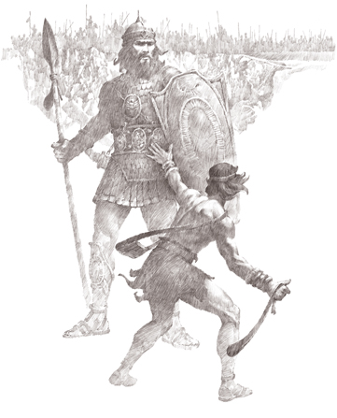
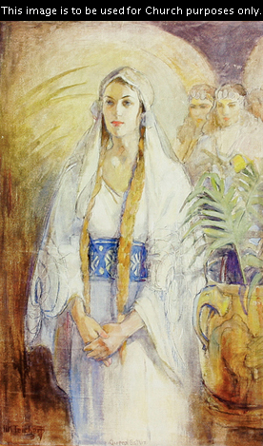
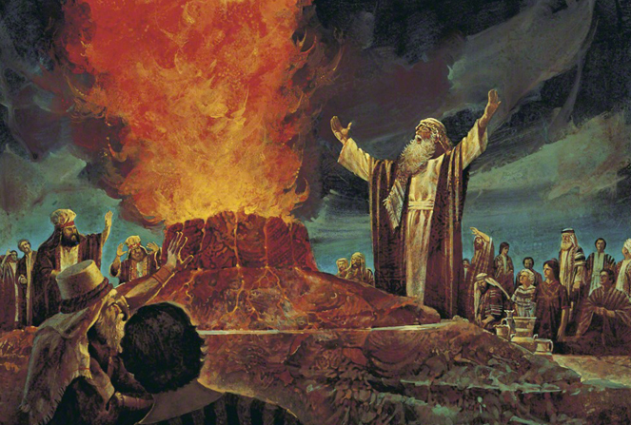
LESSON 1
David Slays Goliath
Esther (Queen Esther)
Elijah Contends against the Priests of Baal

Slide 9
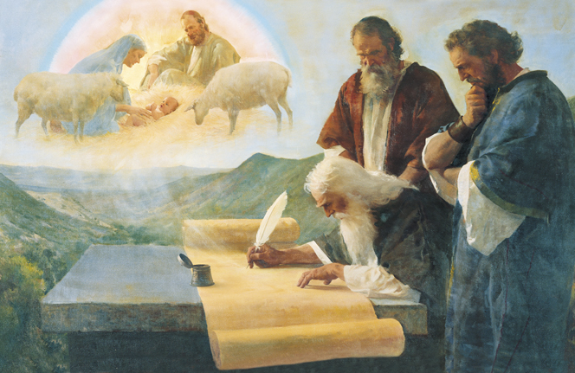
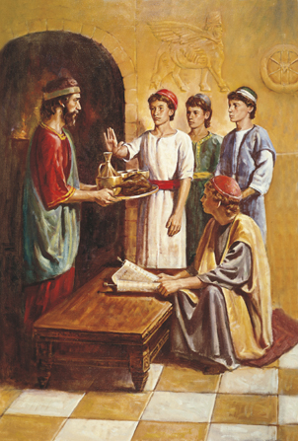
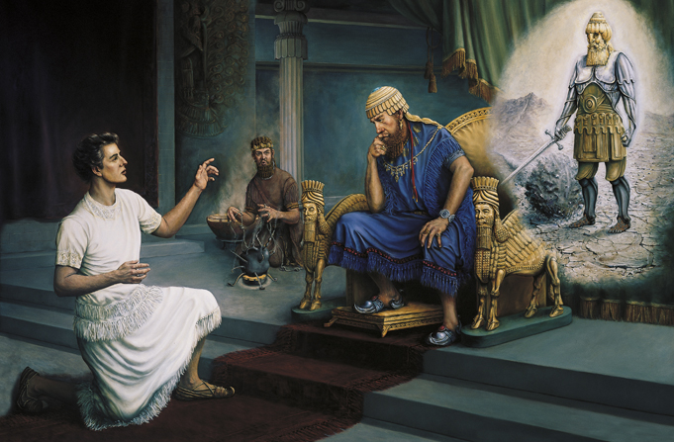
LESSON 1
Isaiah Writes of Christ’s Birth (The Prophet
Isaiah Foretells Christ’s Birth)
Daniel Refusing the King’s
Meat and Wine
Daniel Interprets Nebuchadnezzar’s Dream

Slide 10
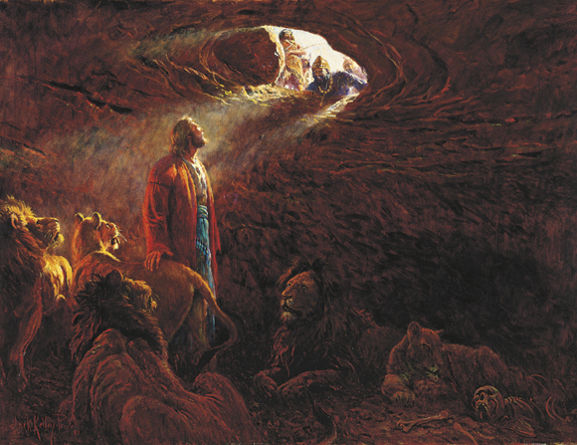
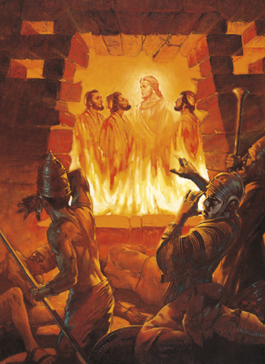
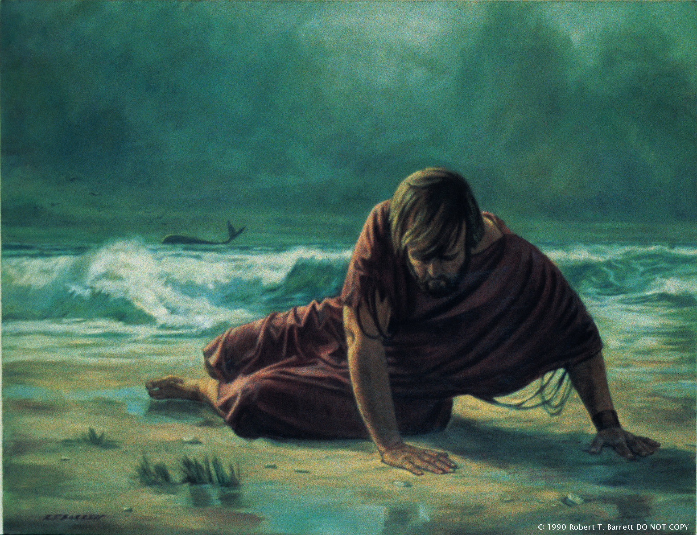
LESSON 1
Daniel in the Lions’ Den
Three Men in the Fiery Furnace
Jonah

Slide 11
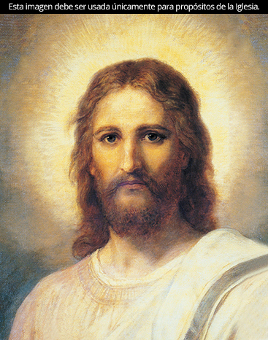
LESSON 1
“The message of the Old Testament is the message of Christ and his coming and his atonement”
(President Marion G. Romney).

Slide 12
LESSON 1
How can the events depicted in these pictures teach of Jesus Christ, His coming, and His Atonement?
Why do you think it might be helpful to know that this book of scripture testifies of Jesus Christ?
As we learn to see how the Old Testament testifies of Jesus Christ, our faith in Jesus Christ will increase.

Slide 13
LESSON 1
Mosiah 3:15
And many signs, and wonders, and types, and shadows showed he unto them, concerning his coming; and also holy prophets spake unto them concerning his coming; and yet they hardened their hearts, and understood not that the law of Moses availeth nothing except it were through the atonement of his blood.
Moses 6:63
And behold, all things have their likeness, and all things are created and made to bear record of me, both things which are temporal, and things which are spiritual; things which are in the heavens above, and things which are on the earth, and things which are in the earth, and things which are under the earth, both above and beneath: all things bear record of me.

Slide 14
LESSON 1
Moses 5:5-7
5 And he gave unto them commandments, that they should worship the Lord their God, and should offer the firstlings of their flocks, for an offering unto the Lord. And Adam was obedient unto the commandments of the Lord.
6 And after many days an angel of the Lord appeared unto Adam, saying: Why dost thou offer sacrifices unto the Lord? And Adam said unto him: I know not, save the Lord commanded me.
7 And then the angel spake, saying: This thing is a similitude of the sacrifice of the Only Begotten of the Father, which is full of grace and truth.

Slide 15
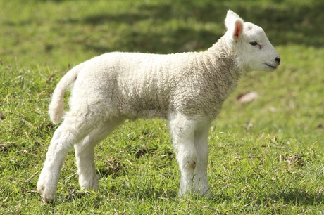
LESSON 1
Why did the Lord command Adam to offer sacrifices?

Slide 16
LESSON 1
Leviticus 1:2-4
2 Speak unto the children of Israel, and say unto them, If any man of you bring an offering unto the Lord, ye shall bring your offering of the cattle, even of the herd, and of the flock.
3 If his offering be a burnt sacrifice of the herd, let him offer a male without blemish: he shall offer it of his own voluntary will at the door of the tabernacle of the congregation before the Lord.
4 And he shall put his hand upon the head of the burnt offering; and it shall be accepted for him to make atonement for him.
What does “without blemish” mean?
How does this symbolize Jesus Christ?
2 Nephi 11:4
Behold, my soul delighteth in proving unto my people the truth of the coming of Christ; for, for this end hath the law of Moses been given; and all things which have been given of God from the beginning of the world, unto man, are the typifying of him.
What does the word typifying mean?
To symbolize or represent

Slide 17
LESSON 1
“In the Old Testament, Jesus Christ is known as Jehovah”

Slide 18
LESSON 1
Anointed One, Creator, Deliverer.
Job 19:25
Psalm 16:10
For I know that my redeemer liveth, and that he shall stand at the latter day upon the earth:
For thou wilt not leave my soul in hell; neither wilt thou suffer thine Holy One to see corruption.
Isaiah 7:14
Isaiah 9:6
Anointed One, Creator, Deliverer.
And behold at evening tide trouble; and before the morning he is not. This is the portion of them that spoil us, and the lot of them that rob us.
For unto us a child is born, unto us a son is given: and the government shall be upon his shoulder: and his name shall be called Wonderful, Counsellor, The mighty God, The everlasting Father, The Prince of Peace.
Isaiah 49:26
And I will feed them that oppress thee with their own flesh; and they shall be drunken with their own blood, as with sweet wine: and all flesh shall know that I the Lord am thy Saviour and thy Redeemer, the mighty One of Jacob.

Slide 19
LESSON 1
Genesis 2:4
¶ These are the generations of the heavens and of the earth when they were created, in the day that the Lord God made the earth and the heavens,
Jehovah
is the name of the premortal Jesus Christ, who is the God of Israel, is “the covenant or proper name of the God of Israel. It denotes ‘the eternal I AM’ .

Slide 20
LESSON 1
“Additional themes in the Old Testament”

Slide 21
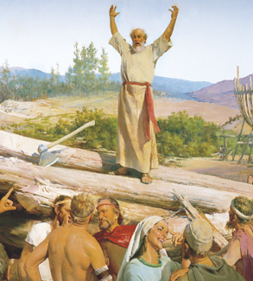
LESSON 1
How does Heavenly Father let us know that we are not forgotten?
How does Heavenly Father help us find our way back to Him?
How do prophets help us return to our Heavenly Father?
God calls prophets to preach the gospel and administer His covenants and ordinances.

Slide 22
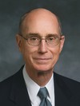
LESSON 1
“Heavenly Father has always helped his children by offering them covenants and empowering his servants to offer ordinances…
Every covenant with God is an opportunity to draw closer to him” (Henry B. Eyring, “Making Covenants with God”[Brigham Young University fireside, Sept. 8, 1996], 2, 3, speeches.byu.edu).
President
Henry B. Eyring
How do covenants and ordinances help us overcome our separation from God?
How well do you think the covenant-making and covenant-keeping process worked for Abraham?
Doctrine and Covenants 132:29
Abraham received all things, whatsoever he received, by revelation and commandment, by my word, saith the Lord, and hath entered into his exaltation and sitteth upon his throne.

Slide 23
LESSON 1
Deuteronomy 29:25-28
25 Then men shall say, Because they have forsaken the covenant of the Lord God of their fathers, which he made with them when he brought them forth out of the land of Egypt:
26 For they went and served other gods, and worshipped them, gods whom they knew not, and whom he had not given unto them:
27 And the anger of the Lord was kindled against this land, to bring upon it all the curses that are written in this book:
28 And the Lord rooted them out of their land in anger, and in wrath, and in great indignation, and cast them into another land, as it is this day.
God’s covenant people were scattered because they broke their covenants with Him.

Slide 24
LESSON 1
Ezekiel 36:24-28
24 For I will take you from among the heathen, and gather you out of all countries, and will bring you into your own land.
25 ¶ Then will I sprinkle clean water upon you, and ye shall be clean: from all your filthiness, and from all your idols, will I cleanse you.
26 A new heart also will I give you, and a new spirit will I put within you: and I will take away the stony heart out of your flesh, and I will give you an heart of flesh.
27 And I will put my spirit within you, and cause you to walk in my statutes, and ye shall keep my judgments, and do them.
28 And ye shall dwell in the land that I gave to your fathers; and ye shall be my people, and I will be your God.
How would you relate the Lord’s words in these verses to us?
God has promised to gather His covenant people when they keep His commandments.

Slide 25
LESSON 1

