Slide 1
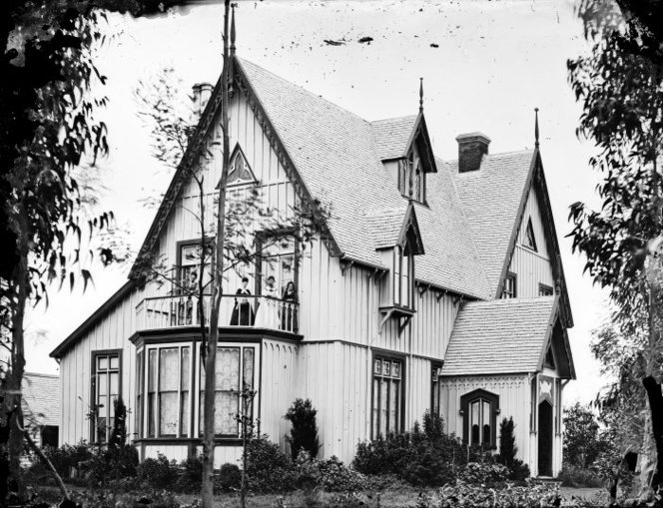
Page, John E.
Born: February 25,1799. Trenton, New York. Baptized: August 18, 1833. Ordained an Elder: September, 1833. Ordained an Apostle: December 19, 1838. Disfellowshipped: February 9, 1846. Excommunicated: June 27, 1846. Died: Fall of 1867, De Kalb County, Illinois. Parents: Ebenezer and Rachel Page. Married: Mary _________.
Trenton, House Oneida.

Slide 2
1836: In May, John Page was called on a mission to Canada. He objected because he has no suitable clothing, but Joseph Smith took his own coat off and gave it to him. He left on May 31 and stayed for seven months and twenty days. He came home and got his wife and two children and then returned to Canada to finish a two year mission.
1838: In company with a group of Saints, he left for Missouri in May. They arrived at De Witt, Missouri, in October, just when the Saints were being attacked by a mob which succeeded in driving the Saints away a few days later. The Saints found their way to Far West, and again underwent the persecutions that occurred there. John Page´s wife and two children did not survive but died as martyrs.

Slide 3
1839: Early in the year, he and his family left for Illinois, However, while en route, he met President Brigham Young who persuaded him to return of Far West to attend a secret conference meeting which was to be held April 26. Shortly thereafter, he moved his family below Warsaw, Hancock County, Illinois, and did not proceed as instructed by the Lord to travel to England with the other members of the Twelve.
1840: In April, he was set apart to go with Elder Orson Hyde to Palestine to dedicate that land for the return of the Jews. Elder Hyde left April 15, 1840., to make his way to Palestine. Elder John E. Page failed to make the journey. Instead of going to Palestine, he traveled through Indiana and Ohio, spending the winter of 1840-1841 preaching around Cincinnati.
1841: On January 19, the Lord designated the General, stake and local leaders of his Church. Elder Page was named as one of the Twelve traveling council (D&C 124:129). Elder Page arrived in Philadelphia in June and met with George A. Smith, who had returned from England. Elder Smith knew that the Saints were willing to raise enough money to support Elder Page on his assignment and urged him to go to Jerusalem.

Slide 4
1842: That spring, he finally complied with President Hyrum Smith`s request and returned to Nauvoo. However, in doing so, he gave several speeches in Pittsburgh and fashioned a petition, which he had the Saints sign, praying that Elder Page be sent to Pittsburgh.
1843: A conference was held in Nauvoo in April during which he was directed to go to Pittsburgh. He then began engaging in some strange activities. He organized a branch and drew up a constitution which stated that the president was to be elected and that the election would be every four months. He was elected to be the first president. Four months later, Elder Smith was elected president. Elder Page moved his family to Pittsburgh and continued to preach. That summer, members of the quorum of the Twelve went east on their missions and Heber C. Kimball and Orson Pratt met Elder Page in Cincinnati and reorganized the branch.

Slide 5
1844: On March 26, the Prophet wrote a memorial to Congress requesting the they pass an ordinance for the protection of citizens of the United States who were emigrating to the territories of California and Oregon and requesting permission to raise a company of one hundred thousand volunteers from various places over a period of time for this purpose. John E. Page and Orson Pratt (and later Orson Hyde) carried this memorial to Congress to urge consideration of the plan. Three months later-June 27, 1844-Joseph and Hyrum Smith were martyred.
1846: He was disfellowshipped February 9 by the council of the quorum of the Twelve. He became very bitter and worked to pull other Saints away, encouraging them to accept James J. Strang, an apostate, as their leader. He left Nauvoo and ran into a group of Saints coming from Canada. He lied to them and said he was one of the Twelve and that he was to instruct them to go to Woree, Wisconsin, which in where Mr. Strang was located. A few of the travelers were deceived but the majority were not; they sent ahead to Nauvoo to get instructions.
1867: He died near Sycamore, De Kalb County, Illinois.

