Slide 1
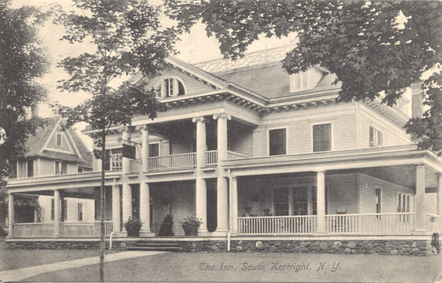
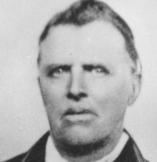
Born: July 15, 1792, Kortright, Delaware County, New York. Baptized: November 5 (December 5), 1830. Ordained an Elder: November, 1830. Ordained an Elder: 1831. Ordained a High Priest: June 6, 1831. Ordained Patriarch: February, 1835. Ordained Bishop: August 21, 1842. Ordained Bishop: February 14, 1849. Died: December 23, 1871, Beaver, Beaver, County, Utah. Parents: John Murdock and Eleanor Riggs. Married: (1) Julia Clapp, December 14, 1823-five children. (She died April 30, 1831). Married: (2) Amoranda Turner, February 4, 1836-no children. (She died August 16, 1837). Married: (3) Electa Allen, May 3, 1838-three children. (She died October, 1845). Married: (4) Sarah Zufelt, March 13, 1846-one child. Vocation: Farmer.
Murdock, John
Delaware County NY Genealogy and History Site

Slide 2
1830: Missionary work began Immediately after the organization of the Church. The elders were successful in Kirtland. John Murdock was among the several converts who joined the Church at that time.
1831: When his wife died April 30, he was left with five small children, two of whom were just six-hour-old-twins. Joseph and Emma Smith, having just lost their own twins, received these infants to be raised in their family. An important conference of the Church was held June 3-6, 1831, during which the first high priests in this dispensation were ordained. John Murdock was one of the brethren ordained.
1833: During the spring of 1833, he lived with Joseph Smith. In August, the Lord gave a revelation through Joseph Smith instructing John Murdock regarding his work in the ministry (D&C 99). After the temple was built in Kirtland, he received instructions and the washing of feet, and beheld the face of the Lord, according to the promise and prayer of the Prophet.

Slide 3
1847: On September 24, he came to Utah with the Captain Wallace Company. He was sustained as the first bishop of the Salt Lake 14th Ward.
1849 and succeeding years: The missionaries were sent out to many different foreign lands with varying degrees of success. John Murdock and Charles W. Wandell carried the Gospel into Australia. He was a member of the first House of Representatives of the State of Deseret.
John Murdock served several missions: In 1830 he served in Geauga County, Ohio, and surrounding counties. When he was called by revelation June 7, 1831, on a special mission to Missouri, he preached in Michigan, Indiana, Illinois and Missouri. While traveling from Missouri to Ohio, he performed missionary work in Missouri, Illinois, Indiana, and Ohio in company with Parley P. Pratt. In Ohio, Pennsylvania, and other areas, he traveled with David W. Patten and others.
1871: He died December 23, in Beaver, Utah.

