Slide 1
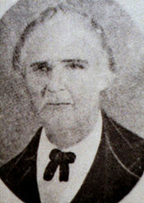
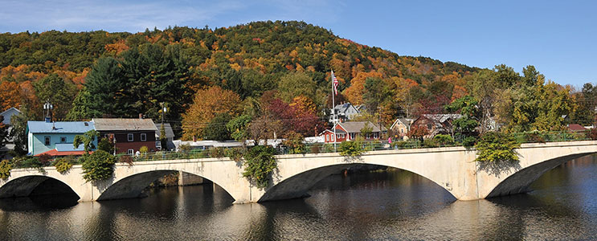
Morley (Morely), Isaac
Born: March 11, 1786, Montague, Franklin County, Massachusetts. Baptized: November 15, 1830. Ordained an Elder: October, 1830. Ordained a High Priest: June 3, 1831. Died: July (June) 21, Fairview, Sanpete County, Utah. Parents: Thomas E. (G.) Morley and Editha Marsh. Married: (1) Lucy Gunn (Gun), June 20, 1812-seven children. Married: (2) Hannah Blakeslee Finch, 1844, Nauvoo, Illinois-three children. Married: (3) Abigail Leonora Snow, 1844, Nauvoo, Illinois-no children listed. Vocations: Cooper and Senator.
Bridge of Flowers, Shelburne Falls

Slide 2
1833: When a mob approached Independence on the morning of July 23, threatening to beat any church member they captured and to demolish their dwellings, etc., several of the leading elders, including Isaac Morley, offered themselves as ransom for the Church. Recognizing the dangerous situation the Church members were in, these brethren entered into an agreement with the mob that the Church members would leave the county within a reasonable time.
1830: Missionary work began immediately after the organization of the Church. The elders were successful in Kirtland. Isaac Morley was among the several converts who joined the Church at that time.
1831: An important conference of the Church was held June 3-6 during which the first high priests in this dispensation were ordained. Isaac Morley was one of the brethren ordained that day. He and John Corrill were then sustained and ordained as assistants, or counselors, to Bishop Whitney.

Slide 3
1835: Elder Morley accompanied Bishop Partridge on a mission to the eastern states.
1836: In March, he attended the Kirtland Temple dedication. He then then returned to Missouri and helped establish Far West.
1837: A general assembly was held November 7 in which Isaac Morley was sustained patriarch at Far West. He was Subsequently ordained to that office by Joseph Smith, Sidney Rigdon and Hyrum Smith.
1838: When General John Clark and his army arrived in Far West with governor Boggs’s Extermination Order, Brother Morley was one of the fifty-six men apprehended by the military and marched to Richmond for trial.

Slide 4
1848: He moved to Winter Quarters where he buried his wife. He then emigrated to the Great Salt Lake Valley.
1838-1844: When the Saints were expelled from Missouri, Morley settled in Illinois at a place they called Yelrome. He was employed in the coopering business.
1849: He led a company that settled the Sanpete Valley. He served as senator in the general assembly of the provisional of Desert.
1845: His houses, business, Property and grain were burned by the mob and he was driven to Nauvoo where he stayed until the Saints were expelled from Illinois.

Slide 5
1856-June 24,1865: He spent the last ten years of his life fulfilling his calling as patriarch. He died June 24, at Fairview. He was fondly referred to by those who knew him as “Father Morley”.

