Slide 1
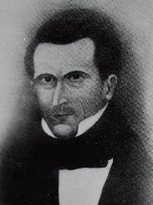
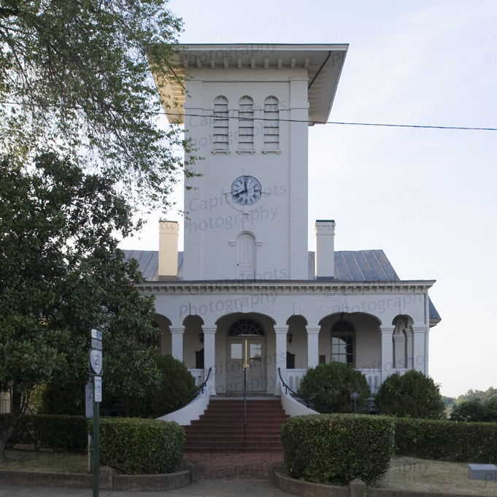
Miller, George
Born: November 25, 1794, Orange County Virginia. Baptized: August 12, 1839. Ordained a High Priest: Prior to 1840. Died: 1855 or 56 in Illinois en route to California. Parents: John Miller and Margaret Pfeiffer. Married: Mary Catherine Fry, prior to 1827-four children. Vocations: Carpenter.
Orange County Courthouse

Slide 2
1819: George Miller was initiated into Masonry.
1841: On January 19, the Lord, by revelation, sealed the office of bishopric upon George Miller. Miller was also instructed, with others, to help build the Nauvoo House. Miller, Lyman Wight, John Snider and Peter Haws were further instructed to organize themselves and select one of themselves to be president of their quorum for the purpose of building the Nauvoo House.
1841-1844: From November or 1841 until 1844, Miller served as presiding bishop in Nauvoo, Illinois. On March 11, 1844 he was made a member of the Council of Fifty. During this same period of time, conspirators were plotting the death of the Prophet. Joseph called his most trusted followers from the high council the Legion and the police together to form a plan.

Slide 3
1847: In January, George Miller rejected Brigham Young’s leadership and joined with Lyman Wight. In November, Elder Hyde reported to the Council of the Twelve at Winter Quarters that Bishop George Miller had action taken against him because he failed to follow counsel and had moved to Texas instead of continuing on to the Rocky Mountains. This action was approved by the Council of the Twelve.
1848-1849: indicates Miller was disfellowshipped December 3, 1849.
1850: He joined with the James Strang group.
1855: He died in Illinois while en route to California.

