Slide 1
LESSON 15
SEMINARY
Doctrine and Covenants
and Church History

Slide 2
LESSON 160
The Living Prophet.

Slide 3
LESSON 160
“Continuing revelation through a living prophet”

Slide 4
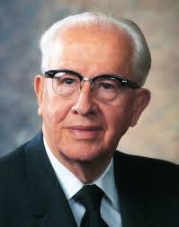
LESSON 160
Who is the most important prophet for you?
“The most important prophet, so far as we are concerned, is the one who is living in our day and age” (“Jesus Christ—Gifts and Expectations,” New Era, May 1975,17).
President
Ezra Taft Benson
Why do you think the living prophet is the most important prophet for us?
“This is the prophet who has today’s instructions from God to us. … Every generation has need of the ancient scripture, plus the current scripture from the living prophet. Therefore, the most crucial reading and pondering that you should do is of the latest inspired words from the Lord’s mouthpiece. That is why it is essential that you have access to and carefully read his words in Church periodicals” (“Jesus Christ—Gifts and Expectations,”17).
President
Ezra Taft Benson

Slide 5
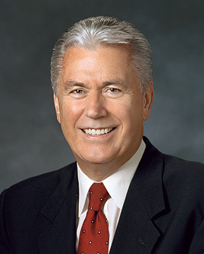
LESSON 160
What you have learned in recent lessons, when has the President of the Church declared revelations for the entire Church or announced significant changes in the way the Church operates?
“One of the glorious messages of the Restoration of the Church of Jesus Christ is that God continues to speak to His children! He is not hidden in the heavens but speaks today as He did in ancient days.…
“God’s priceless instructions to humankind are found in the Bible, the Book of Mormon, the Doctrine and Covenants, and the Pearl of Great Price. In addition, the Lord speaks to us through His servants, as He will again at … general conference” (“Why Do We Need Prophets?” Ensign, March 2012,4).
Elder
Dieter F. Uchtdorf
What doctrine concerning revelation did Elder Uchtdorf teach?
The Lord continues to speak to us today through His living prophet.
Where can we find the words of the living prophet?

Slide 6
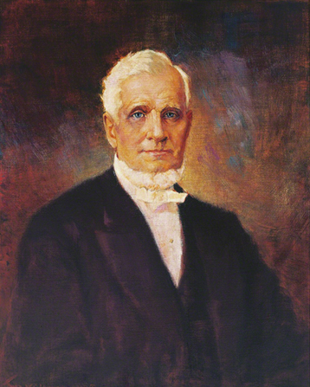
LESSON 160
“We require a living tree—a living fountain—living intelligence, proceeding from the living priesthood in heaven, through the living priesthood on earth. … And from the time that Adam first received a communication from God, … it always required new revelations, adapted to the peculiar circumstances in which the churches or individuals were placed. Adam’s revelation did not instruct Noah to build his ark; nor did Noah’s revelation tell Lot to forsake Sodom; nor did either of these speak of the departure of the children of Israel from Egypt” (in The Gospel Kingdom, sel. G. Homer Durham [1987],34).
President
John Taylor
Why do we need a living prophet?
How can understanding the need for continuing revelation affect the way you listen to or read the words of the living prophet?

Slide 7
LESSON 160
“Following the counsel of the living prophet”

Slide 8
LESSON 160
Which of these principles or doctrines do you feel are especially relevant to you? Why?
In what ways are you and your family trying to follow the counsel of the prophet?
Why do you think it is important that we study and apply what the current President of the Church is teaching?
What messages do you feel the Lord wants you to receive?
What will you do because of the prophet’s recent counsel?

