Slide 1
LESSON 15
SEMINARY
Doctrine and Covenants
and Church History

Slide 2
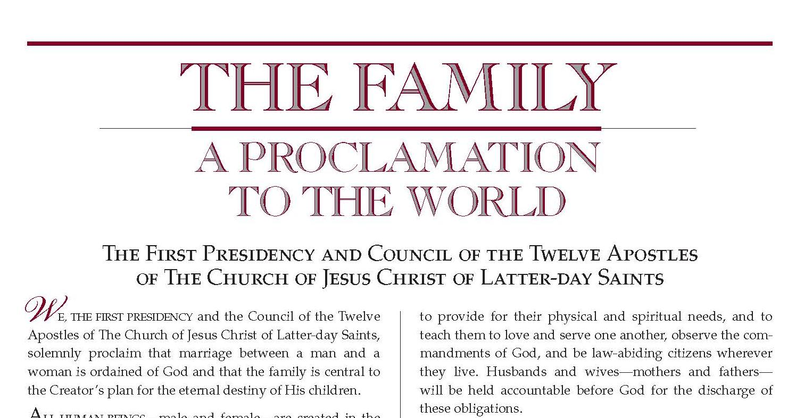
LESSON 159

Slide 3
LESSON 159
“The First Presidency and the Quorum of the Twelve Apostles issue a proclamation to the world concerning the family”.

Slide 4
LESSON 159
The importance of marriage and family
Divorce
Same-sex marriage
Gender
Having children
Sexual relations outside of marriage
Roles of mothers
Roles of fathers
Abortion

Slide 5
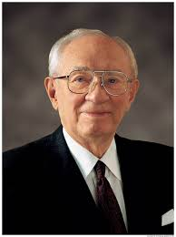
LESSON 159
Where can we find the Lord’s instructions on these topics?
“With so much of sophistry that is passed off as truth, with so much of deception concerning standards and values, with so much of allurement and enticement to take on the slow stain of the world, we have felt to warn and forewarn. In furtherance of this we of the First Presidency and the Council of the Twelve Apostles now issue a proclamation to the Church and to the world as a declaration and reaffirmation of standards, doctrines, and practices relative to the family which the prophets, seers, and revelators of this church have repeatedly stated throughout its history” (“Stand Strong against the Wiles of the World, ”Ensign, Nov. 1995,100).
President
Gordon B. Hinckley
Why was this proclamation issued to the Church and the world?

Slide 6
LESSON 159
Marriage between a man and a woman is ordained of God.
The family is central to Heavenly Father’s plan.
Gender is an essential characteristic of individual premortal, mortal, and eternal identity and purpose.
The plan of happiness enables family relationships to continue after death.
God’s commandment for husbands and wives to have children remains in force today.
God has commanded that the sacred powers of procreation are to be employed only between a man and a woman who are legally married.
The creation of mortal life is a sacred and important part of Heavenly Father’s plan.

Slide 7
LESSON 159
How does this doctrine relate to the topics listed on the board?
Why do you think it is important to understand this doctrine?
How can understanding and believing this doctrine influence the decisions you make?

Slide 8
LESSON 159
“The family proclamation helps us establish
successful families”

Slide 9
LESSON 159
What types of activities, characteristics, attitudes, and beliefs do you think will bring happiness to your future family?
How is happiness in families most likely to be achieved?
Happiness in family life is most likely to be achieved when founded upon the teachings of the Lord Jesus Christ.

Slide 10
LESSON 159
HUSBAND AND WIFE have a solemn responsibility to love and care for each other and for their children. “Children are an heritage of the Lord” (Psalm 127:3). Parents have a sacred duty to rear their children in love and righteousness, to provide for their physical and spiritual needs, and to teach them to love and serve one another, observe the commandments of God, and be law-abiding citizens wherever they live. Husbands and wives—mothers and fathers—will be held accountable before God for the discharge of these obligations.
THE FAMILY is ordained of God. Marriage between man and woman is essential to His eternal plan. Children are entitled to birth within the bonds of matrimony, and to be reared by a father and a mother who honor marital vows with complete fidelity. Happiness in family life is most likely to be achieved when founded upon the teachings of the Lord Jesus Christ. Successful marriages and families are established and maintained on principles of faith, prayer, repentance, forgiveness, respect, love, compassion, work, and wholesome recreational activities. By divine design, fathers are to preside over their families in love and righteousness and are responsible to provide the necessities of life and protection for their families. Mothers are primarily responsible for the nurture of their children. In these sacred responsibilities, fathers and mothers are obligated to help one another as equal partners. Disability, death, or other circumstances may necessitate individual adaptation. Extended families should lend support when needed.
What are some principles that help families find happiness?

Slide 11
LESSON 159
What examples have you seen of families following the teachings listed on the board?
Why do you think families that follow these teachings are more likely to be happy?
What are the responsibilities of fathers?
In what ways have you seen your father or other fathers fulfill these responsibilities?
What is the primary responsibility of mothers?
In what ways have you seen your mother or other mothers fulfill this role?
What does it mean that these responsibilities are given “by divine design”?
Which phrases in paragraph 7 help us understand how fathers and mothers are to help each other?
Fathers and mothers are obligated to help each other as equal partners in their family responsibilities.
Why do you think it is important for mothers and fathers to understand that they are equal partners?

Slide 12
LESSON 159
WE WARN that individuals who violate covenants of chastity, who abuse spouse or offspring, or who fail to fulfill family responsibilities will one day stand accountable before God. Further, we warn that the disintegration of the family will bring upon individuals, communities, and nations the calamities foretold by ancient and modern prophets.
WE CALL UPON responsible citizens and officers of government everywhere to promote those measures designed to maintain and strengthen the family as the fundamental unit of society.
What will happen if we neglect our family responsibilities?
The Lord will hold us accountable if we do not fulfill our responsibilities in our families.
What responsibilities do you think children have in the family?

