Slide 1
LESSON 15
SEMINARY
Doctrine and Covenants
and Church History

Slide 2
LESSON 158
Hastening the Work of Salvation

Slide 3
LESSON 158
“The Lord is hastening His work”

Slide 4
LESSON 158
What does it mean to hasten something?
To accelerate it.
What are some reasons someone might hasten, or accelerate, at ask?
Doctrine and Covenants 88:73
Behold, I will hasten my work in its time.
What do you think it means for the Lord to hasten His work?
We live in a time when the Lord is hastening His work.
What are some of the ways you have witnessed the Lord hastening His work?

Slide 5
LESSON 158
Doctrine and Covenants 133:10
Yea, let the cry go forth among all people: Awake and arise and go forth to meet the Bridegroom; behold and lo, the Bridegroom cometh; go ye out to meet him. Prepare yourselves for the great day of the Lord.
What does this verse suggest about why the Lord would hasten His work?
What do you think President Kimball meant when he said that we must “lengthen our stride”?

Slide 6
LESSON 158
Teaching Assignment 1: Hastening missionary work.
Teaching Assignment 2: New editions of the scriptures.
Teaching Assignment 3: Hastening temple and family history work.

Slide 7
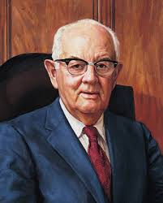
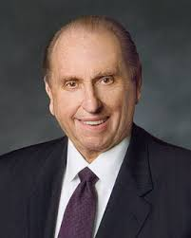
LESSON 158
Teaching Assignment 1: Hastening missionary work.
“I know they have curtains, like iron curtains and bamboo curtains. I know how difficult it is because we have made some efforts. … But I can see no good reason why the Lord would open doors that we are not prepared to enter. Why should he break down the Iron Curtain or the Bamboo Curtain or any other curtain if we are still unprepared to enter?” (“When the World Will Be Converted,” Ensign, Oct. 1974,5,7).
“There remain … areas of the world where our influence is limited and where we are not allowed to share the gospel freely. As did President Spencer W. Kimball over 32 years ago, I urge you to pray for the opening of those areas, that we might share with them the joy of the gospel. As we prayed then in response to President Kimball’s pleadings, we saw miracles unfold as country after country, formerly closed to the Church, was opened. Such will transpire again as we pray with faith” (“Welcome to Conference,” Ensign or Liahona, Nov. 2008,6).
“The question is frequently asked: Should every young man fill a mission? And the answer has been given by the Lord. It is ‘Yes.’ Every young man should fill a mission” (“When the World Will Be Converted,”8).

Slide 8
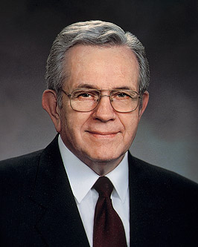
LESSON 158
Teaching Assignment 2: New editions of the scriptures.
“I find that when I get casual in my relationships with divinity and when it seems that no divine ear is listening and no divine voice is speaking, that I am far, far away. If I immerse myself in the scriptures the distance narrows and the spirituality returns” (The Teachings of Spencer W. Kimball, ed. Edward L. Kimball [1982],135).
“With the passing of years, these scriptures will produce successive generations of faithful Christians who know the Lord Jesus Christ and are disposed to obey His will.
“…They will develop a gospel scholarship beyond that which their forebears could achieve. They will have the testimony that Jesus is the Christ and be competent to proclaim Him and to defend Him” (“Scriptures,” Ensign, Nov. 1982,53).

Slide 9
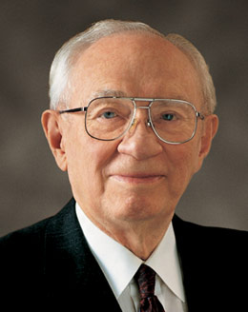
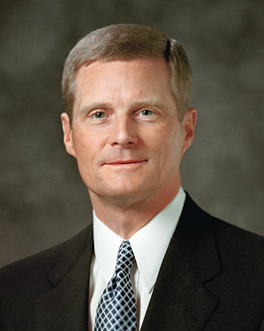
LESSON 158
Teaching Assignment 3: Hastening temple and family history work.
“I have a burning desire that a temple be located within reasonable access to Latter-day Saints throughout the world. … The work is moving about as fast as we can go. It is my constant prayer that somehow it might be speeded up so that more of our people might have easier access to a sacred house of the Lord” (“Of Missions, Temples, and Stewardship,” Ensign,Nov. 1995, 52,53).
“It is no coincidence that FamilySearch and other tools have come forth at a time when young people are so familiar with a wide range of information and communication technologies. Your fingers have been trained to text and tweet to accelerate and advance the work of the Lord—not just to communicate quickly with your friends. The skills and aptitude evident among many young people today are a preparation to contribute to the work of salvation” (“The Hearts of the Children Shall Turn,” Ensignor Liahona, Nov. 2011,26).

Slide 10
LESSON 158
“Our responsibility in moving the work forward”

Slide 11
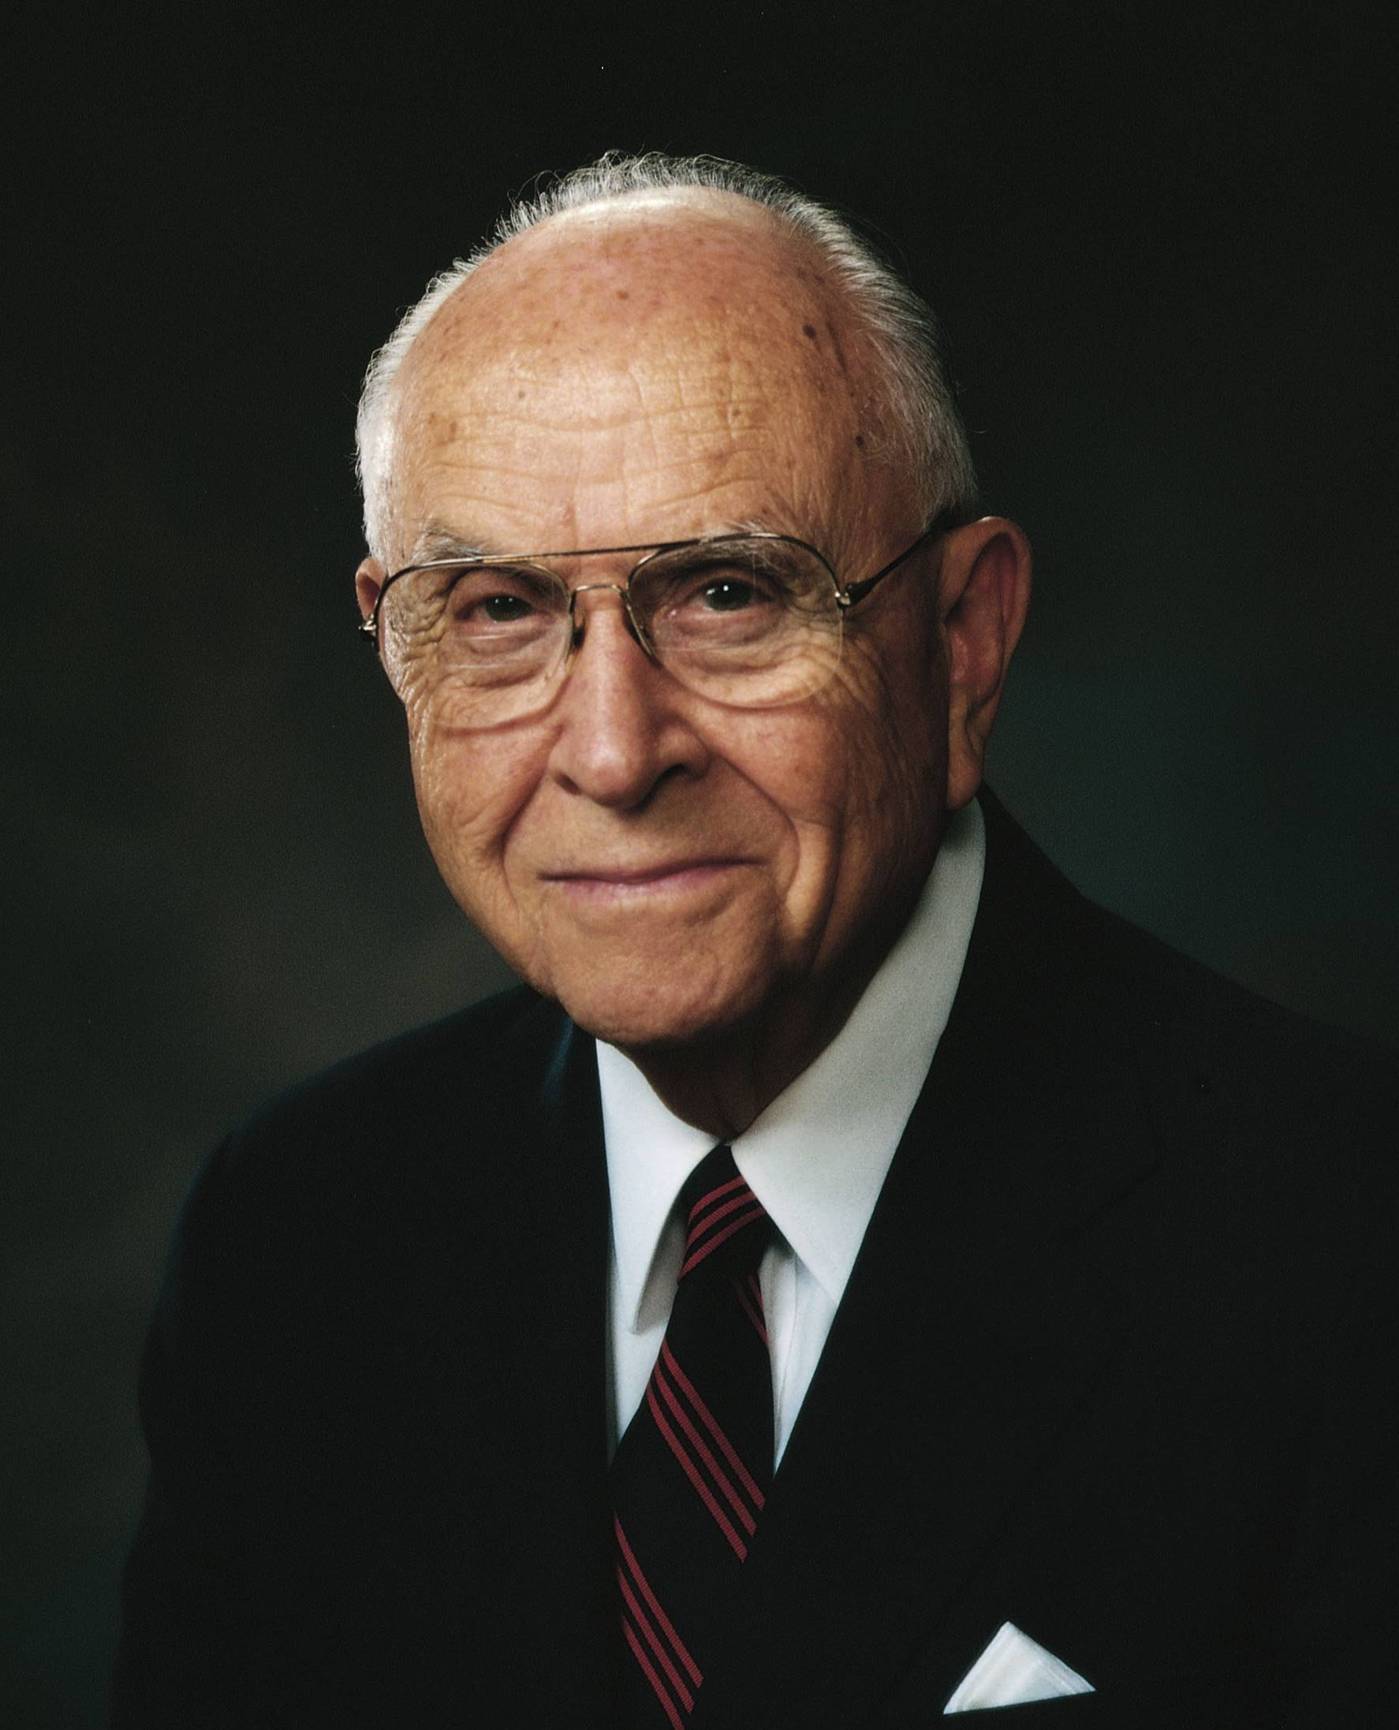
LESSON 158
“Brothers and sisters, the Lord is opening the way and making it possible to expand His work throughout the world, and what a blessing it is for all of us—each in his own way—to take part.…
“Who but the prophets of God could have foreseen the miracle of the rapid expansion of the work of the Lord? Truly, as the Lord foretold in section 88 of the Doctrine and Covenants, He is hastening His work in its time (seeD&C 88:73)” (“Missionary Work—Our Responsibility,” Ensign, Nov. 1993, 61,62).
What can happen as we take part in the Lord’s work?
We can be blessed by taking part in the hastening of the Lord’s work.
What blessings have you experienced as you have participated in the hastening of the Lord’s work?
What are some ways you can contribute to the hastening of the Lord’s work?

