Slide 1
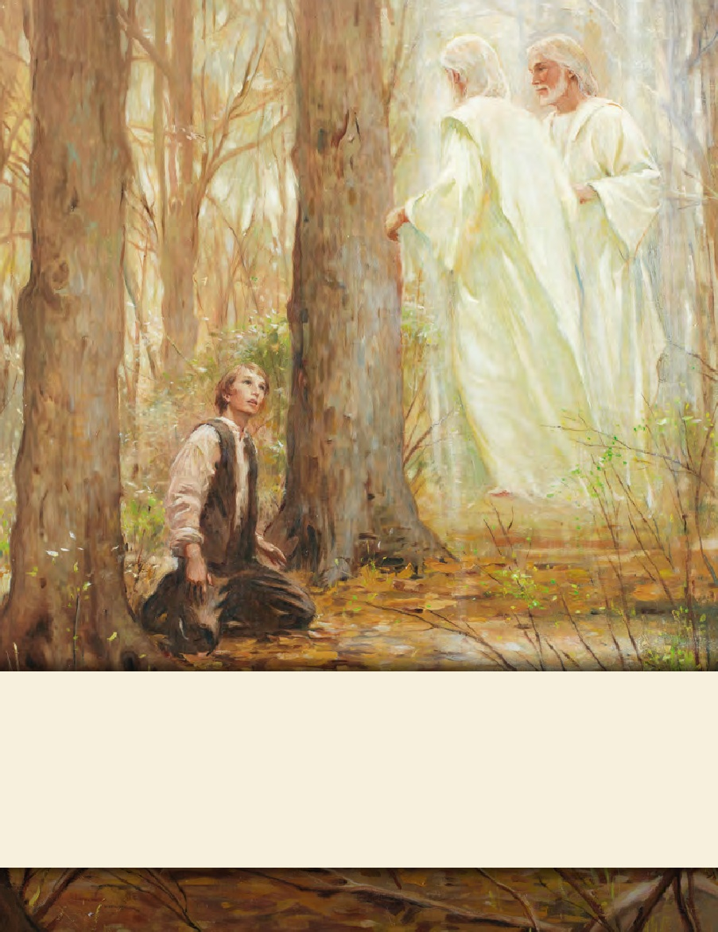
LESSON 15
SEMINARY
Doctrine and Covenants
and Church History

Slide 2
LESSON 157
Official Declaration 2

Slide 3
LESSON 157
Official Declaration 2
“The Lord reveals that priesthood and temple blessings may be extended to every worthy Church member”

Slide 4
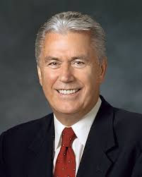
LESSON 157
What would you encourage your friend to do?
“My dear young friends, we are a question-asking people because we know that inquiry leads to truth.…
“…Inquiry is the birthplace of testimony. Some might feel embarrassed or unworthy because they have searching questions regarding the gospel, but they needn’t feel that way. Asking questions isn’t a sign of weakness; it’s a precursor of growth.
“God commands us to seek answers to our questions (see James 1:5–6) and asks only that we seek ‘with a sincere heart, with real intent,
Elder
Dieter F. Uchtdorf
having faith in Christ’ (Moroni 10:4). When we do so, the truth of all things can be manifested to us ‘by the power of the Holy Ghost’ (Moroni 10:5).
“Fear not; ask questions. Be curious, but doubt not! Always hold fast to faith and to the light you have already received” (“The Reflection in the Water” [Church Educational System devotional, Nov. 1, 2009],LDS.org).
What did President Uchtdorf teach that could help someone who has questions about the Church?

Slide 5
LESSON 157
“On a clear April night in 1972 … Helvécio Martins contemplated his family’s search for truth. He and his wife, Rudá, had investigated many religions, but none seemed to fill their spiritual void. ‘I conversed with God that night, asking for help,’ he says” (“Elder Helvécio Martins of the Seventy, ”Ensign, May 1990,106). A few days later missionaries came to their home in Rio de Janeiro, Brazil. Elder Martins recalled, “The moment those two young men stepped into our apartment, all of my gloom and spiritual discomfort immediately disappeared and was replaced by a calm and serenity which I now know came from the influence of the Holy Spirit” (with Mark Grover, The Autobiography of Elder Helvécio Martins[1994],43).
Elder
Helvécio Martins
What questions might you have had as you learned of the priesthood restriction?

Slide 6
LESSON 157
“The Book of Mormon teaches that ‘all are alike unto God,’ including ‘black and white, bond and free, male and female’ (2Nephi 26:33). Throughout the history of the Church, people of every race and ethnicity in many countries have been baptized and have lived as faithful members of the Church. During Joseph Smith’s lifetime, a few black male members of the Church were ordained to the priesthood. Early in its history, Church leaders stopped conferring the priesthood on black males of African descent. Church records offer no clear insights into the origins of this practice.”
What questions about the priesthood restriction can be answered through this statement?

Slide 7
LESSON 157
The Martins family was baptized on July 2, 1972, and served faithfully in the Church. When their oldest son, Marcus, received his patriarchal blessing, it promised that he would preach the gospel. Although the priesthood restriction at that time prevented Marcus from serving a full-time mission, his parents opened a missionary savings account. In 1975 the Church announced that a temple would be built in São Paulo, Brazil. To help with the fundraising, Sister Martins sold her jewelry. Brother Martins faithfully served as a member of the publicity committee for the temple. The Martins family made these sacrifices even though they believed they would not have the opportunity to receive priesthood ordinances in the temple.
Why do you think the Martins family was willing to be baptized and serve faithfully in the Church, even though they were affected by the priesthood restriction at that time?

Slide 8
LESSON 157
“‘We had found the truth, and nothing would stop us from living it.’ … ‘When the Spirit tells you the gospel is true, how can you deny it?’” (in“ Elder Helvécio Martins of the Seventy,” 106).
How can the Martins family serve as an example for you when you have questions?
We can hold fast to what we already know and stand strong until additional knowledge comes.

Slide 9
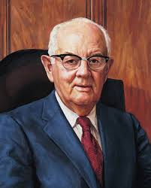
LESSON 157
Inform students that Official Declaration 2contains the official announcement of a revelation President Spencer W. Kimball received on June 1, 1978. Invite a student to read aloud the first paragraph under the phrase “Dear Brethren.” Invite the class to follow along, looking for what Church leaders said they had witnessed.
What had Church leaders witnessed throughout the earth?
What were Church leaders inspired with as they witnessed the expansion of the Lord’s work?

Slide 10
LESSON 157
Aware of the promises made by the prophets and presidents of the Church who have preceded us that at some time, in God’s eternal plan, all of our brethren who are worthy may receive the priesthood, and witnessing the faithfulness of those from whom the priesthood has been withheld, we have pleaded long and earnestly in behalf of these, our faithful brethren, spending many hours in the Upper Room of the Temple supplicating the Lord for divine guidance.
How did President Spencer W. Kimball and other Church leaders act on their inspired desires?
What does this teach us about prophets?
Prophets seek the Lord’s guidance in directing the Church.
“Aware of the promises made by the prophets.”
What does this phrase and the sentence it introduces teach us about what Church leaders knew regarding the restriction of the priesthood?

Slide 11
LESSON 157
He has heard our prayers, and by revelation has confirmed that the long-promised day has come when every faithful, worthy man in the Church may receive the holy priesthood, with power to exercise its divine authority, and enjoy with his loved ones every blessing that flows therefrom, including the blessings of the temple. Accordingly, all worthy male members of the Church may be ordained to the priesthood without regard for race or color. Priesthood leaders are instructed to follow the policy of carefully interviewing all candidates for ordination to either the Aaronic or the Melchizedek Priesthood to insure that they meet the established standards for worthiness.
We declare with soberness that the Lord has now made known his will for the blessing of all his children throughout the earth who will hearken to the voice of his authorized servants, and prepare themselves to receive every blessing of the gospel.
What was the Lord’s response to the prayers of His prophets?
What does this teach us about how the Lord directs His Church?
The Lord directs His Church through revelation to His prophets.

Slide 12
LESSON 157
“I could not contain my emotions. Rudá and I went into our bedroom, knelt down, and prayed. We wept as we thanked our Father in Heaven for an event we had only dreamed about. The day had actually arrived, and in our mortal lives” (Autobiography,69–70). The Martins family was sealed in the temple. Their son Marcus was the first Church member of African descent to serve a mission after the revelation to end the priesthood restriction. Helvécio Martins became a local priesthood leader and eventually was called to serve as a member of the Second Quorum of the Seventy.

