Slide 1
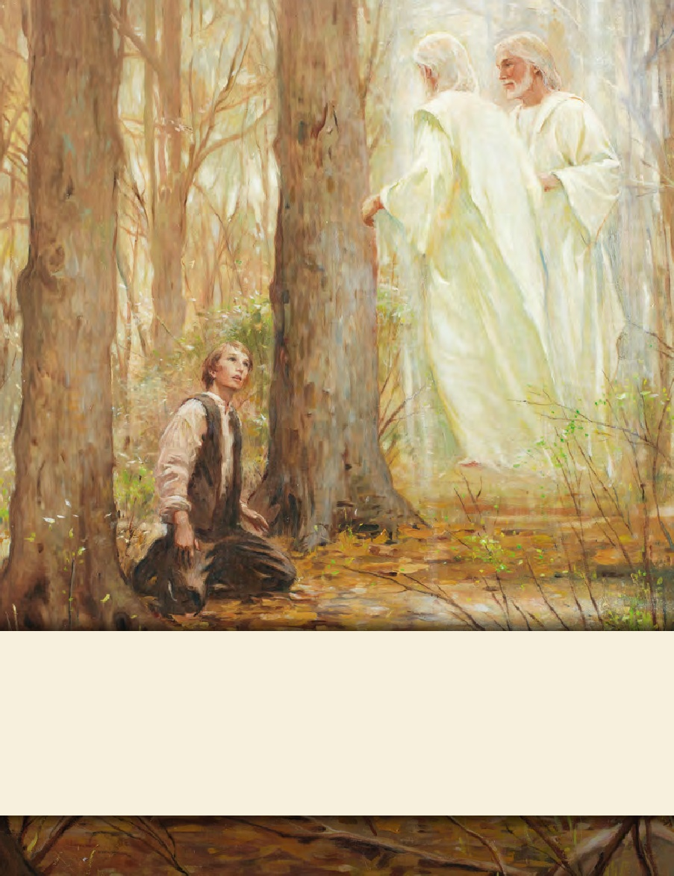
LESSON 15
SEMINARY
Doctrine and Covenants
and Church History

Slide 2
LESSON 155
Doctrine and Covenants 138:7–60

Slide 3
LESSON 155
Doctrine and Covenants 138:7–37.
“President Joseph F. Smith learns how the gospel was preached in the spirit world”

Slide 4
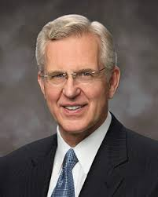
LESSON 155
How can we know which beliefs about life after death are accurate?
“The scriptures are the touchstone for measuring correctness and truth” (“The Blessing of Scripture,” Ensign or Liahona, May 2010,34).
Elder
D. Todd Christofferson

Slide 5
LESSON 155
Doctrine and Covenants 138:12–15, 22
12 And there were gathered together in one place an innumerable company of the spirits of the just, who had been faithful in the testimony of Jesus while they lived in mortality;
13 And who had offered sacrifice in the similitude of the great sacrifice of the Son of God, and had suffered tribulation in their Redeemer’s name.
14 All these had departed the mortal life, firm in the hope of a glorious resurrection, through the grace of God the Father and his Only Begotten Son, Jesus Christ.
15 I beheld that they were filled with joy and gladness, and were rejoicing together because the day of their deliverance was at hand.
22 Where these were, darkness reigned, but among the righteous there was peace;
Spirit Paradise
Spirit Prison

Slide 6
LESSON 155
Doctrine and Covenants 138:20-22.
20 But unto the wicked he did not go, and among the ungodly and the unrepentant who had defiled themselves while in the flesh, his voice was not raised;
21 Neither did the rebellious who rejected the testimonies and the warnings of the ancient prophets behold his presence, nor look upon his face.
22 Where these were, darkness reigned, but among the righteous there was peace;
Spirit Paradise
Spirit Prison

Slide 7
LESSON 155
Doctrine and Covenants 138:7–10.
7 “For Christ also hath once suffered for sins, the just for the unjust, that he might bring us to God, being put to death in the flesh, but quickened by the Spirit:
8 “By which also he went and preached unto the spirits in prison;
9 “Which sometime were disobedient, when once the longsuffering of God waited in the days of Noah, while the ark was a preparing, wherein few, that is, eight souls were saved by water.” (1 Peter 3:18–20.)
10 “For for this cause was the gospel preached also to them that are dead, that they might be judged according to men in the flesh, but live according to God in the spirit.” (1 Peter 4:6.)
What did Peter say the Savior did when He went to the spirit world?

Slide 8
LESSON 155
Doctrine and Covenants 138:25–28.
25 I marveled, for I understood that the Savior spent about three years in his ministry among the Jews and those of the house of Israel, endeavoring to teach them the everlasting gospel and call them unto repentance;
26 And yet, notwithstanding his mighty works, and miracles, and proclamation of the truth, in great power and authority, there were but few who hearkened to his voice, and rejoiced in his presence, and received salvation at his hands.
27 But his ministry among those who were dead was limited to the brief time intervening between the crucifixion and his resurrection;
28 And I wondered at the words of Peter—wherein he said that the Son of God preached unto the spirits in prison, who sometime were disobedient, when once the long-suffering of God waited in the days of Noah—and how it was possible for him to preach to those spirits and perform the necessary labor among them in so short a time.
What was President Smith’s question?
How was it possible for the Lord to preach the gospel to all of the people in spirit prison in only three days?

Slide 9
LESSON 155
Doctrine and Covenants 138:29–32.
29 And as I wondered, my eyes were opened, and my understanding quickened, and I perceived that the Lord went not in person among the wicked and the disobedient who had rejected the truth, to teach them;
30 But behold, from among the righteous, he organized his forces and appointed messengers, clothed with power and authority, and commissioned them to go forth and carry the light of the gospel to them that were in darkness, even to all the spirits of men; and thus was the gospel preached to the dead.
31 And the chosen messengers went forth to declare the acceptable day of the Lord and proclaim liberty to the captives who were bound, even unto all who would repent of their sins and receive the gospel.
32 Thus was the gospel preached to those who had died in their sins, without a knowledge of the truth, or in transgression, having rejected the prophets.
How did the Savior preach the gospel to those in spirit prison in such a short amount of time?
Under the direction of Jesus Christ, righteous messengers teach the gospel to those in spirit prison.

Slide 10
LESSON 155
Doctrine and Covenants 138:33–34.
33 These were taught faith in God, repentance from sin, vicarious baptism for the remission of sins, the gift of the Holy Ghost by the laying on of hands,
34 And all other principles of the gospel that were necessary for them to know in order to qualify themselves that they might be judged according to men in the flesh, but live according to God in the spirit.
Spirit Paradise
How do these teachings compare with what people are taught as they prepare for baptism in mortality?
What is “vicarious baptism”?
Spirit Prison
Why do these principles of the gospel need to be preached to those in spirit prison?

Slide 11
LESSON 155
Doctrine and Covenants 138:35–37.
35 And so it was made known among the dead, both small and great, the unrighteous as well as the faithful, that redemption had been wrought through the sacrifice of the Son of God upon the cross.
36 Thus was it made known that our Redeemer spent his time during his sojourn in the world of spirits, instructing and preparing the faithful spirits of the prophets who had testified of him in the flesh;
37 That they might carry the message of redemption unto all the dead, unto whom he could not go personally, because of their rebellion and transgression, that they through the ministration of his servants might also hear his words.
Why do you think it is important to know that all of Heavenly Father’s children will have the opportunity to hear and accept the gospel of Jesus Christ?

Slide 12
LESSON 155
Doctrine and Covenants 138:38–60
“President Smith sees the noble and great spirits who would preach the gospel in spirit prison”

Slide 13
LESSON 155
Have you ever wondered what they are doing in the spirit world?
Doctrine and Covenants 138:53–56
53 The Prophet Joseph Smith, and my father, Hyrum Smith, Brigham Young, John Taylor, Wilford Woodruff, and other choice spirits who were reserved to come forth in the fulness of times to take part in laying the foundations of the great latter-day work,
54 Including the building of the temples and the performance of ordinances therein for the redemption of the dead, were also in the spirit world.
55 I observed that they were also among the noble and great ones who were chosen in the beginning to be rulers in the Church of God.
56 Even before they were born, they, with many others, received their first lessons in the world of spirits and were prepared to come forth in the due time of the Lord to labor in his vineyard for the salvation of the souls of men.
How have latter-day Church leaders helped the spirits in prison?
When did these leaders begin preparing for the work they would do here on the earth?

Slide 14
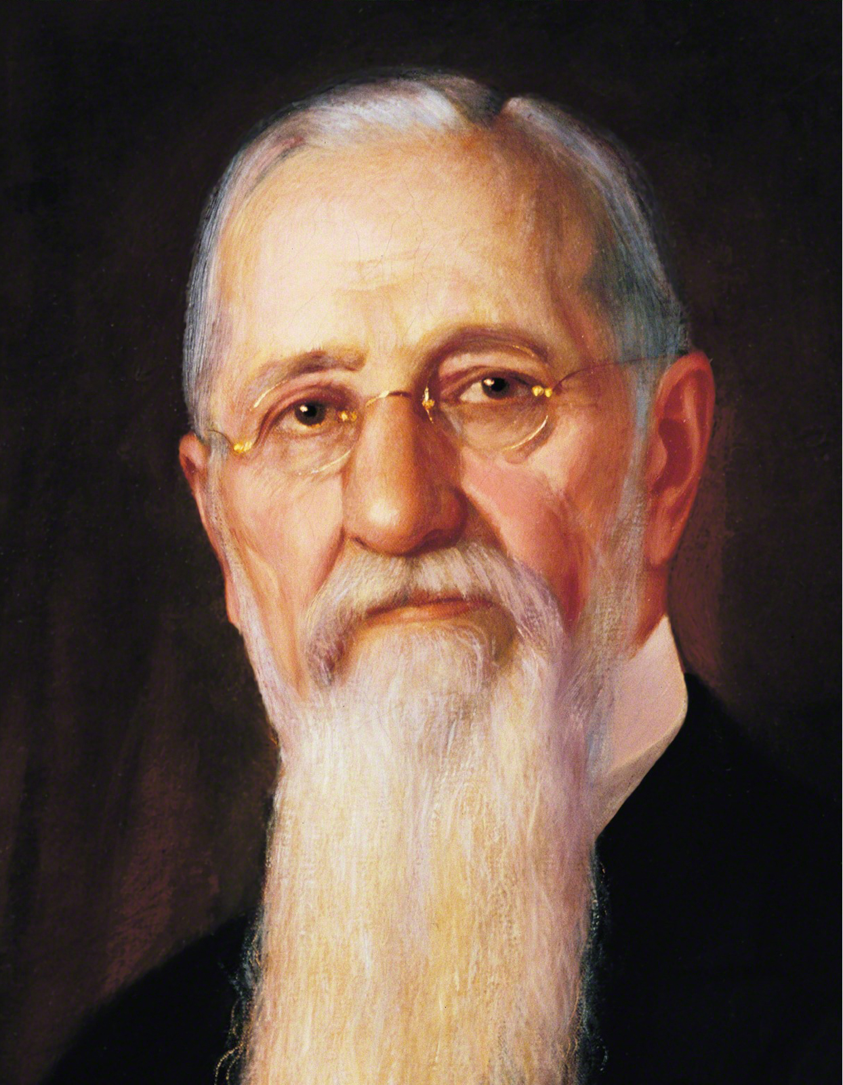
LESSON 155
Doctrine and Covenants 138:57
I beheld that the faithful elders of this dispensation, when they depart from mortal life, continue their labors in the preaching of the gospel of repentance and redemption, through the sacrifice of the Only Begotten Son of God, among those who are in darkness and under the bondage of sin in the great world of the spirits of the dead.
What will faithful elders continue to do after they die?
“These good sisters who have been set apart, ordained to the work, … will be fully authorized and empowered to preach the gospel and minister to the women while the elders and prophets are preaching it to the men” (Gospel Doctrine,5th ed. [1939],461).
President
Joseph S. Smith
After departing mortal life, faithful Saints will continue their labors in preaching the gospel.

Slide 15
LESSON 155
Doctrine and Covenants 138:58–59.
58 The dead who repent will be redeemed, through obedience to the ordinances of the house of God,
59 And after they have paid the penalty of their transgressions, and are washed clean, shall receive a reward according to their works, for they are heirs of salvation.
What will happen to those who repent in the spirit world?
Spirits who repent will be redeemed through obedience to the ordinances of the temple, be cleansed through the Atonement, and receive their reward.
How can we assist in the work of salvation for the dead while we are here on the earth?

Slide 16
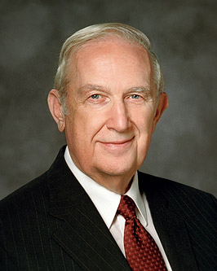
LESSON 155
Elder Richard G. Scott Said:
“Any work you do in the temple is time well spent, but receiving ordinances vicariously for one of your own ancestors will make the time in the temple more sacred, and even greater blessings will be received” (“The Joy of Redeeming the Dead,” Ensign or Liahona, Nov. 2012,93–94).

Slide 17
LESSON 155
How can this knowledge influence your experiences in doing temple and family history work?
How have you been blessed by participating in family history and temple work?
Doctrine and Covenants 138:60
Thus was the vision of the redemption of the dead revealed to me, and I bear record, and I know that this record is true, through the blessing of our Lord and Savior, Jesus Christ, even so. Amen.
Spirit Paradise
Spirit Prison

