Slide 1
LESSON 15
SEMINARY
Doctrine and Covenants
and Church History

Slide 2
LESSON 153
Official Declaration 1 and the Continued Development of Temple Work

Slide 3
LESSON 153
“The Lord reveals that Latter-day Saints should cease the practice of plural marriage”

Slide 4
LESSON 153
Daniel.
Abinadi.
Peter.
Joseph Smith.
The Savior.

Slide 5
LESSON 153
In August 1852, as part of a conference in Salt Lake City, Elder Orson Pratt publicly announced that in obedience to a commandment from God, some members of the Church were practicing plural marriage. Elder Pratt made this announcement under the direction of President Brigham Young. Many religious and political leaders in the United States opposed this marriage system, which they considered immoral and uncivilized. Latter-day Saints were ridiculed in public speeches, books, magazines, and newspapers. The United States Congress passed laws that limited Church members’ freedom and hurt the Church economically by restricting the amount of property the Church could own. These laws ultimately led to the arrest and imprisonment of men who had more than one wife. These men were denied “the right to vote, the right to privacy in their homes, and the enjoyment of other civil liberties” (Our Heritage: A Brief History of The Church of Jesus Christ of Latter-day Saints[1996], 97). By 1890, hundreds of faithful Latter-day Saints had served time in prison. Others went into hiding to avoid arrest and imprisonment. In these conditions, many families suffered from stress, grief, poverty, and hunger.
After the 1852 announcement, plural marriage became much more widespread, and thousands of men and women were sealed in plural marriages under the direction of priesthood leaders. Although the world ridiculed them for practicing plural marriage, many faithful Latter-day Saints defended the practice and testified that they knew it had been revealed by God through the Prophet Joseph Smith.

Slide 6
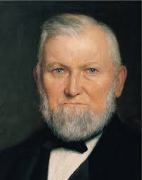
LESSON 153
How would you summarize the difficulties early Latter-day Saints faced because they obeyed the Lord’s direction to practice plural marriage?
Explain that these difficult circumstances led President Wilford Woodruff to prayerfully seek the Lord’s guidance concerning the Saints’ practice of plural marriage. In 1889, President Woodruff instructed Church leaders to discontinue teaching the principle of plural marriage. By 1890, very few plural marriages were performed, and these were done against the counsel of President Woodruff. However, some people published reports that the Church was still promoting the practice of plural marriage. These reports brought further
President
Wilford Woodruff
opposition against the Church. In September 1890, President Woodruff issued a Manifesto, which is now known as Official Declaration 1 in the Doctrine and Covenants.
What were the Saints instructed to do?
Refrain from contracting or forming any plural marriages.
Why is it important that the direction to refrain from contracting any more plural marriages came through the President of the Church?

Slide 7
LESSON 153
“Excerpts from Three Addresses by President Wilford Woodruff Regarding the Manifesto”
First paragraph.
The Lord will never permit me or any other man who stands as President of this Church to lead you astray. It is not in the programme. It is not in the mind of God. If I were to attempt that, the Lord would remove me out of my place, and so He will any other man who attempts to lead the children of men astray from the oracles of God and from their duty. (Sixty-first Semiannual General Conference of the Church, Monday, October 6, 1890, Salt Lake City, Utah. Reported in Deseret Evening News, October 11, 1890, p. 2.)
What did President Woodruff teach the Saints?
The Lord will never permit the President of the Church to lead the Church astray.
How can this principle help us today?

Slide 8
LESSON 153
“Excerpts from Three Addresses by President Wilford Woodruff Regarding the Manifesto”
Third paragraph.
I have had some revelations of late, and very important ones to me, and I will tell you what the Lord has said to me. Let me bring your minds to what is termed the manifesto. …
Fourth paragraph.
The Lord has told me to ask the Latter-day Saints a question, and He also told me that if they would listen to what I said to them and answer the question put to them, by the Spirit and power of God, they would all answer alike, and they would all believe alike with regard to this matter.

Slide 9
LESSON 153
“Excerpts from Three Addresses by President Wilford Woodruff Regarding the Manifesto”
Fifth paragraph.
The question is this: Which is the wisest course for the Latter-day Saints to pursue—to continue to attempt to practice plural marriage, with the laws of the nation against it and the opposition of sixty millions of people, and at the cost of the confiscation and loss of all the Temples, and the stopping of all the ordinances therein, both for the living and the dead, and the imprisonment of the First Presidency and Twelve and the heads of families in the Church, and the confiscation of personal property of the people (all of which of themselves would stop the practice); or, after doing and suffering what we have through our adherence to this principle to cease the practice and submit to the law, and through doing so leave the Prophets, Apostles and fathers at home, so that they can instruct the people and attend to the duties of the Church, and also leave the Temples in the hands of the Saints, so that they can attend to the ordinances of the Gospel, both for the living and the dead?

Slide 10
LESSON 153
How would you summarize the question President Woodruff was inspired to ask the Saints?
What important work would cease if the temples were confiscated?
What would President Woodruff have done?
What can we learn from President Woodruff’s statement, “I wrote what the Lord told me to write”?
The Lord directs His Church through revelation to the President of the Church.
How has this doctrine influenced you?

Slide 11
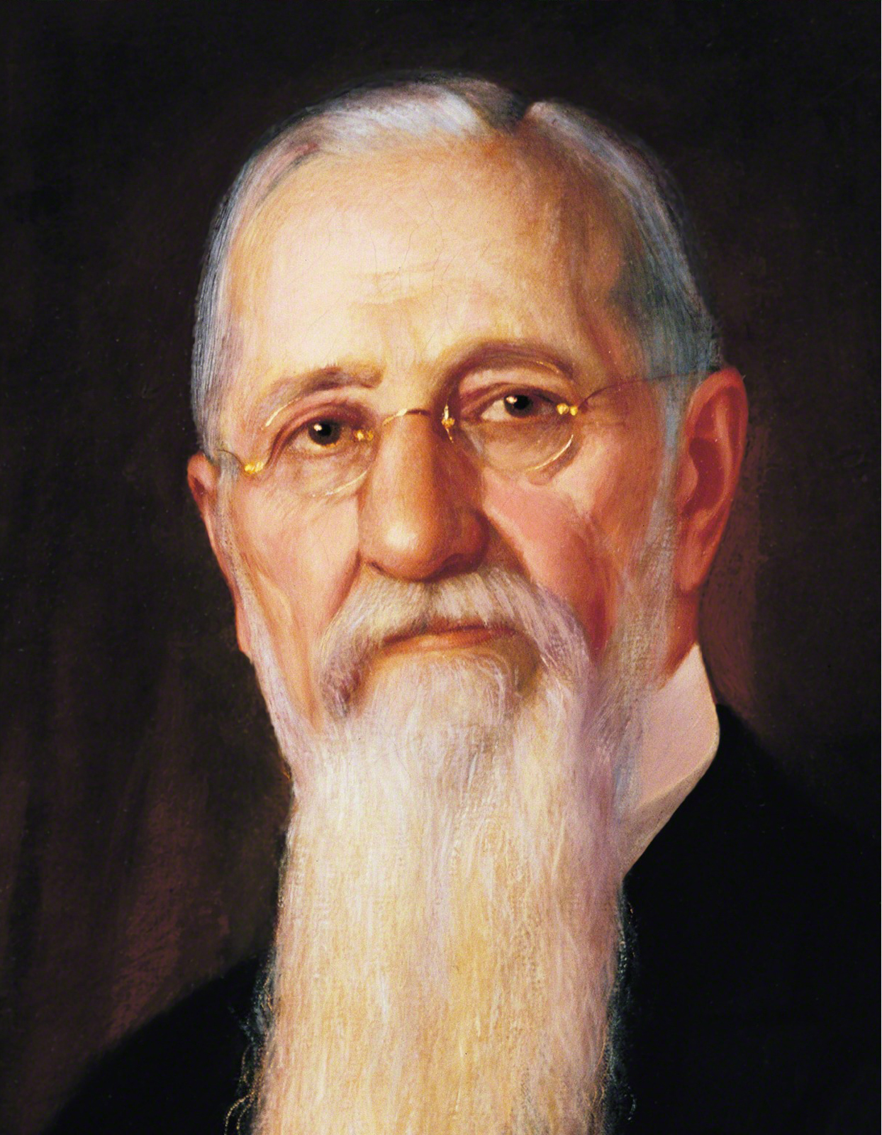
LESSON 153
Explain that a small number of Latter-day Saints continued to enter into new plural marriages after the Manifesto was given. In 1904, President Joseph F. Smith announced “that all [plural] marriages are prohibited, and if any officer or member of the Church shall assume to solemnize or enter into any such marriage he will be … excommunicated” (in Conference Report, Apr. 1904, 75). This policy continues today.
President
Joseph F. Smith
How would you respond if someone asked you if Latter-day Saints practice plural marriage?
Who can we be sealed to through the sealing ordinance?
We can be sealed to our family members, including those who came before us and those who come after us, through the sealing power.
How do you feel about knowing that you can be sealed to your family members?

