Slide 1
LESSON 15
SEMINARY
Doctrine and Covenants
and Church History

Slide 2
LESSON 151
“The Utah War and the Mountain
Meadows Massacre”

Slide 3
LESSON 151
Tension builds between Latter-day Saints and the United States government.

Slide 4
LESSON 151
If you had been a Latter-day Saint in 1857 and had heard that a large army was approaching your city, what concerns might you have had?
In sermons to the Saints, President Young and other Church leaders described the coming troops as enemies. President Young, who for years had asked the Saints to save grain, renewed his instructions so they would have food to eat if they needed to flee from the troops. As governor of the Utah Territory, he also directed the territory’s militia to prepare to defend the territory.

Slide 5
LESSON 151
Conflict arises between some Latter-day Saints and members of an emigrant wagon train.

Slide 6
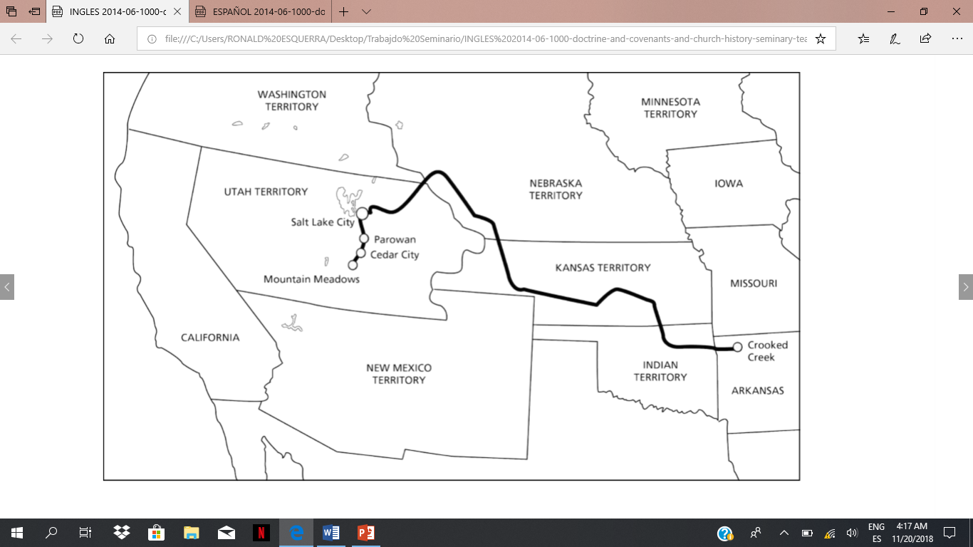
LESSON 151

Slide 7
LESSON 151
3Nephi 12:25
Agree with thine adversary quickly while thou art in the way with him, lest at any time he shall get thee, and thou shalt be cast into prison.
What do you think it means to “agree with thine adversary quickly”?
Elder David E. Sorensen of the Seventy taught that the phrase “agree with thine adversary quickly” means to “resolve our differences early on, lest the passions of the moment escalate into physical or emotional cruelty, and we fall captive to our anger” (“Forgiveness Will Change Bitterness to Love,” Ensignor Liahona, May 2003,11).
How would you summarize the Savior’s teaching in 3Nephi 12:25 in your own words?
If we resolve conflict with others in the Lord’s way, then we can avoid the harmful effects of contention.
How might obeying the principle in 3Nephi 12:25 have helped the Latter-day Saints who had become upset with members of the wagon train?

Slide 8
LESSON 151
What should the Cedar City leaders have done when William Dame counseled them not to use the militia?
What did rejecting counsel then lead them to do?
If we ignore counsel to do what is right, then we become more susceptible to making poor choices.
Doctrine and Covenants 121:36–37
36 That the rights of the priesthood are inseparably connected with the powers of heaven, and that the powers of heaven cannot be controlled nor handled only upon the principles of righteousness.
37 That they may be conferred upon us, it is true; but when we undertake to cover our sins, or to gratify our pride, our vain ambition, or to exercise control or dominion or compulsion upon the souls of the children of men, in any degree of unrighteousness, behold, the heavens withdraw themselves; the Spirit of the Lord is grieved; and when it is withdrawn, Amen to the priesthood or the authority of that man.
What warning does the Lord give to priesthood holders who seek to cover their sins or act unrighteously?

Slide 9
LESSON 151
What resulted from the decision to disobey the counsel of the militia commander?
What choices did those responsible for the attacks have?
What should they have done?
What do you do when you do something wrong?
Do you confess what you have done wrong and receive the consequences, or do you try to hide the sin through deception?

Slide 10
LESSON 151
“Some Latter-day Saints plan and carry out the Mountain Meadows Massacre”

Slide 11
LESSON 151
How would you summarize the choices that led to the Mountain Meadows Massacre?
What principles can we learn from this tragedy?
Choosing to hide our sins can lead us to commit further sins. Choosing to hide our sins can bring regret and suffering.
Why is it important to realize that the wrong actions of some Church members do not determine the truthfulness of the gospel?

Slide 12
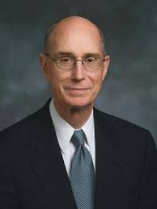
LESSON 151
“The gospel of Jesus Christ that we espouse, abhors the cold-blooded killing of men, women, and children. Indeed, it advocates peace and forgiveness. What was done [at the Mountain Meadows] long ago by members of our Church represents a terrible and inexcusable departure from Christian teaching and conduct” (“150th Anniversary of Mountain Meadows Massacre,” Sept. 11, 2007, mormonnewsroom.org/article/ 150th-anniversary-of-mountain-meadows-massacre)
President
Henry B. Eyring
Helaman 5:12.
And now, my sons, remember, remember that it is upon the rock of our Redeemer, who is Christ, the Son of God, that ye must build your foundation; that when the devil shall send forth his mighty winds, yea, his shafts in the whirlwind, yea, when all his hail and his mighty storm shall beat upon you, it shall have no power over you to drag you down to the gulf of misery and endless wo, because of the rock upon which ye are built, which is a sure foundation, a foundation whereon if men build they cannot fall.

Slide 13
LESSON 151
What can we do to develop and maintain our testimonies?
We can develop strong testimonies by building our faith on the foundation of Jesus Christ.
“James Sanders is the great-grandson of … one of the children who survived the massacre [and is also a member of the Church]. … Brother Sanders … said that learning his ancestor had been killed in the massacre ‘didn’t affect my faith because it’s based on Jesus Christ, not on any person in the Church’” (Richard E. Turley Jr., “The Mountain Meadows Massacre,”21).
How can our faith in Jesus Christ strengthen us when we learn of instances when Church members have failed to live according to the Savior’s teachings?
What do you do that helps you to build your faith on the foundation of Jesus Christ?

