Slide 1
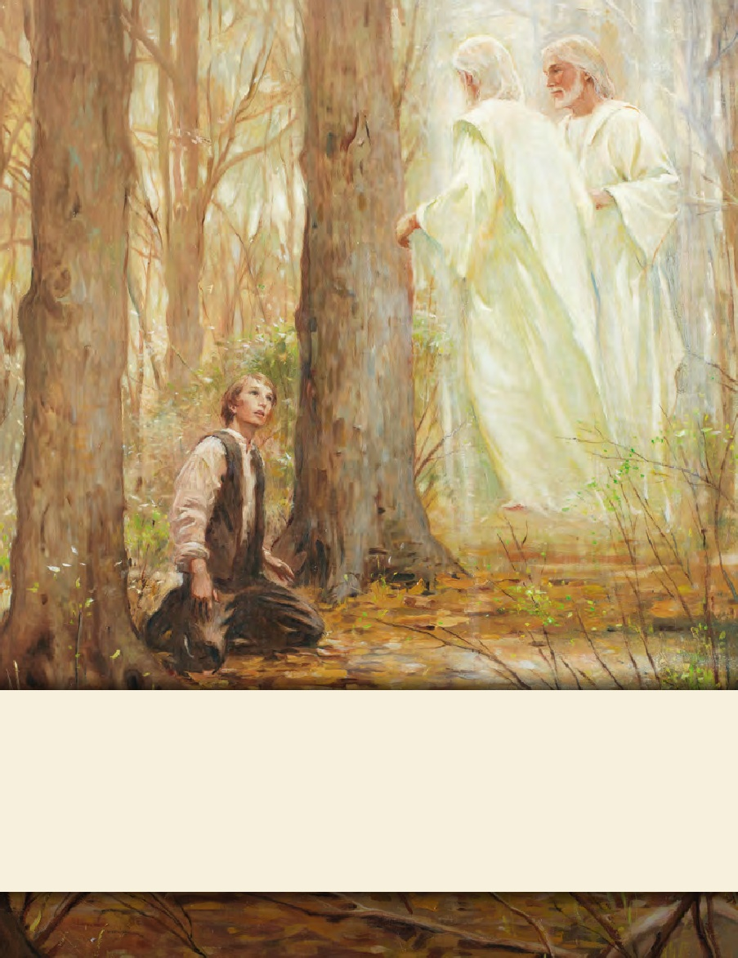
LESSON 15
SEMINARY
Doctrine and Covenants
and Church History

Slide 2
LESSON 150
Handcart Pioneers, 1856–1860.

Slide 3
LESSON 150
“Saints obey the counsel to gather
in the Salt Lake Valley”

Slide 4
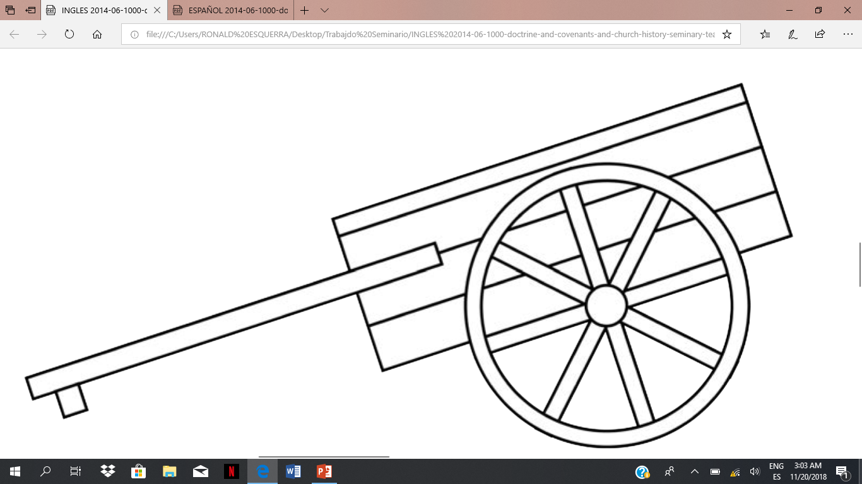
LESSON 150
What material possessions would you have chosen to bring? Why?
Why do you think the Saints were willing to sacrifice so much to get to Utah?

Slide 5
LESSON 150

Slide 6
LESSON 150
“About nine o’clock I retired. … I slept until, as it appeared to me, about midnight. I was extremely cold. The weather was bitter. I listened to hear if my husband breathed—he lay so still. I could not hear him. I became alarmed. I put my hand on his body, when to my horror I discovered that my worst fears were confirmed. My husband was dead.… I called for help to the other inmates of the tent. They could render me no aid. … When daylight came, some of the male part of the company prepared the body for burial. … They wrapped him in a blanket and placed him in a pile with thirteen others who had died, and then covered him up in the snow.… “I will not attempt to describe my feelings at finding myself thus left a widow with three children, under such excruciating circumstances. I cannot do it. But I believe the Recording Angel has inscribed in the archives above, and that my sufferings for the Gospel’s sake will be sanctified unto me for my good” (Leaves from the Life of Elizabeth Horrocks Jackson Kingsford[1908], 6–7; see alsohistory.lds.org).
What did Elizabeth say her suffering for the gospel’s sake would do for her?
What do you think the phrase “sanctified unto me for my good” means?
Her suffering would be made sacred and holy for her benefit.

Slide 7
LESSON 150
What can happen to us if we need to suffer patiently for the gospel’s sake?
If we suffer patiently for the gospel’s sake, it can sanctify us for good.
In what ways might you have to suffer for the gospel’s sake?
How might you be blessed through these experiences?
“It will be readily perceived that under such adverse circumstances I had become despondent. I was six or seven thousand miles from my native land, in a wild, rocky, mountain country, in a destitute condition, the ground covered with snow, the waters covered with ice, and I with three fatherless children with scarcely nothing to protect them from the merciless storms. When I retired to bed that night, being the 27th of Oct., I had a stunning revelation. In my dream, my husband stood by me and said—‘Cheer up, Elizabeth, deliverance is at hand’” (Leaves from the Life of Elizabeth Horrocks Jackson Kingsford,8; see alsohistory.lds.org).

Slide 8
LESSON 150
“Many of our brethren and sisters are on the plains with hand-carts, and probably many are now 700 miles [about 1,100 kilometers] from this place, and they must be brought here, we must send assistance to them.…
“That is my religion; that is the dictation of the Holy Ghost that I possess, it is to save the people. … This is the salvation I am now seeking for, to save our brethren that would be apt to perish, or suffer extremely, if we do not send them assistance.
President
Brigham Young
“I shall call upon the Bishops this day, I shall not wait until to-morrow, nor until [the] next day, for 60 good mule teams and 12 or 15 wagons … [as well as] 12 tons of flour and 40 good teamsters, besides those that drive the teams.…
“I will tell you all that your faith, religion, and profession of religion, will never save one soul of you in the celestial kingdom of our God, unless you carry out just such principles as I am now teaching you. Go and bring in those people now on the plains” (“Remarks,” Deseret News, Oct. 15, 1856,252).
What did President Brigham Young teach the Saints?
As disciples of Jesus Christ, we are to help those in need.

Slide 9
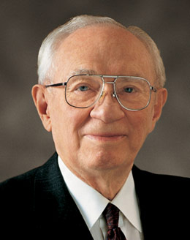
LESSON 150
How might this rescue effort have been a sacrifice for the Saints in the Salt Lake Valley?
What are some sacrifices we can make to help those with physical needs?
What are some sacrifices we can make to help those with spiritual needs?
“I am grateful that today none of our people are stranded on the Wyoming highlands. But I know that all about us there are many who are in need of help and who are deserving of rescue. Our mission in life, as followers of the Lord Jesus Christ, must be a mission of saving. There are the homeless, the hungry, the destitute. Their condition is obvious. We have done much. We can do more to help those who live on the edge of survival.
“We can reach out to strengthen those who wallow in the mire of pornography, gross immorality, and drugs. Many have become so addicted that they have lost power to control their own destinies. They are miserable and broken. They can be salvaged and
President
Gordon B. Hinckley
saved.…
“It is not with those on the high plains of Wyoming that we need be concerned today. It is with many immediately around us, in our families, in our wards and stakes, in our neighborhoods and communities” (“Our Mission of Saving,” Ensign, Nov. 1991,59).
When have you seen someone help those in spiritual or physical need? How did they help?

Slide 10
LESSON 150
In 1856, Francis and Betsy Webster had enough money to travel to Utah in a wagon, but they donated their money to a fund created to help the Saints emigrate to Utah (the Perpetual Emigrating Fund). Their donation allowed an additional nine individuals to travel by handcart. Francis and Betsy, who were expecting a baby, traveled to Salt Lake City with the Martin handcart company and suffered along with the rest of the company. Years later, as Brother Webster sat in a Sunday School class, he listened to some Church members criticize Church leaders for the handcart tragedy. Unable to constrain himself, he arose and testified of the blessings of being in the Martin handcart company.
He Said:
“I ask you to stop this criticism for you are discussing a matter you know nothing about. Cold historical facts mean nothing here for they give no proper interpretation of the questions involved. Mistake to send the handcart company out so late in the season? Yes. But I was in that company and my wife was in it. … We suffered beyond anything you can imagine and many died of exposure and starvation. But did you ever hear a survivor of that company utter a word of criticism?…
“I have looked back many times to see who was pushing my cart but my eyes saw no one. I knew then that the Angels of God were there.
“Was I sorry that I chose to come by handcart? No. Neither then nor one moment of my life since. The price we paid to become acquainted with God was a privilege to pay and I am thankful that I was privileged to come to Zion in the Martin Handcart Company” (in William R. Palmer, “Pioneers of Southern Utah,” The Instructor,vol.79, no.5 [May 1944], 217–18).

Slide 11
LESSON 150
What principle can we learn from Francis Webster’s testimony?
If we endure suffering faithfully, we can become acquainted with God.
What types of attitudes or behaviors have you seen in those who have endured suffering faithfully?
In what ways have you become acquainted with God through the trials you have faced?

