Slide 1
Knight, Vinson
14 Mar. 1804–31 July 1842. Farmer, druggist, school warden. Born at Norwich, Hampshire Co., Massachusetts. Son of Rudolphus Knight and Rispah (Rizpah) Lee. Married Martha McBride, July 1826. Moved to Perrysburg, Cattaraugus Co., New York, by 1830. Owned farm at Perrysburg when baptized into Church of Jesus Christ of Latter–day Saints, spring 1834. Moved to Kirtland, Geauga Co., Ohio, by 24 June 1835. Ordained an elder, 2 Jan. 1836. Ordained a high priest and appointed counselor to Bishop Newel K. Whitney, 13 Jan. 1836, at Kirtland. Member of Nauvoo City Council, 1841–1842. Served as warden of Nauvoo common schools, 1841–1842. Appointed guard in Nauvoo Legion, Mar. 1841. Member of Nauvoo Masonic Lodge. Died at Nauvoo.
Knight, Vinson

Slide 2
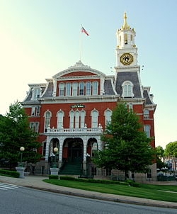
U.S. Historic district Contributing property

