Slide 1
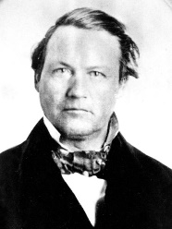
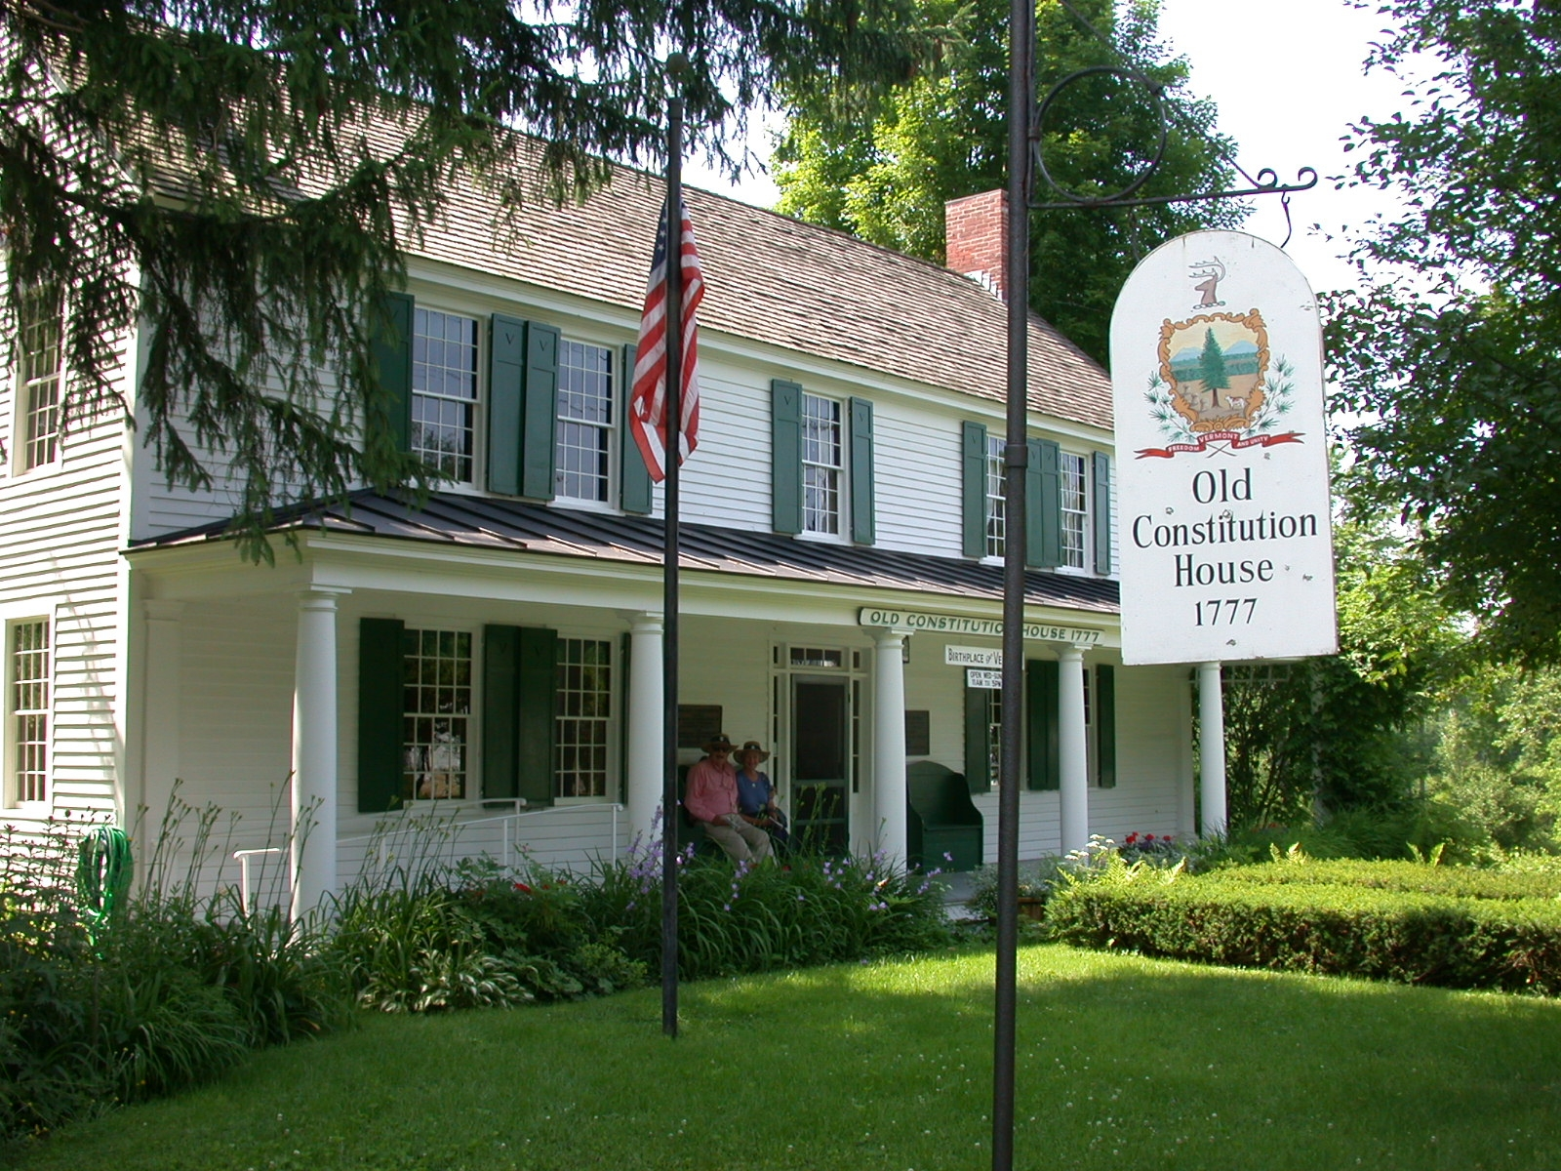
Johnson, Lyman E.
Born: October 24, 1811, Pomfret, Windsor County, Vermont. Baptized: February, 1831. Ordained an Elder: October 25, 1831. Ordained a High Priest: November 1, 1831. Ordained an Apostle: February 14, 1835. Died: December 20, 1856, Prairie du Chien, Wisconsin. Parents: John Johnson and Elsa Jacobs. Brother to Luke S. Johnson. Married: Sarah Long, September 4, 1834-two children.
Old constitution house

Slide 2
1831: In November, Lyman Johnson, along with Orson Hyde, his brother Luke Johnson, and William E. McLellin, was called by revelation (D&C 68:7) to the ministry. He was assigned to go to Ohio, the eastern states and Nova Scotia.
1832: Two months later, on January 25, the Lord again instructed Lyman and Orson Pratt to go to the eastern countries (D&C 75:14)
1834: He traveled to Missouri a member of Zion´s camp.
1835: On February 14 the quorum of the Twelve Apostles was organized. Lyman E. Johnson was the first apostle selected to serve. He was 23 years old.

Slide 3
1837: He claimed to have lost $6000 in the Kirtland paper. In May, he charged the Prophet with slander and lying , and on September 3, 1837, he was disfellowshipped.
1838: On April 13, he was excommunicated at Far West, Missouri. This was a time of great turmoil within the Church, and during the months of April and May several of the leading brethren in the Church were excommunicated. He remained of friendly terms with the Church and his forms colleagues and often visited Nauvoo after the Church had moved there.
1856: On December 20, he drowned in the Mississippi River at Prairie du Chien, Wisconsin. He was 45 years old.

