Slide 1
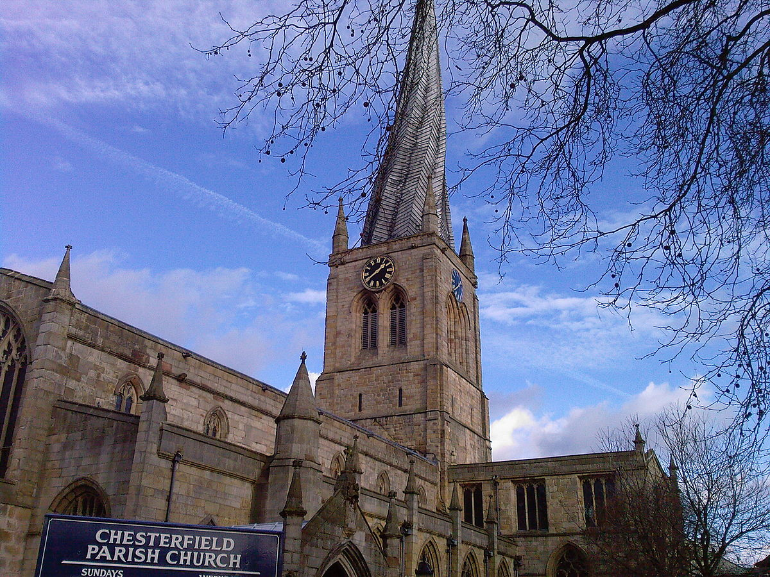
Johnson, John
Born: April 11, 1778, Chesterfield, Cheshire, New Hampshire. Baptized: Spring 1831. Ordained an Elder: February 17, 1833. Ordained a High Priest: June 4, 1833. Withdrew from Church: 1838. Died: July 30, 1843, Kirtland, Lake, Ohio. Parents: Israel Johnson and Abial (Abigail) Higgins. Married: Mary Elsa Jacobs, June 22, 1800-seven children. Father of Luke S. and Lyman E. Johnson (plus 5 more children). Vocation: Farmer.
The Parish Church of St Mary and All Saints, Chesterfield.

Slide 2
1831: November 1-12, four special conferences were held during this time as the Prophet and other leaders prepared for the printing of the revelations-the Doctrine and Covenants. On November 3, the Lord had given what was called the Appendix to the Book of Commandments and is now Section 133 in the Doctrine and Covenants. The fourth of the special conferences was held in the home of John Johnson.
1831-1832: In September, John Johnson invited the Prophet and his family to live with them. Several months earlier, the Prophet had healed Elsa’s arthritic arm. Joseph received fifteen of the revelations contained in the Doctrine and Covenants while living there in Haram. He also prepared the text of his translation of the Bible while living there.

Slide 3
1833: On June 4, the Lord instructed Joseph Smith at Kirtland to admit Brother John Johnson in the United Order. Johnson was to diligently seek to take away incumbrancers that were upon the house “named among you, that he may dwell therein” (D&C 96:6-9).
1834: On February 17, John Johnson was chosen to be a member of the first high council organized in this dispensation (D&C 102:24). The organization occurred in Kirtland at the home of Joseph Smith. On April 23, John Johnson's inheritance was defined by the Lord (D&C 104:24, 34). During his time in Kirtland, Brother Johnson worked on the Kirtland Temple.

Slide 4
1837: He became a charter member and stockholder in the Kirtland Safety Society. That same year, September 4, 1837, he was rejected as a high councilor.
1838: He withdrew from the Church.
1843: He died July 30 in Kirtland, Lake County, Ohio.

