Slide 1
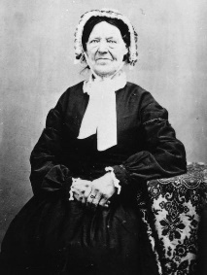
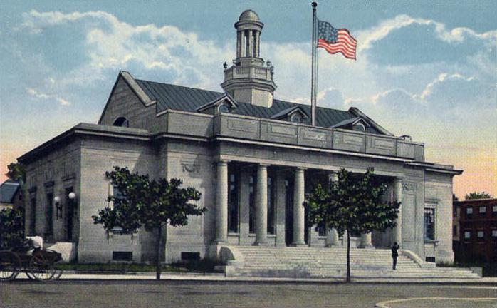
Jaques, Vienna
Born: June 10, 1787, Beverly, Essex County, Missouri. Baptized: July, 1832. Died: February 7, 1884, Salk Lake City, Salt Lake County, Utah. Parents: Henry Jaques and Lucinda. Married: Daniel Shearer. Sealed to Joseph Smith Jr. March 28,1858.
Post Office in 1919

Slide 2
1833: In March 8, Joseph Smith was directed to give Vienna money to cover her expenses so she could move to Zion (D&C 90:28). Apparently, she was driven from Jackson County, Missouri, with the other Saints.
Records indicate that she was directed to consecrate her property to the Church and receive an inheritance in Zion. When she arrived in Kirtland in 1833, she had $1400. She the worked for Joseph Smith. Although she married Daniel Shearer, she was sealed to the Prophet several years after his death.

