Slide 1
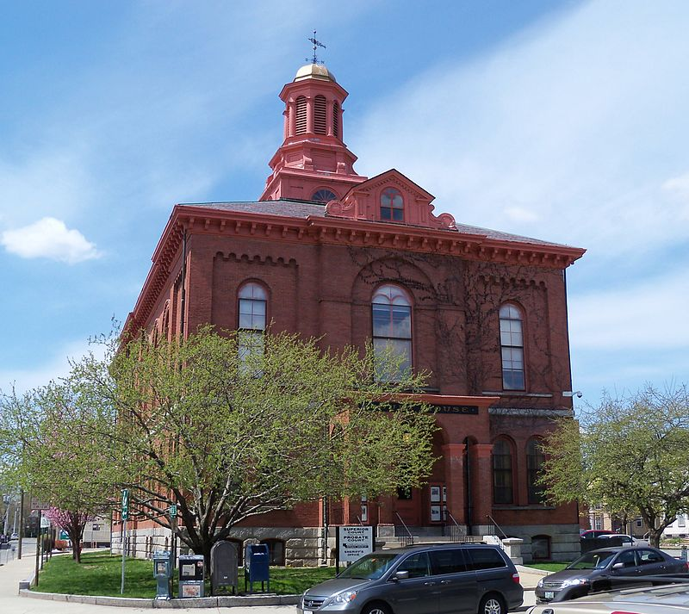
Huntington, Willian Sr.
Born: March 28, 1784, Grantham, Cheshire Country, New Hampshire.
Baptized: 1835.
Died: August 19, 1846, Mt. Pisgah, Harrison, Iowa.
Parents: Willian Huntington and Prescinda Lathrop.
Married: (1) Zina Baker, December 28, 1806-no children listed. Married: (2) Lydia Clisbee Partridge (widow of Edward Patridge), August 28, 1840-nochildren listed, Married: (3) Dorcas Baker (no date given)-no children listed.
Born: March 28, 1784, Grantham, Cheshire Country, New Hampshire.
Baptized: 1835.
Died: August 19, 1846, Mt. Pisgah, Harrison, Iowa.
Parents: Willian Huntington and Prescinda Lathrop.
Married: (1) Zina Baker, December 28, 1806-no children listed. Married: (2) Lydia Clisbee Partridge (widow of Edward Patridge), August 28, 1840-nochildren listed, Married: (3) Dorcas Baker (no date given)-no children listed.
County, New Hampshire

Slide 2
1806-1812: After his marriage in 1806, Willian Huntington prospered until 1811, at which time he sold out. War with England was declared the next year and he was reduced to poor circumstances.
1816: William Huntington seemed to hunger after religion. In 1816, following his military service his fortune again improved. This was the same time he began of seek guidance from the Lord about religion and the doctrines taught in the Bible. He was given to know that intoxicating drinks were not good for man. He gave them up and, at this time, joined the Presbyterian Church. He was then given to know that tobacco was not good for man, and he gave that up. Upon further inquiry of the Lord, William received the answer that none of the Churches was true but that the true Church would be forthcoming, that he would live to see it, and that it would have the same gifs and graces as did the original Church established by Christ when he was here upon the earth.

Slide 3
1832-1833: During the winter of 1832-1833, he learned about the Book of Mormon, studied it, and believed it. He preached its doctrine from them on.
1835: He, his wife and two of their children were finally baptized in 1835.
1836: On May 18, he sent two oh his children and their families to Kirtland. On October 1, having completed his own personal business, he also moved to Kirtland. He had been ordained an elder prior to the move.
1839: On January 26, under the leadership of Brigham Young- all three members of the First Presidency were in prison-a committee was selected to draft plans for the removal of the Saints from Missouri.
1840: On August 28, William married Lydia Partridge, the widow of Bishop Edward Partridge.

Slide 4
1841: On January 19, the Lord gave instructions to Joseph Smith regarding the organization of the General, stake and local officers of the Church. William Huntington was called to be on the stake high council (D&C 124:132). On April 6, he helped lay the corner stones of the Nauvoo Temple. He worked on the temple in various capacities until its completion. He administered in the temple as soon as it was completed.
1844: In his journal notes, William Huntington indicated that he helped bury the bodies of Joseph and Hyrum after their martyrdom.
1846: As the leaders of the Church looked to moving the Saints to the Rocky Mountains, it was the intent of President Brigham Young to sent a company of single men ahead to build homes and plant crop for the Saints who would follow. However, the Saints didn`t want to be left behind so plans were made for moving the company pioneers.

