Slide 1
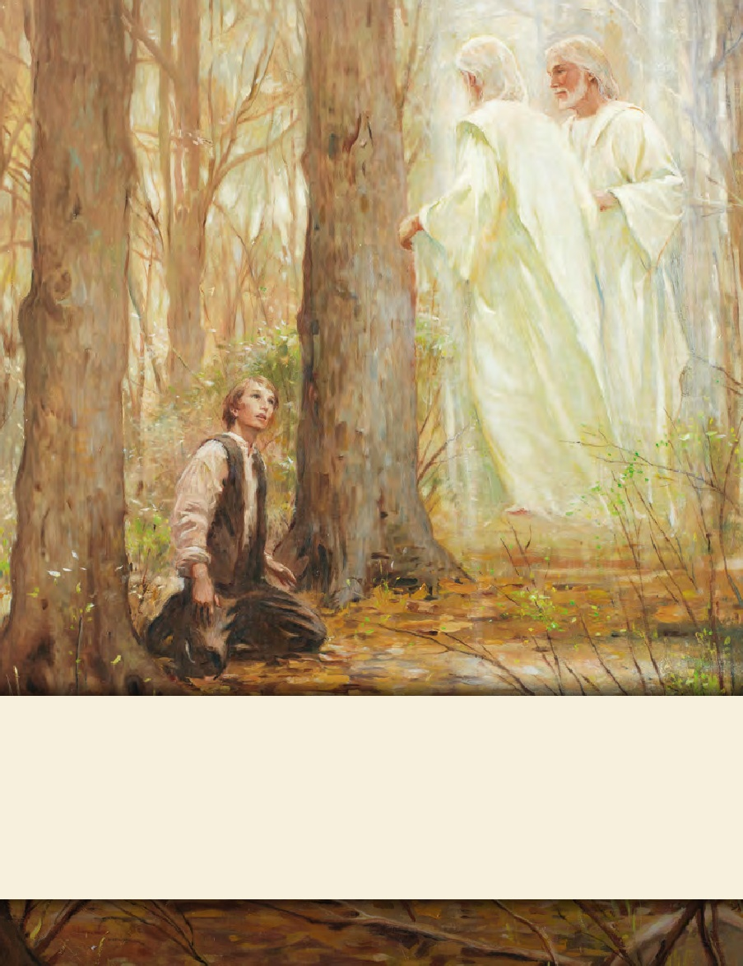
LESSON 15
SEMINARY
Doctrine and Covenants
and Church History

Slide 2
LESSON 148
The Trek across Iowa;
Doctrine and Covenants 136:1–18

Slide 3
LESSON 148
“Latter-day Saints cross Iowa and establish headquarters at Winter Quarter”

Slide 4
LESSON 148
Why did you choose that person?
How does our trust in another person influence how closely we follow their directions?
Under threats of violence from local mobs, the Saints began leaving Nauvoo in February 1846, journeying west across the state of Iowa. “Leaving Nauvoo was an act of faith for the Saints. They departed without knowing exactly where they were going or when they would arrive at a place to settle. They only knew that they were on the verge of being driven out of Illinois by their enemies and that their leaders had received revelation to locate a refuge somewhere in the Rocky Mountains” (Church History in the Fulness of Times Student Manual,2nd ed. [Church Educational System manual, 2003], 309).
How was the Saints’ experience of leaving Nauvoo similar to the experience of the student who was led across the classroom?
Both relied on the vision and direction of someone they trusted to help them reach their destinations.

Slide 5
LESSON 148
What can we learn from the Saints’ experience of leaving Nauvoo?
We exercise faith when we follow the counsel and direction of our Church leaders.
“William Clayton was called to be in one of the first groups to leave Nauvoo and left his wife, Diantha, with her parents, only a month away from delivering her first child. Slogging through muddy roads and camping in cold tents wore his nerves thin as he worried about Diantha’s well-being. Two months later, he still did not know if she had delivered [her baby] safely but finally received the joyful word that a ‘fine fat boy’ had been born. Almost as soon as he heard the news, William sat down and wrote a song that not only had special meaning to him but would become an anthem of inspiration and gratitude to Church members for generations. The song was ‘Come, Come, Ye Saints’” (Our Heritage: A Brief History of the Church of Jesus Christ of Latter-day Saints[1996],71).

Slide 6
LESSON 148
“Come, Come Ye Saints”
1. Come, come, ye Saints, no toil nor labor fear;
But with joy wend your way.
Though hard to you this journey may appear,
Grace shall be as your day.
'Tis better far for us to strive
Our useless cares from us to drive;
Do this, and joy your hearts will swell--
All is well! All is well!
2. Why should we mourn or think our lot is hard?
'Tis not so; all is right.
Why should we think to earn a great reward
If we now shun the fight?
Gird up your loins; fresh courage take.
Our God will never us forsake;
And soon we'll have this tale to tell--
All is well! All is well!
3. We'll find the place which God for us prepared,
Far away in the West,
Where none shall come to hurt or make afraid;
There the Saints will be blessed.
We'll make the air with music ring,
Shout praises to our God and King;
Above the rest these words we'll tell--
All is well! All is well!

Slide 7
LESSON 148
How does this hymn illustrate the Saints’ faith in Jesus Christ and trust in their leaders?
“After leaving Nauvoo, [Catherine], ever delicate and frail, sank rapidly under the ever accumulating hardships. The sorrowing husband wrote imploringly to the wife’s parents, asking them to receive her into their home until the Saints should find an abiding place. The answer came, ‘Let her renounce her degrading faith and she can come back, but never until she does.’
“When the letter was read to her, she asked her husband to get his Bible and to turn to the book of Ruth and read the first chapter, sixteenth and seventeenth verses: ‘Entreat me not to leave thee or to return from following after thee; for whither thou goest I will go, and where thou lodgest I will lodge. Thy people shall be my people and thy God my God’” (Memoirs of John R. Young: Utah Pioneer 1847[1920], 17–18). Catherine Spencer died shortly thereafter.

Slide 8
LESSON 148
4. And should we die before our journey's through,
Happy day! All is well!
We then are free from toil and sorrow, too;
With the just we shall dwell!
But if our lives are spared again
To see the Saints their rest obtain,
Oh, how we'll make this chorus swell--
All is well! All is well!
How do the words of this verse relate to Catherine Spencer?

Slide 9
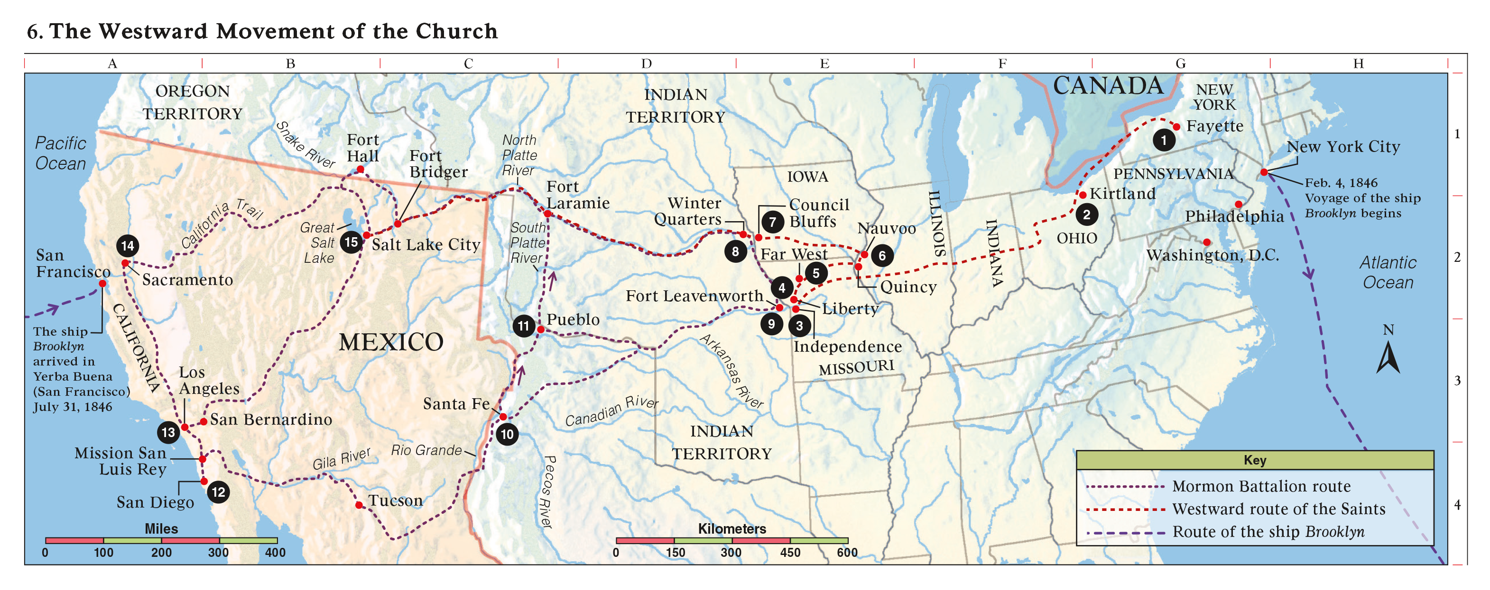
LESSON 148

Slide 10
LESSON 148
Many of the Saints lived in log houses and in dugouts made of willows and dirt. Many people were inadequately sheltered from the cold weather. Diseases such as malaria, pneumonia, tuberculosis, cholera, and scurvy resulted in widespread suffering and death. More than seven hundred people died in the camps by the end of the first winter. (See Our Heritage, 71–72; Church History in the Fulness of Times Student Manual, 319–20.)
What feelings might you have had, realizing that you would still have to travel hundreds of miles?

Slide 11
LESSON 148
Doctrine and Covenants 136:1-18.
“The Lord counsels the Saints to organize themselves and prepare to continue their journey west”

Slide 12
LESSON 148
Introduction to Doctrine and Covenants136
The word and will of the Lord, given through President Brigham Young at Winter Quarters, the camp of Israel, Omaha Nation, on the west bank of the Missouri River, near Council Bluffs, Iowa.
Doctrine and Covenants136:1.
The Word and Will of the Lord concerning the Camp of Israel in their journeyings to the West:
How do you think it might have helped the Saints to know that the Lord continued to reveal His will to them?

Slide 13
LESSON 148
Doctrine and Covenants 136:2-5.
2 Let all the people of The Church of Jesus Christ of Latter-day Saints, and those who journey with them, be organized into companies, with a covenant and promise to keep all the commandments and statutes of the Lord our God.
3 Let the companies be organized with captains of hundreds, captains of fifties, and captains of tens, with a president and his two counselors at their head, under the direction of the Twelve Apostles.
4 And this shall be our covenant—that we will walk in all the ordinances of the Lord.
5 Let each company provide themselves with all the teams, wagons, provisions, clothing, and other necessaries for the journey, that they can.
How were the companies to be organized?
Why do you think it would have been helpful to organize the Saints into groups with designated leaders?
How is this similar to the way the Church is organized today?
The Lord organizes His Saints into groups so that each person can be guided and cared for.
What does verse 4 suggest about how the Saints would receive strength?

Slide 14
LESSON 148
Doctrine and Covenants 136:6-11.
6 When the companies are organized let them go to with their might, to prepare for those who are to tarry.
7 Let each company, with their captains and presidents, decide how many can go next spring; then choose out a sufficient number of able-bodied and expert men, to take teams, seeds, and farming utensils, to go as pioneers to prepare for putting in spring crops.
8 Let each company bear an equal proportion, according to the dividend of their property, in taking the poor, the widows, the fatherless, and the families of those who have gone into the army, that the cries of the widow and the fatherless come not up into the ears of the Lord against this people.
9 Let each company prepare houses, and fields for raising grain, for those who are to remain behind this season; and this is the will of the Lord concerning his people.
10 Let every man use all his influence and property to remove this people to the place where the Lord shall locate a stake of Zion.
11 And if ye do this with a pure heart, in all faithfulness, ye shall be blessed; you shall be blessed in your flocks, and in your herds, and in your fields, and in your houses, and in your families.

Slide 15
LESSON 148
What words and phrases in verses 6–11 indicate how the Saints were to care for those in need?
What word in verse 7 refers to people who prepare the way for others?
Pioneers.
“One who goes before to prepare or open up the way for others to follow.”
Pioneers.
What did the Lord promise to those who would help others in need and prepare the way for them?
What can we learn from this?
The Lord will bless us when we help others in need and prepare the way for them.
Who has prepared the way for you to enjoy the blessings of the gospel?
What will you do to be a pioneer to help others in need and prepare the way for them to enjoy the blessings of the gospel?

